Slide 1
Float to Live

Slide 2
This is a true story
It happened last year 31st July 2020
https://www.bbc.co.uk/news/uk-england-york-north-yorkshire-53687115

Slide 6
WALT use features to write a newspaper report
WILF:
Headline – short, snappy, alliteration
Lead sentence to give the where, who and why
Paragraphs for body of story
Photograph with captions
Direct quotations

Slide 7
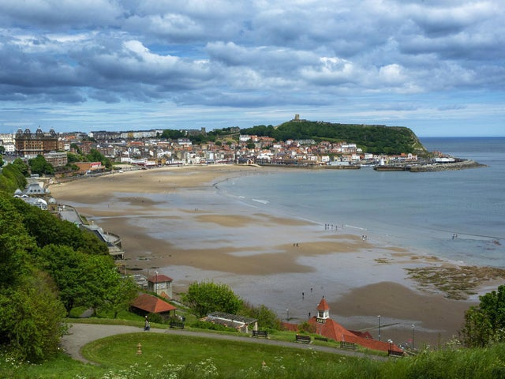
Scarborough RNLI reveal missing boy, 10, had been swept out to sea
Scarborough's RNLI lifeboat crew have revealed that a 10-year-old boy
who went missing on Friday was in the sea for nearly an hour. The boy
was reported missing just after 7pm on Friday,
when Scarborough's beaches were packed with
crowds enjoying the hot weather.
The RNLI have praised the boy's courage and
presence of mind after he survived being blown
across the entire length of the South Bay. He adopted the position
recommended by the RNLI for anyone who finds themselves in trouble
in the water - floating on the back with arms and legs spread out –
because he had watched a TV programme about sea rescues.
Monday 3rd August 2020

Slide 8
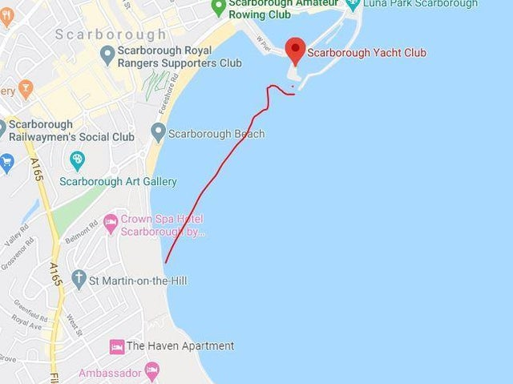
The red line shows the approximate distance across South Bay the boy was blown when he was swept out to sea
He was finally found shouting for help near Vincent Pier, having been swept out to sea by the wind and tide. The RNLI launched their lifeboat to assist police and Humber Coastguard with the search.
Scarborough lifeboat captain, Lee Marton said: "We were told that he’d been watching lifeboat rescues on the BBC documentary ‘Saving Lives at Sea’ and had followed the advice given on the show. We’re very much in awe of this incredible lad, who managed to remain calm and follow safety advice in terrifying and stressful circumstances. Had he not, the outcome might have been very different.“
The RNLI advises anyone struggling in the water to float in a starfish position while awaiting rescue, as people often end up in more difficulty when trying to swim against the current.

