Slide 1
Walt: understand and remember the Water SAFE CODE
WILF
understand why we use mnemonics (‘nuh·mo·nuhk’)
explain what each letter stands for
find a way to remember the safe code
describe some dangers near outdoor water
describe what to do in some situations
https://youtu.be/zwzB7So7jSM

Slide 2
Walt: understand and remember the Water SAFE CODE
WILF
understand why we use mnemonics (‘nuh·mo·nuhk’)
explain what each letter stands for
find a way to remember the safe code
describe some dangers near outdoor water
describe what to do in some situations
https://youtu.be/zwzB7So7jSM

Slide 3
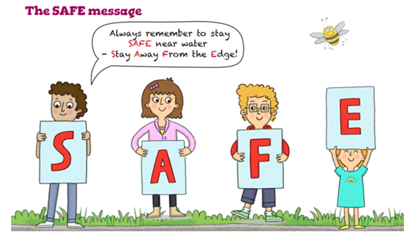
S

Slide 4
S
Stop and think!

Slide 5
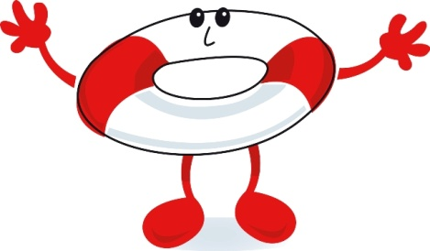
S is for SPOT
Notes:
Tell children S is for SPOT – it means spot the dangers
Ask children what dangers there might be.
Answers could be:
deep water, currents, rocks, cold water, slippery banks, water sports nearby, hidden objects under the water
Split the children into groups and get a child/pair to act out a danger or hazard, getting the rest of the group to guess

Slide 6
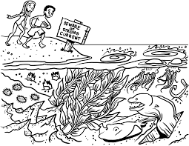
Look Before You Leap

Slide 7
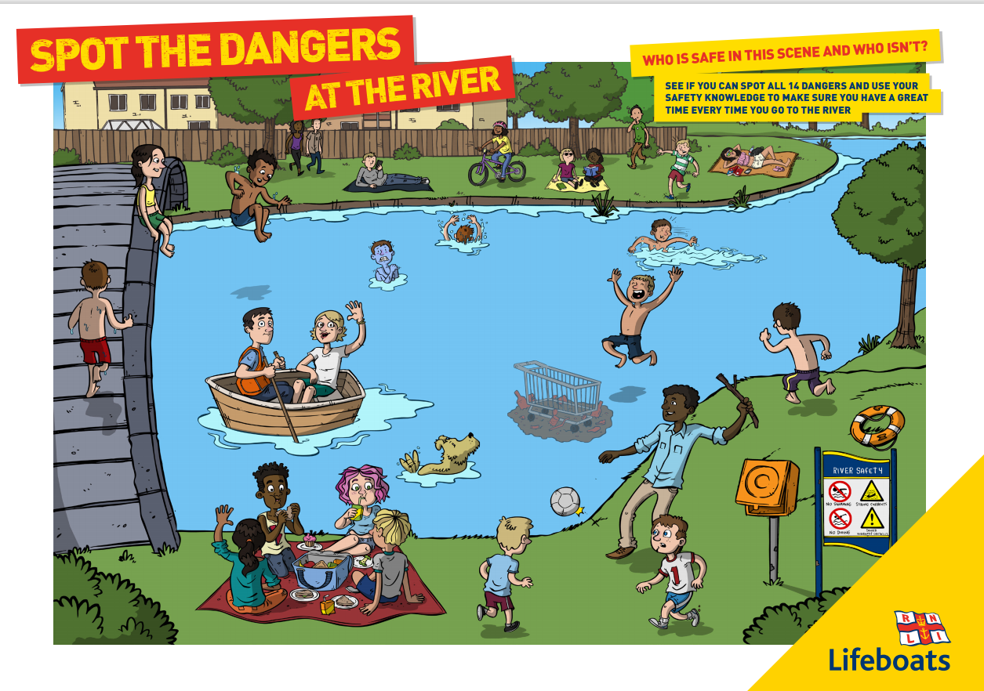

Slide 8
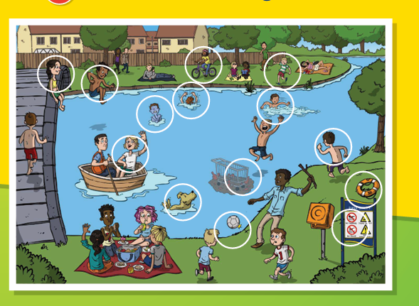

Slide 9
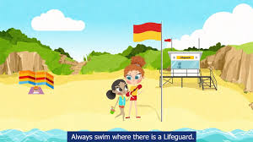
A
Always stay with an Adult!
Listen and follow Advice!

Slide 10
A is for ADVICE
Notes:
Tell children A is for ADVICE – There are lots of things that help to keep you safe near the water

Slide 11
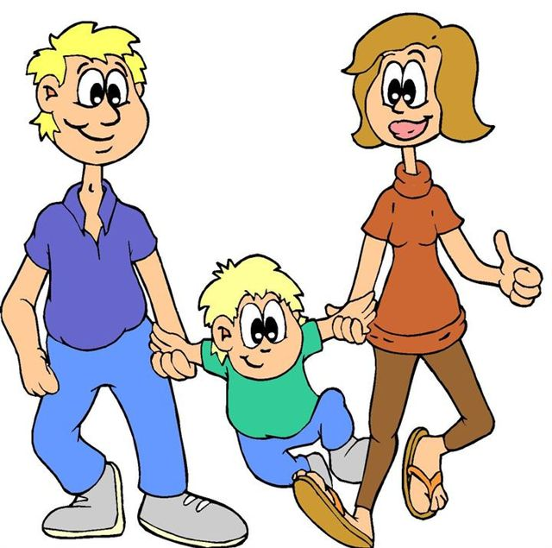
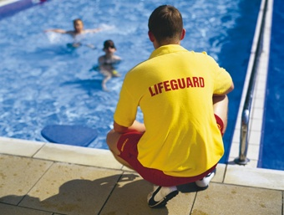
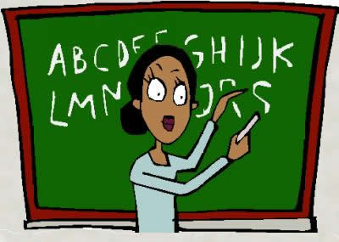
Adults who help
Notes:
Ask the children what people look after them when they are near water – lifeguards, parents teachers etc
Tell children to ask these people for advice about going near the water. Never swim without permission

Slide 12
Advice: Beach flags
Red and Yellow Flags –Lifeguards patrol here, safest place to swim
Black and White Chequered Flags - Between these flags is for non-swimming water sports such as surfing and wind surfing
Red Flags - Danger, stay out of the water
Windsock or Orange Flag - This shows the direction and force of the wind, special care should be taken during an offshore wind
Notes:
Tell children flags give you advice at the Beach
Show the flags and say what they mean
Activity option - Play the flags game:
Using the accompanying documents, make the flags
Place a flag in each corner of the room
The children all stand in the middle
The tutor describes a situation/weather condition etc
The children have to decide which flag they think they would see and go and stand by that flag

Slide 13
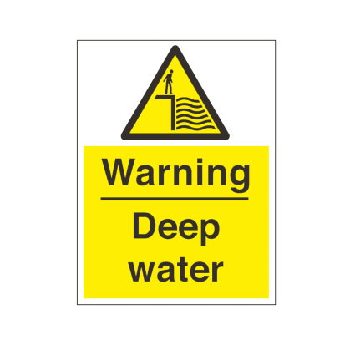
Advice: Warning Signs
Notes:
Use accompanying document to ask children what the various water signs might mean

Slide 14
Advice: Warning Signs
Notes:
Use accompanying document to ask children what the various water signs might mean

Slide 15
F
Float
RNLI Respect the Water 2017 Video News Feature | RNLI
Float to Live
https://www.youtube.com/watch?v=fgASxPh-xqU&list=RDCMUCtJyE1cNPjz35piKXXXKDEA&index=5
https://www.youtube.com/watch?v=odWm3DeRFlA

Slide 16
E
Emergency
https://www.youtube.com/watch?v=HpgF3BA5YIo
https://www.youtube.com/watch?v=kX2pwVxgtIQ
https://www.youtube.com/watch?v=HpgF3BA5YIo

Slide 17
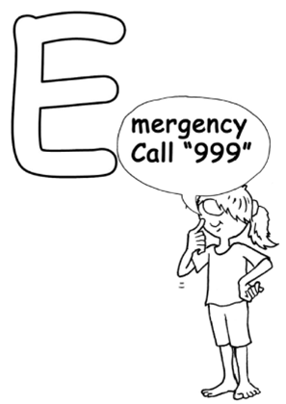
E is for EMERGENCY
Notes:
Tell children E is for Emergency – what to do if someone is in trouble

Slide 18
S
Stop and think

Slide 19
S
Stop and think

Slide 20
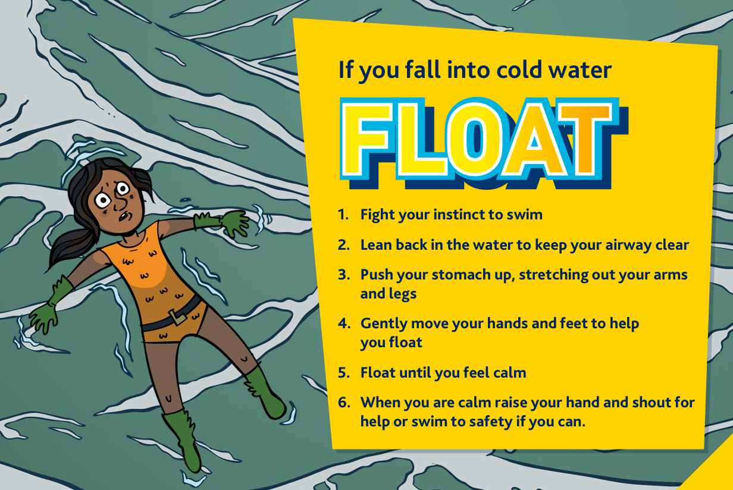

Slide 21
Acrostic Poem
S
A
F
E
C
O
D
E

Slide 22
Walt: understand and remember the SAFE CODE
WILF
understand why we use mnemonics (‘nuh·mo·nuhk’)
explain what each letter stands for
find a way to remember the safe code
describe some dangers near outdoor water
describe what to do in some situations

