Slide 1
Safety Rules at the swimming pool

Slide 4
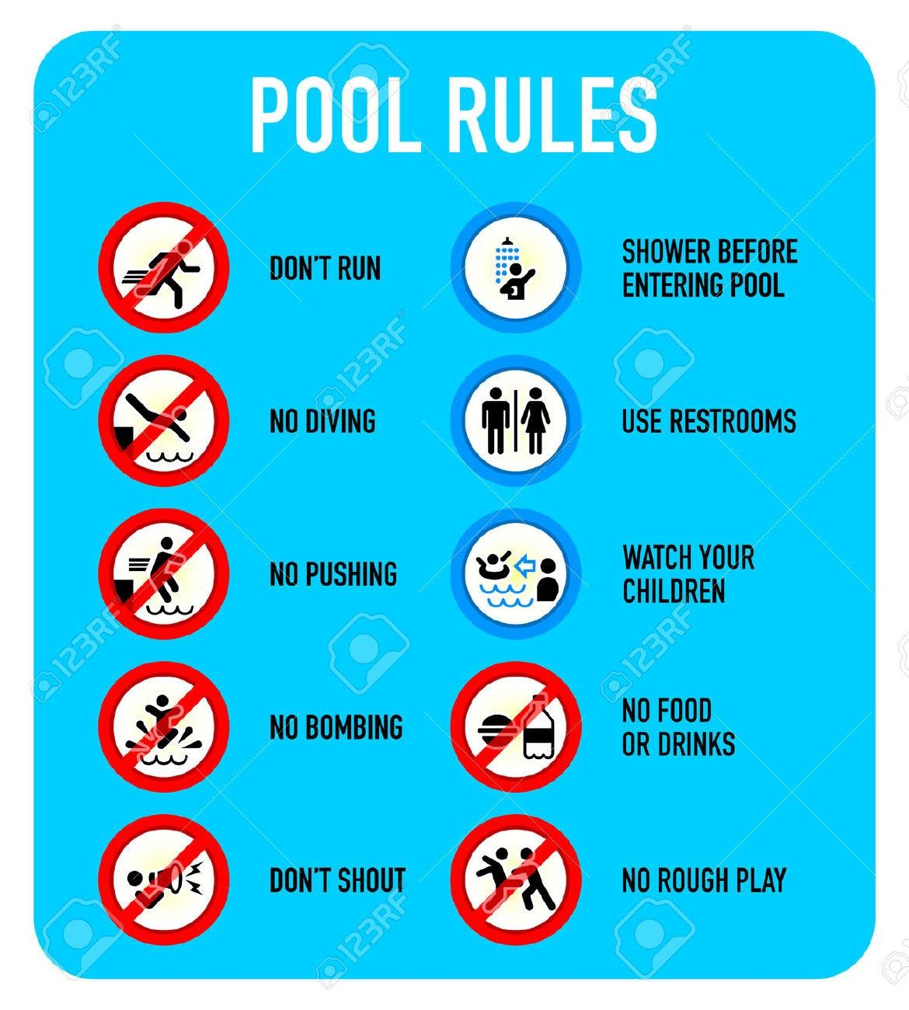

Slide 5
