Slide 1
Intent, Implementation and Impact of your PESSPA Offer
28th January 2021
Nathan Barthrop
Forge School Sport Partnership & School Games Organiser
Notes:
Welcome and introduction – Difficult to pitch today as people attending will be at different stages, some will be new, some will be experienced but hopefully there will be a something for everyone to take away from the webinar.

Slide 2
Outcomes of Today
Consider how to plan your PESSPA provision and resources in line with the ‘3 I’s’
Identify how you can scrutinise the outcomes of your PESSPA provision and different ways in which these outcomes can be delivered across your school
Consider how to monitor and evaluate the impact you are having as a subject

Slide 3
Planning Your PESSPA Offer
PE and School Sport Premium KPI’s
Engagement of all pupils in regular physical activity – the Chief Medical Officer guidelines recommend that all children and young people aged five to 18 engage in at least 60 minutes of physical activity a day, of which 30 minutes should be in school
Profile of PE and sport is raised across the school as a tool for whole-school improvement
Increased confidence, knowledge and skills of all staff in teaching PE and sport
Broader experience of a range of sports and activities offered to all pupils
Increased participation in competitive sport
Notes:
Sure all aware of these KPI’s but it’s worth a quick recap

Slide 4
AfPE/YST Recording Template
Notes:
Use of nationally recognised template

Slide 5
Intent
What & Why?
Your school focus should be clear about what you want the pupils to know and be able to do, and about what they need to learn and to consolidate through practice
When deciding WHAT you want to include in your offer, it is important that you can demonstrate WHY you are including it in your offer
Identify baseline data as a starting point and to measure progress
Use a wide range of tools to help you decide and prioritise actions
PESSPA Toolkit
School Games Mark Application
School Games Inclusive Health Check
Staff Audit
Active Schools Planner
AfPE/YST Quality Mark
Equipment & Resource Audit
Lesson Observations
Pupil & Parent Questionnaires
Assessment in PE

Slide 6
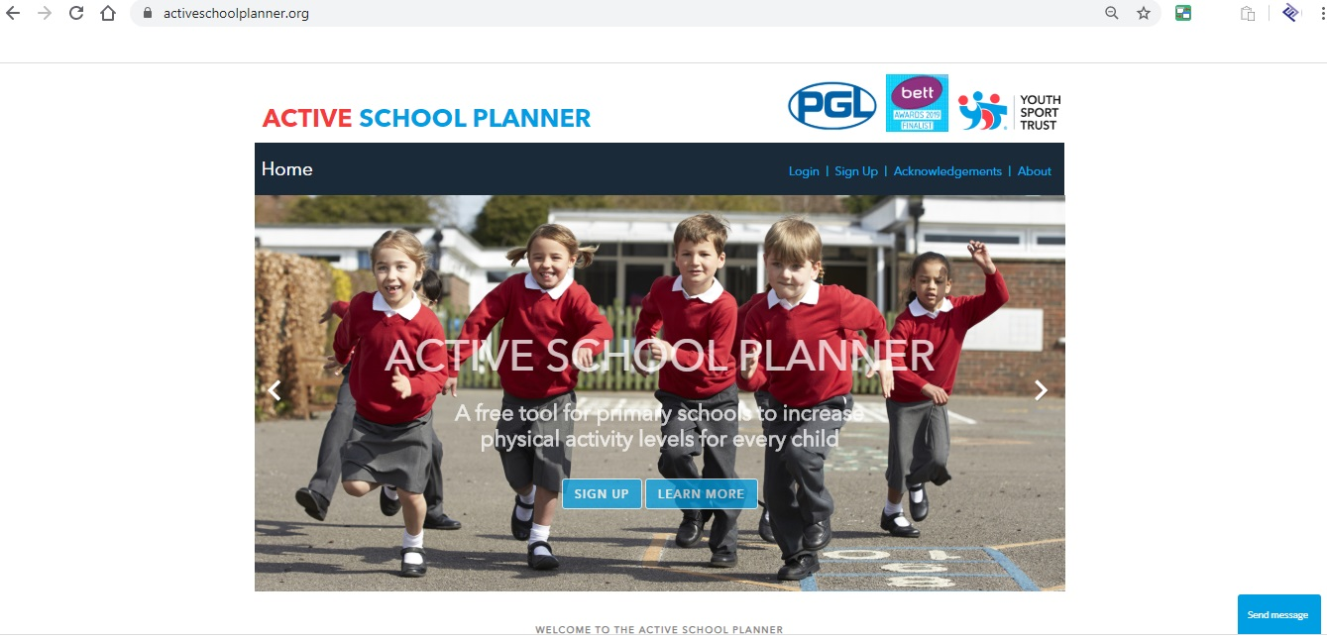
Intent
Active Schools Planner
https://www.activeschoolplanner.org/
a tool for primary schools to track and improve physical activity levels in their pupils.
This easy to use tool will enable you to:
Look at where and how the school is increasing physical activity and reducing sedentary behaviour in pupils
Find guidance and best practice to continue to make improvements
Provide reports as evidence to show how you are using Primary Sport Premium Funding to improve health outcomes for pupils
Why?
PESSPA Toolkit
https://www.learnsheffield.co.uk/Downloads/Partnerships/PESSPA/PESSPA%20Toolkit.pdf
Audit for schools to use in order to evaluate their provision and plan strategically for improvement. The toolkit also provides guidance on each aspect so that our collective understanding of the evidence base for best practice is enhanced.
AfPE Quality Mark
https://www.afpe.org.uk/physical-education/afpe-quality-mark-for-pe-a-sport/
https://www.youthsporttrust.org/membership/quality-mark
The afPE and YST Quality Mark are unique self review and evaluation tools. Both nationally recognised.

Slide 7
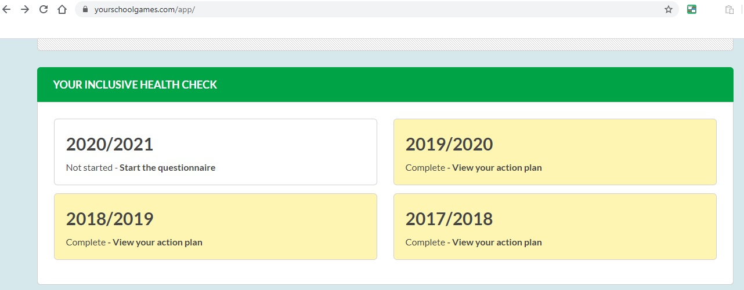
Intent
School Games Inclusive Health Check
https://www.yourschoolgames.com/
A useful tool to review SEND provision across your school and enable you to evaluate the effectiveness of your provision for ALL young people.
When considering each of the questions it is essential that you can identify specific current examples to back up your responses. Found on Your School Games Dashboard.
Why?
School Games Mark
https://www.yourschoolgames.com/
The School Games Mark is a government led awards scheme launched in 2012 to reward schools for their commitment to the development of competition across their school and into the community. Participating in this process allows schools to evaluate their PE provision and assists them in developing an action plan for future progress.
For the academic year 2020/21, the School Games Mark Framework will be positioned as a self-review tool to support schools and other educational establishments to reflect on their involvement in the School Games in light of the country’s ongoing plight with COVID-19.
Application provides guidance to reach next level.
Lesson Observations
Useful to identify any support teachers may require and focus on learning of pupils.

Slide 8
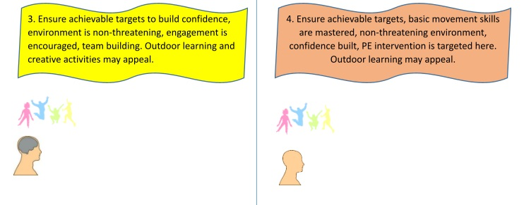
Intent
Assessment Tools – Attainment in PE
Utilise assessment in PE tools to identify pupils who are most need to support/development.
Assessment Quadrant below (Helen Stevens Points LN Assessment Webinar) may prove a useful tool.
Why?
Consider the pupils needs from these 4 groups
E.g. Pupils in group 4 might be the pupils that you may target for Change4Life Clubs or targeted interventions

Slide 9
Intent
Parent Questionnaires
Parents may have some supportive ideas to help inform your PESSPA offer. Asking parents can improve parental engagement and foster better relationships.
What can you find out?
What pupils do outside of school
What activities they would like on offer at school?
Would parents engage in parent-pupil sessions? e.g. daily mile
What could be improved?
Do any parents have coaching qualifications and could deliver clubs for your school?
Use google forms, survey monkey, paper based questionnaires.
Why?
Equipment & Resource Audit
Spend an afternoon clearing out the PE cupboard and resource shelf.
Identify what new equipment is required
Create a signing in and out sheet of equipment to prevent equipment going missing
What range of resources are available to staff? Is it up-to-date?
Are there any gaps in provision?
Staff Audit
Identify confidence of staff in delivering PE
Identify common areas for development across whole school
Identify preferred methods of learning e.g. team teaching, insets, discussions, central CPD, resources
Pupil Voice (Sport Leaders/SSOC’s)
Utilise your sports leaders, SSOC’s and School Council.
Let them carry out research for you.
Find out what they want.
Pupil Voice = Happy Ofsted

Slide 10
Intent
*** Whole School Development Plan***
Consider your whole school development plan.
How can you use your PESSPA offer to contribute to achieving whole school areas for development in YOUR school?
What are YOUR Whole School Priorities?
Examples might include:
• Ensure learning activities are well matched to pupils’ abilities
• Integrating subjects and using a creative approach
• Improved lunch and break time experience for children
• Embed a consistent whole school approach to teaching and learning through the implementation of the school ‘Passport to Success’
• Narrow the gap of attainment between pupils and challenge the more able
• To increase the attainment of boys in EYFS
• To enrich pupils’ learning through outdoor learning opportunities
Why?
Successful Learners…..

Slide 11
Intent
Why?
How do we achieve our priorities using PESSPA as part of the answer?
What ideas can you develop?
- What programmes / resources can we develop /utilise?
Consider time for PE
Space and facilities
Equipment and resources both from school and through SSPs/LN’s
Approaches to teaching, learning and evidence of learning – links across the curriculum
Links between curriculum / extended activities and learning beyond the curriculum / the community
Embedding change to make a difference
Sustainability – role of Governors / parents
What are YOUR pupils experiences in and outside of school
Can you relate it to wider school programmes that are running already (SMSC or family engagement etc.)
Cross curricular etc.

Slide 12
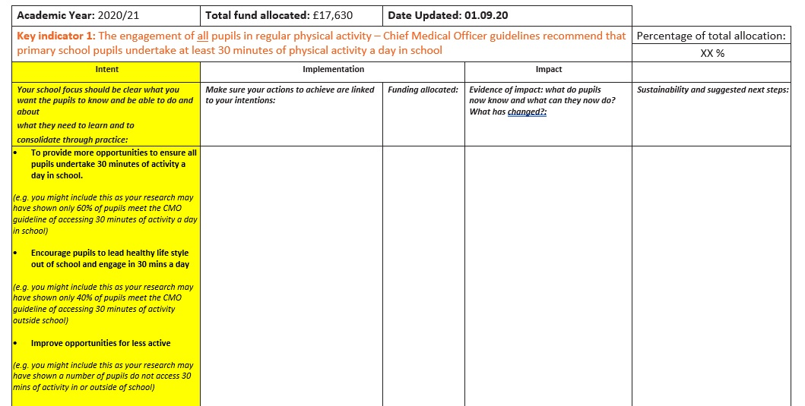
Intent
What?
When you have completed your research, you should be in a position to start planning your offer and finalise your ‘Intent’
Use the findings of your research to identify key areas for development
Each PESSPA offer should be unique to your individual school’s needs
Intent should be more general and outline aims under each KPI with the more specific details following in the implementation stage
Notes:
Linked to Planning Doc - INTENT

Slide 13
Impact – Consider from the outset
Evidence of what has been achieved
It is extremely important that you consider how you will monitor and evaluate your impact from the outset. The impact of your offer will be a continual process.
What tools can you use and create to help demonstrate your impact?
Tracking database – Competition Participation, Staff CPD, Extra-Curricular, Curriculum Provision, Sports Leadership, demographics of engagement
PE Assessment Tools/Pupil Progress
Questionnaires – Pupil/Staff/Parents
Extra-Curricular Registers
Revisit Staff Audit – Question staff on impact of CPD
School Games Mark Application – progress each year
YST/AfPE Quality Mark self-review improvements
Lesson Observations
Attainment in PE
Has any cross curricular provision linked to PE and Sport impacted on attainment in other areas of the curriculum?

Slide 14
Implementation
How?
The implementation stage should consider HOW you are going to improve your PESSPA offer and achieve the intent you have set out
This is the more detailed and specific area of your PESSPA plan
Consider a range of ideas that could help you achieve your WHAT
During this stage you should also consider the Costs V Benefit/Return (value for money)

Slide 15
Implementation
How?
Selection of ideas under each KPI:
Key indicator 1: The engagement of all pupils in regular physical activity – Chief Medical Officer guidelines recommend that primary school pupils undertake at least 30 minutes of physical activity a day in school
Consider: Active Travel Physically Active Learning Active Interventions Active At Home Targeted Groups Active Environments/Places In School | Ideas could include: Active travel initiative – class wall charts/stickers Bikeability or scootability training Healthy school week Introduction of active lessons e.g. Active Maths or English Active homework Introduction of Change4Life Clubs Development of playground – markings, fixed equipment Purchase of playground equipment Sports leader training Purchase of external coaches Widen extra-curricular programme Introduction of breakfast/lunchtime targeted clubs Daily Mile Wake and Shake/10 minute active bursts in lessons Local SSP/Network or SGO Assistance

Slide 16
Implementation
How?
Selection of ideas under each KPI:
Key indicator 2: The profile of PESSPA being raised across the school as a tool for whole school improvement
Consider: Whole School Development Plan Targeted programmes – School target groups Cross Curricular Opportunities Profile of PESSPA across the school community | Ideas could include: Active Play Through Storytelling Improve Maths/English attainment – introduction of Active Maths/English across school Projects linking to self-esteem issues, mental health issues, healthy lifestyles, obesity issues Cross curricular links e.g. Health Weeks could include food projects, healthy living, science based tasks linked to sport/PE Development of ‘Employability/Future Life Skills’ through PESSPA Introduction of newsletters PESSPA School Twitter Account to help raise the profile in the school community Local SSP/Network or SGO Assistance

Slide 17
Implementation
How?
Selection of ideas under each KPI:
Key indicator 3: Increased confidence, knowledge and skills of all staff in teaching PE and sport
Consider: Broad and balanced PE Curriculum High Quality Teaching Lesson Planning, Schemes of Work, Structure of PE lessons Equipment and resources Assessment and pupil progress | Ideas could include: Planning of PE Curriculum and Extra-Curriculum map Clear progression between year groups/Key Stages Purchase of new resources e.g. Imoves, Get Set for PE Twilight/Inset CPD opportunities Purchase of new equipment Curriculum support/team teaching Coach/specialist teacher support Introduction of assessment in PE to track pupil progress Subject Leader Training/Support Introduction of regular PE lesson observations Local SSP/Network or SGO Assistance

Slide 18
Implementation
How?
Selection of ideas under each KPI:
Key indicator 4: Broader experience of a range of sports and activities offered to all pupils
Consider: PE offer Pupil voice/SSOC’s Extra-Curricular Offer | Ideas could include: 2 hours of PE each week External coaches Introduce alternative sports alongside ‘mainstream sports’ to provide a wider reach to pupils e.g. karate, dance, tchouckball, handball, quidditch Purchase new/varied equipment Reward trips to local venues to access new opportunities or residential trips e.g. Thornbridge, Ice Sheffield etc… Develop sports leadership offer Formation of SSOC – pupil voice Links to local clubs/facilities and promotion of opportunities Targeted clubs e.g. Active Girls Booster swimming lessons Engagement in projects e.g. Girls Football Partnership Local SSP/Network or SGO Assistance

Slide 19
Implementation
How?
Selection of ideas under each KPI:
Key indicator 5: Increased participation in competitive sport
Consider: Engagement in School Games Inter Competitions Intra Competitions Personal Best Opportunities | Ideas could include: Attendance at School Games Competitions Participation in SFSS competitions Engagement in other external competitive opportunities e.g. SUFC/SWFC competitions Coach hire costs to get to central venues Cluster based competitions/festivals School Games Day (Sports Day) Introduction of intra-competition programme to engage more pupils in competitive opportunities Purchase equipment to enable practice for competition Link extra-curricular provision to competitions Introduce personal best activities throughout the year Local SSP/Network or SGO Assistance Utilise House System – link competitive opportunities

Slide 20
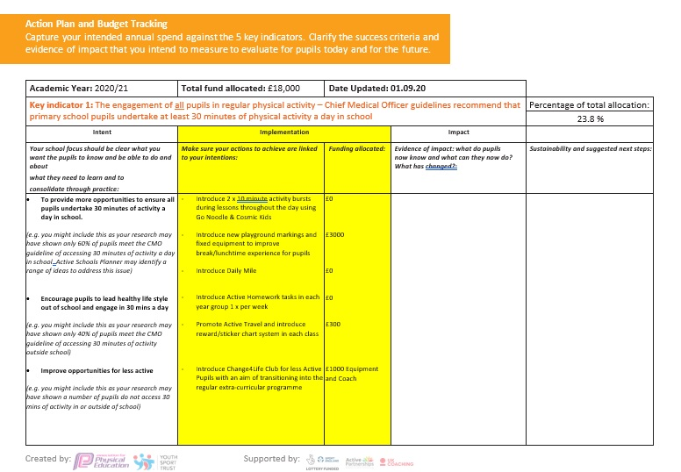
Implementation
How?
Make sure your actions to achieve are linked to your intentions
Include costings and consider return on investment
Notes:
Linked to Planning Doc - IMPLEMENTATION

Slide 21
Impact
Evidence of what has been achieved
What tools can you use and create to help demonstrate your impact?
Revisit Baseline Figures – Identify Progressions
Tracking database – Competition Participation, Staff CPD, Extra-Curricular, Curriculum Provision, Sports Leadership, demographics of engagement
Extra curricular registers
PE Assessment Tools/Pupil Progress
Questionnaires – Pupil/Staff/Parents
Extra-Curricular Registers
Revisit Staff Audit – Question staff on impact of CPD
School Games Mark Application – progress each year
YST/AfPE Quality Mark self-review improvements
Lesson Observations
Attainment in PE
Has any cross curricular provision linked to PE and Sport impacted on attainment in other areas of the curriculum?

Slide 22
Impact
Evidence of what has been achieved
Schools commonly include subjective and qualitative statements on their PESSPA plan to identify the impact
Subjective and qualitative statements are ok BUT there should be quantitative data to provide solid evidence of what has been achieved through your PESSPA offer
For example, a school might have implemented a Change4Life Club in an attempt to engage the 30% of pupils within their school that did not access an extra-curricular club the previous year.
Subjective Qualitative Statement
As a result of introducing a Change4Life Club for less active pupils, more pupils have now accessed an extra-curricular club and are now happier and healthier as a result.
Quantitative Evidence Statement
As a result of introducing a lunchtime Change4Life Club for less active pupils, 100% of pupils on roll have now accessed an extra-curricular club. Of the pupils that were previously classed as less active and who attended the Change4Life Club, 80% (20 pupils) now attend a regular mainstream extra-curricular club. These pupils now appear happier and healthier as a result.

Slide 23
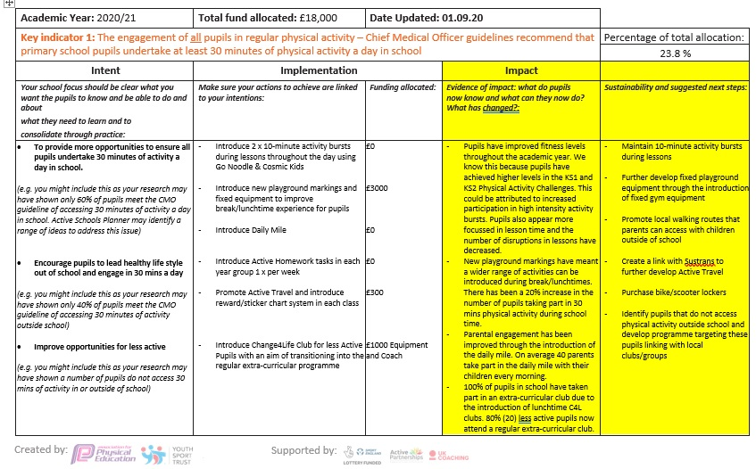
Impact
Evidence of what has been achieved
Consider sustainability and what next steps are required (if any)
Evidence of impact: what do pupils now know and what can they now do? What has changed?
Naturally some things will be harder to demonstrate impact than others.
Notes:
Linked to Planning Doc - IMPLEMENTATION

Slide 24
Case Studies and Good Practice
Top Tips: https://www.afpe.org.uk/physical-education/top-tips-for-spending-the-primary-pe-and-sport-premium/
https://www.youthsporttrust.org/case-studies
https://yorkshirepeawards.co.uk/last-year
https://documents.hants.gov.uk/ccbs/Sport/SHIOWPrimaryPremiumfundingcasestudyNorwoodPrimarySchool.pdf
https://www.teesvalleysport.co.uk/young-people/active-schools/best-practice-case-studies-in-primary-pe/
https://www.lrsport.org/primarysportpremiumcasestudies
https://www.teambedsandluton.co.uk/pe-case-studies

Slide 25
Contact Details
Nathan Barthrop
forgesdo@hotmail.com
07983430970

