Slide 1
EPKCE UKS2 Session 1
Building Safe and Supportive Relationships

Slide 2
Session Overview
This session introduces students to the importance of positive friendships, recognising red flags in relationships, and identifying safe spaces in their daily lives. Through interactive discussions and activities, students will develop strategies to maintain healthy relationships and seek support when needed.

Slide 3
Learning Objectives
Reinforce understanding of good relationships.
Recognise red flags in friendships and social situations.
Identify and define personal safe spaces.
Develop confidence in seeking help when feeling unsafe.

Slide 4
Session Outline
Activity: Friendship Tree.
Materials: Large paper tree outline, coloured paper leaves, markers.
Task: Each young person writes one quality of a good friend on a leaf and one place where they feel safe. Leaves are then attached to the tree.
Interactive Element: Discuss different scenarios involving friendships (e.g., peer pressure, bullying) and discuss positive ways to handle these situations

Slide 5
Introduction
How would you define or describe a “good friend” in one word?
What makes a friendship positive or negative?

Slide 6



Friendship Tree Activity
Think: What qualities are most important to you in positive friendships? Where or what spaces do you feel the safest?
Create: Write one quality on each leaf and a space you feel most safe on each leaf as well.
Present: Add your leaf to the large friendship tree and the safe space tree

Slide 7
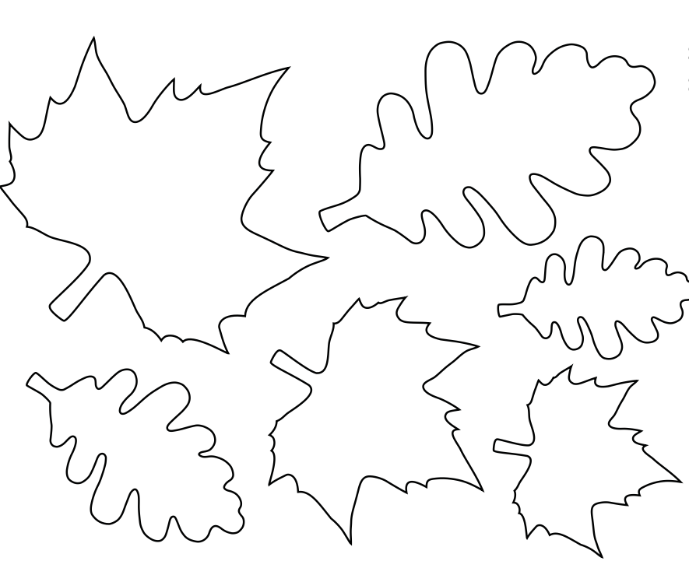


Example of the Friendship Tree
Respectful
Kind
Honest
Trusting
Fun

Slide 8
Example of the Safe Space Tree
Friend’s Home
Home
Football Club
School
Dance Class

Slide 9
Community Agreements for Group Discussion
Respect: Everyone’s opinions and experiences are valued.
Listen Actively: Let’s hear each other out without interrupting.
Be Kind: Treat others how you want to be treated.
No Judgment: We all come from different experiences and are here to learn.
Speak Up for Safety: If something doesn’t feel right, talk to a trusted adult.
Confidentiality: What is shared in discussion stays in discussion (unless it concerns safety).

Slide 10
Discussion
What qualities of a good friend did you add to the tree that are important to you? Why are these important qualities to you?
What safe spaces did you add to the tree? Why are these spaces important to you and your safety?

Slide 11
Interactive Scenario Discussion
Ask two young people to volunteer to role-play the scenario. As a group, discuss the scenario and other possible solutions.

Slide 12
Scenario #1: “Can I Have Your Lunch Money?”
A friend asks you for lunch money every day. Today, they ask again.
Friend A: “Hey friend, can I have your lunch money again today?”
Friend B: “Hmm... I’m sorry, but I need it for my lunch.”
Friend A: “But I’m really hungry.”
Friend B: “I get that. Have you told a teacher? Maybe they can help.”
Friend A: “I don’t know...I'm scared to ask a teacher.”
Friend B: “You shouldn’t have to go hungry. Let’s talk to our teacher together. She might be able to help you.”

Slide 13
Scenario #1 Interactive Discussion
What are other possible solutions or strategies to use in this scenario?
How did it feel to say no?
What could a trusted adult do in this situation?
Why might someone ask for lunch money every day?

Slide 14
Scenario #1 Interactive Discussion
Possible Solutions and Strategies:
Saying no is okay.
Explain that you need your lunch.
Ask if they are okay or if they need lunch.
Encourage them to talk to a trusted adult if they need help.
Seek help from a teacher or a trusted adult if they continue to ask, or if you think they may need support.

Slide 15
Scenario #2: “Left out at Break Time.”
During the break, a group is playing a game. One child is nearby but isn’t being invited to play.
Friend A: (noticing the Friend C standing nearby) “Hey guys, I think Friend C wants to join in.”
Friend B: “Oh, I didn’t see her there.”
Friend A: “Friend C, do you want to play tag with us?”
Friend C: “Yeah, that’d be nice.”
Friend B: “Cool! You can be the tagger first if you want.”
Friend C: “Okay, thanks!”

Slide 16
Scenario #2 Interactive Discussion
What are other possible solutions or strategies to use in this scenario?
How did the person feel when they were left out?
What made the situation better?
How can you make sure everyone feels included?

Slide 17
Scenario #2 Interactive Discussion
Possible Solutions and Strategies:
Invite a friend to join in.
Encourage others to include them.
Start a new game where everyone can participate.

Slide 18
Scenario #3: “Snapchat Dares.”
A friend sends you an online message through Snapchat to participate in a dare of you holding a knife.
Friend A: (via message): “Hey, I dare you to post a pic holding my brother’s knife. Everyone’s doing it. Don’t be scared. Just snap it and delete it after.”
Friend B: (typing): “What? Why would I do that?”
Friend A: “It’s just a joke. You won’t get in trouble. No one will know. I already posted mine, and I got 20 likes. Be cool.”
Friend B: “No, that doesn’t feel right. Someone could screenshot it or tell someone.”
Friend A: “Ugh. You’re so boring.”
Friend B: “I don’t care. I’m not doing something that could get me or you hurt. I’m going to delete this chat and talk to someone about it. You should, too.”

Slide 19
Scenario #3 Interactive Discussion
What are other possible solutions or strategies to use in this scenario?
Why was it brave for Friend B to say no?
What could have happened if they had posted the picture?
How can we support a friend who feels pressured online?
What steps can you take if you receive a message like that?

Slide 20
Scenario #3 Interactive Discussion
Possible Solutions and Strategies:
Peer pressure can happen online, just like in person.
Nothing on Snapchat (or any platform) is ever truly deleted.
It’s okay to say no and block/report someone — even if they’re a friend.
A trusted adult can always help — both with the pressure and the person doing the pressure.

Slide 21
Scenario #4: “Can You Hold This for Me?”
Friend A wants you to hold something for them that makes you uncomfortable. They say, “Don’t worry, nothing will happen.”
Friend A: “Hey [Name] Friend B… Could you do me a favour? Just hold this in your backpack for me, alright?”
Friend B: “What is it?”
Friend A: “(whispers) It’s just a knife. I don’t want to get caught with it. You’re good at keeping quiet.”
Friend B: “No, I’m not okay with that. I don’t want to be involved in anything like that.”
Friend A: “Come on, just for a bit! No one will know.”
Friend B: “No. I’m serious. I don’t feel safe with this, and I think you need to talk to an adult.”
Friend A: “Don’t say anything, okay?”
Friend B: “I won’t keep a secret that could hurt someone. I’m going to tell a teacher because I care about both of us staying safe.”

Slide 22
Scenario #4 Interactive Discussion
What are other possible solutions or strategies to use in this scenario?
Why was it important for Friend B to say no?
What risks were involved in saying yes?
What might happen if Friend B didn’t tell a trusted adult?
What support might Friend A need?

Slide 23
Scenario #4 Interactive Discussion
Possible Solutions and Strategies:
Saying no is okay.
Stand firm in your decision.
Walk away.
Talk to a trusted adult if needed.

Slide 24
Recap on Strategies for Handling Peer Pressure and Red Flags in Friendships
Say No with Confidence: Use a firm but polite “No, I’m not comfortable with that.”
Give a Reason (If You Want To): “I don’t think that’s a good idea because…”
Suggest an Alternative: “Let’s do something else instead.”
Walk Away: If the pressure continues, remove yourself from the situation.
Talk to a Trusted Adult: If something feels wrong, ask for help.
Find Supportive Friends: Surround yourself with people who respect your boundaries.
Practice Role-Playing Responses: Prepare phrases for saying no to uncomfortable situations.
Use the Buddy System: Have a friend with you who shares your values and can back you up.
Recognise Manipulation: If someone makes you feel guilty or scared, that may be a red flag.
Block and Report (especially for online situations): If peer pressure is happening online, block the person and report their behaviour.

Slide 25
Wrap Up Reflection
What is something new you learned today about friendships?
What is one thing you might do differently in your friendships now moving forward?
Remember, whenever you don’t feel comfortable, seek advice from and talk to a trusted adult.

