Slide 1
EPKCE KS4 Lesson 2
Social Media and Knife Crime

Slide 2
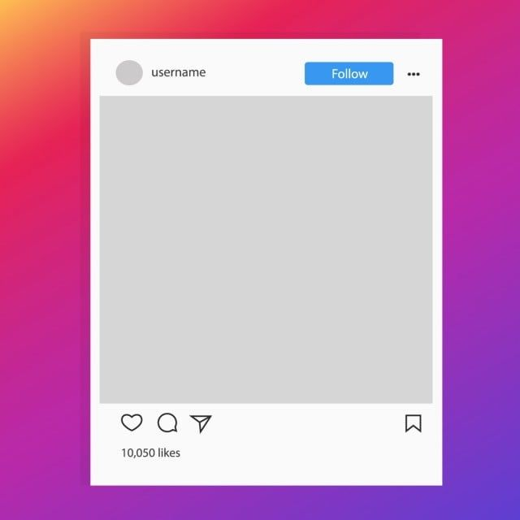
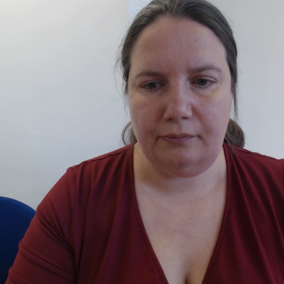
Social Media and Knife Crime
Think, Pair, Share
Imagine you see this social media post alongside an image of someone with a blade or something similar.
Independent thinking:
Have you ever seen a post like this on social media?
Why do you think the person posted this?
Person photographed with a blade
Paired discussion:
If you saw this post, would you like, comment or share it?
Would you report it? Would you know where to report it?
What could be the real-life consequences of posting/sharing/liking it?
Do you think the law applies to social media content like this?
Don’t come around here or you’ll be sorry. I’ll be waiting.
Starter activity

Slide 3

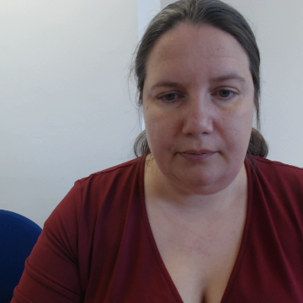
These types of comments could be prosecuted under the Malicious Communications Act 1988 or Threats To Kill (Offences Against the Person Act 1861).
You could also be prosecuted for the possession of an offensive weapon.
The Law
The Murder of Jermaine Goupall (2017).
Jermaine was a 15 year old boy living in London when he was fatally stabbed by members of a gang in 2017. Before the murder, the perpetrators had posted videos on social media brandishing weapons and making threats towards rival groups.
These videos were used as evidence in court to demonstrate the premeditated nature of the attack. Several individuals were convicted and sentenced.
Real Life Example of how a post like this can escalate into violence
Starter activity

Slide 4
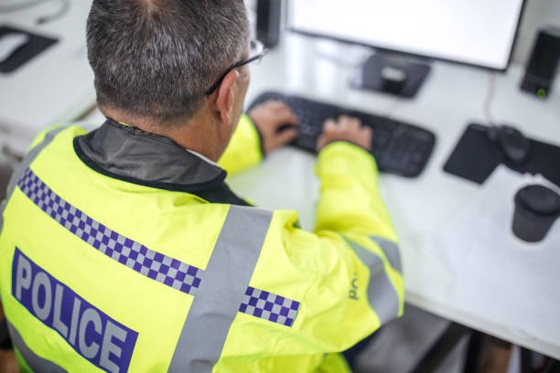
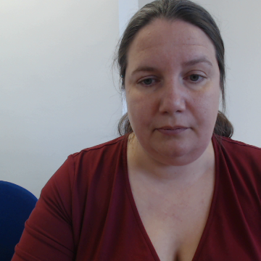
Introduction/background to the lesson
Knife crime in the UK seems to be linked to increased social media.
Some people believe they can post, like, comment and share content without real consequences, but engaging in knife crime posts plays a significant role in escalating tensions.
The police can – and do – track people down, whether they are the ones who originally post the content or the ones who engage with it.
Lesson objectives
Demonstrate an understanding of the risks and consequences of posting, sharing, liking and commenting on knife-related content on social media.
Consider how social media can escalate violence.
Explore ways to react to knife crime posts.

Slide 5
Ground rules
Everyone has the right to be heard and respected, so listen to what others say and show respect by not talking over people.
Use language that will not offend or upset anyone and avoid stereotypes.
When you give an opinion, try to explain your reasons.
If you disagree, do so with what is said not with the person who said it.
We will not judge people or make assumptions about them.
Do not share personal information or stories about other people. Always make that person anonymous. This may also be wise if the story is about you.
We won’t put people on the spot. Everyone has the right not to comment.
If you’re worried about something that has happened to you or a friend, talk to a member of staff or an adult you trust, after the lesson.
If a member of staff becomes aware of a risk to a young person’s safety, this information may need to be shared.

Slide 6
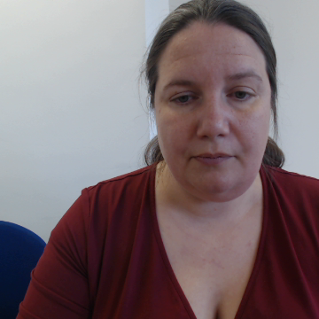
Social media and knife crime
have you seen any of these posts?
Young people showing off knives
Threats to harm with knives
Opportunities to purchase banned knives / advertising knives (often disguised as household ideas)
Videos and photos of violent acts/ filming or sharing a stabbing
With a partner, discuss the risks and consequences of creating one of these posts
Activity 1

Slide 7

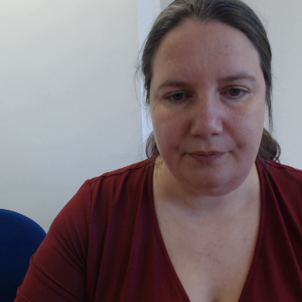
The Law – Social media and knife crime
Under the Criminal Justice Act 1988 and the Offensive Weapons Act 2019, it is illegal to use or display a knife in a threatening way – even if no actual harm is intended. If the image appears to show unlawful possession or an intent to cause fear, you could face legal consequences.
If the post suggests violent intent or could be perceived as a threat, you could be prosecuted under one or more of these pieces of legislation:
Public Order Act 1986
Malicious Communications Act 1988 and Communications Act 2003
Encouragement of Violence (Serious Crime Act 2007)
Section 127 of the Communications Act 2003 makes it illegal to send or post anything grossly offensive, indecent or obscene over a public electronic communications network.
Activity 1

Slide 8
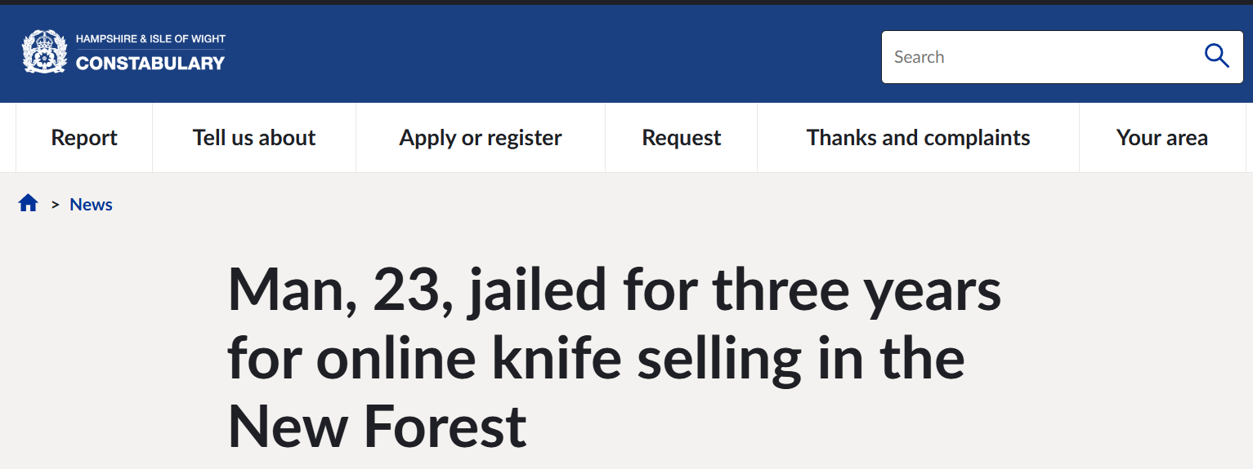

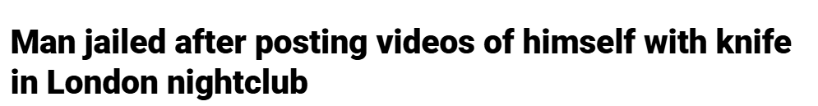
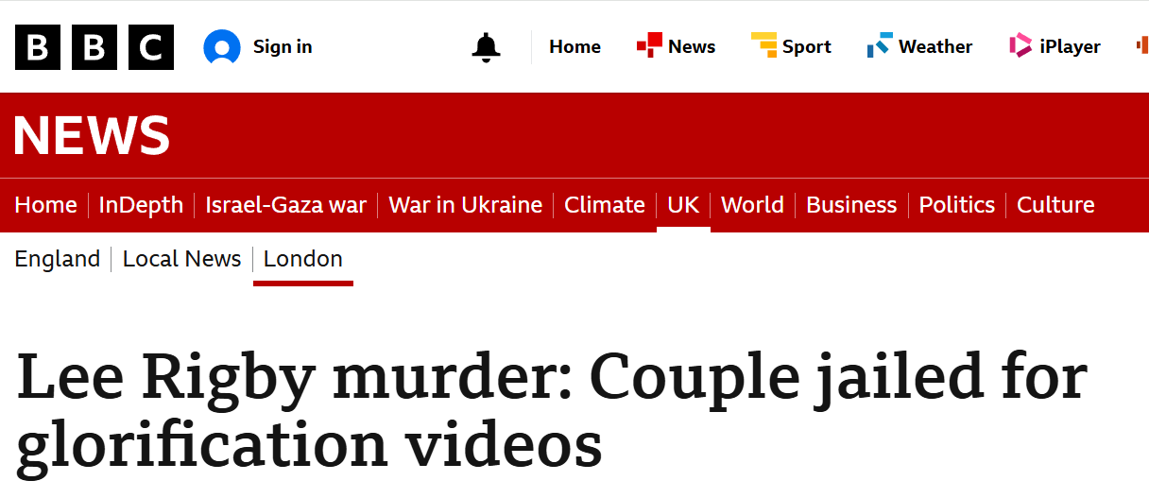

Real Life Examples
Activity 1

Slide 9

Real Life Examples
You are with a group of friends in a secluded area. One of them pulls out a knife and laughs. He says you will look really ‘hard’ if you post a photo of yourself on social media for a laugh.
What are the risks of going along with what your friend has suggested?
What things should you avoid doing in this scenario?
What is the best course of action?
Activity 1

Slide 10
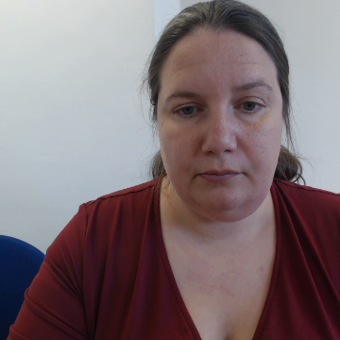
Imagine you saw one of the posts we have discussed and shared it
What could the possible effects be on the next person who sees it?
Fear and anxiety
They may start seeing it as a normal part of life (desensitisation)
Increased likelihood they will carry a weapon
Copycat behaviour
Increase in aggression
Peer pressure
Activity 2

Slide 11
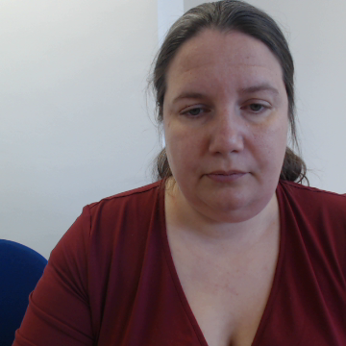
Liking and commenting on posts
Agree
Unsure
Disagree
Liking a post about knife crime doesn’t mean I support it
I can’t get into trouble for commenting on a violent post
If I put a laughing emoji on a knife crime post as a joke, it’s not that bad
Activity 3

Slide 12
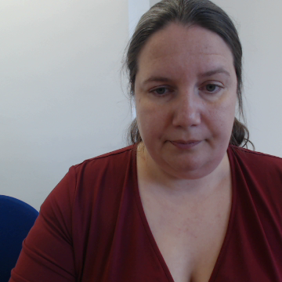
Key Takeaways
When people like or comment on a post, it signals to social media that the post is popular, and then more people see it.
Comments, likes and shares can contribute to conflicts escalating quickly.
If you comment on gang-related posts, others may assume you are part of the conflict.
If someone attacks someone else after being hyped up online, people in the comments could be investigated as accessories.
Activity 3

Slide 13
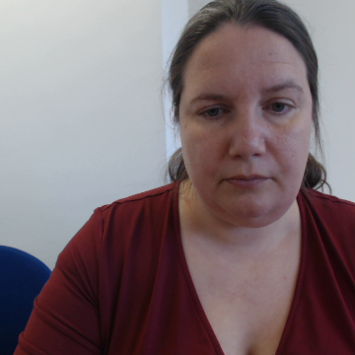
Paired Work - Scenario
A video of a recent stabbing appears on your feed. You see your friend has added a knife emoji in the comments.
What are the risks of what your friend has done?
What would you do in this scenario?
Would you report the video? Why/ why not?
Activity 3

Slide 14
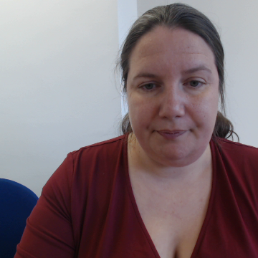
Sharing information about crime or a perpetrator on social media
If someone commits a crime, should we expose them on social media?
What if the police haven’t arrested them yet?
What if they’re innocent?
Activity 4

Slide 15
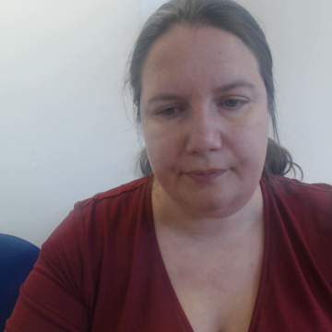
Sharing information about crime or a perpetrator on social media
Commenting on a social media post – whether about a perpetrator, crime or general discussion, can encourage violent activity.
Risks:
Inciting retaliation
Innocent family members can get attacked
If it was them, it might make the suspect more dangerous
If it wasn’t them, this will affect their life in many ways
Activity 4

Slide 16
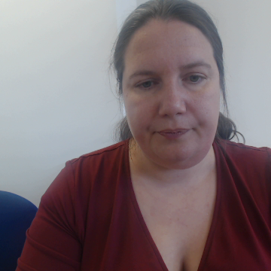
Sharing information about crime or a perpetrator on social media
Commenting on a social media post – whether about a perpetrator, crime or general discussion can carry legal risks.
Even if the information is true, publicly posting about a perpetrator could still lead to legal issues if it incites violence or vigilante action. It also endangers an investigation.
The law:
Malicious communications Act and Communications Act 2003.
Inciting violence or hatred Serious Crime Act 2007 and Public Order Act 1986.
Contempt of Court Act 1981. If a suspect is awaiting trial, posting about them could prejudice a fair trial, leading to arrest or fines.
Activity 4

Slide 17
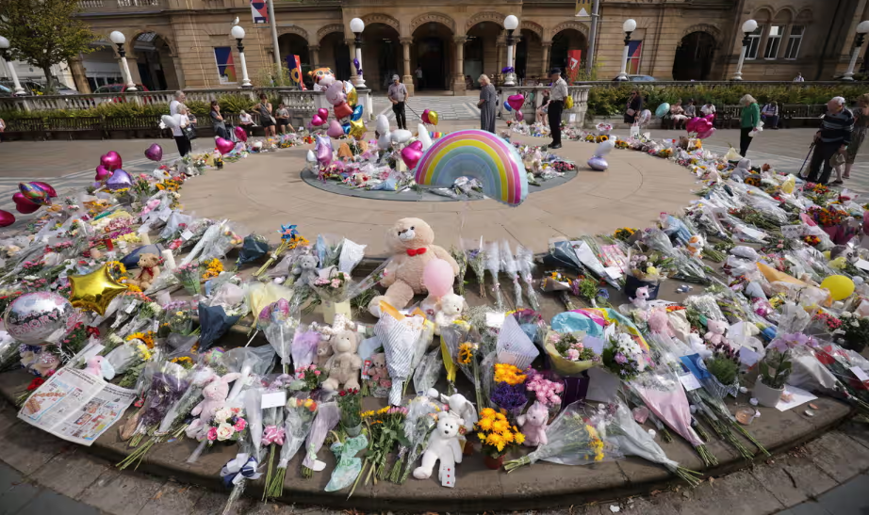
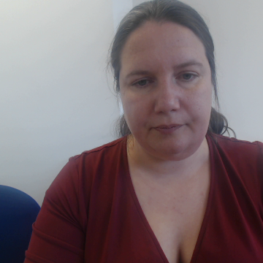
Southport Knife Attack
Speculation about the identity of the suspect behind the Southport stabbings, in which three children died, was rampant on social media. This included the sharing of a false name and nationality.
Taxi driver who stoked Southport riots jailed
Childminder admits inciting racial hatred over social media post
Activity 4

Slide 18
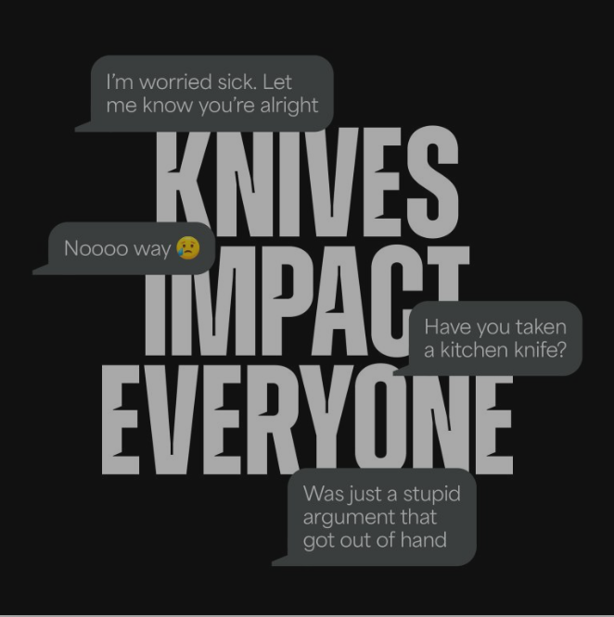
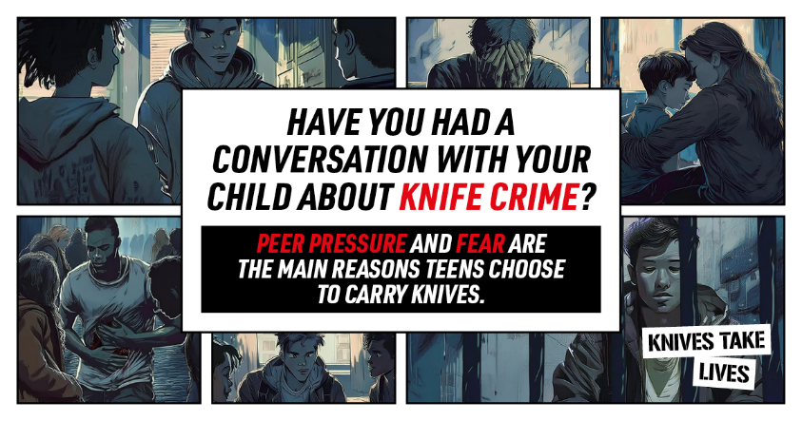
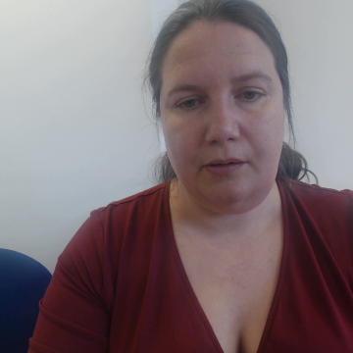
Social Media Campaign
Social media can also be a powerful tool for education and prevention.
One such campaign is the ‘Knives Impact Everyone’ campaign, that was launched by Police Commissioner Kim McGuinness and Northumbria’s Violence and Reduction Unit. This campaign highlights the consequences carrying a knife can have, and points to places that can offer support or advice.
Another campaign is ‘Knives Take Lives’, which is a South Yorkshire based campaign that educates young people on the consequences of carrying a knife.
In pairs, create your own campaign name and write down what you would share to reach millions of people.

Slide 19
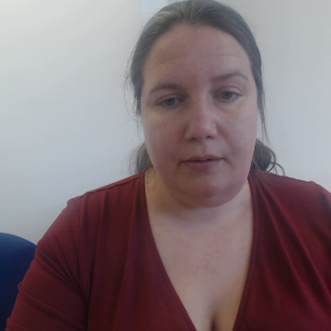
Signposting
If you are worried about anything you have heard in today’s lesson, please speak to trusted adult.
Knife crime is very rare but very real.
We can work together to make good decisions and keep ourselves and others safe.
If you are concerned about knives or other weapons that your friends or any other family member might have, these are the people who can help you.
Teachers and any other school staff that you trust
Family
Friends
Youth workers, sports/out of school activity coaches or tutors
The Police
Childline 0800 1111
You can also contact Fearless on 0800 555 111 to give information anonymously

Slide 20
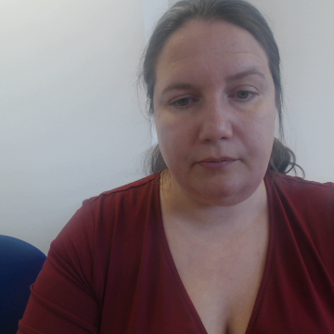
To what extent does liking, commenting and sharing on knife crime posts make you part of the problem?
Extension Activity
Discussion
Ideas for discourse markers
In my opinion…
From my perspective….
Personally, I believe that….
It is clear that….
I agree with you because…
That’s a valid point, and I will add that….
I share your view….
I understand what you are saying, but….
I am not sure I fully agree as…
I would instead argue that…
For example…
A good example of this is…
An incident that illustrate this…
Activity 5

