Slide 1
EPKCE KS4 Lesson 1
Knife Crime and Adult Situations

Slide 2
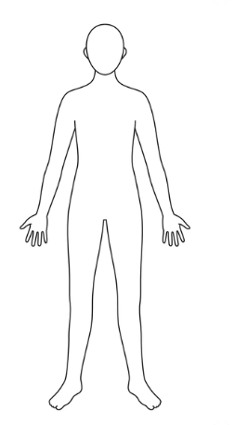
Knife Crime and Adult Situations
Starter Activity: Think of a typical person who would be a perpetrator of knife crime. Write notes around the figure on your sheet based on what you hear.
What gender are they?
Why would they be carrying a knife?
Where would they be heading?
How old are they?
What nationality are they?
What would they be wearing?
Perpetrator – a person who carries out a harmful, illegal or immoral act

Slide 3
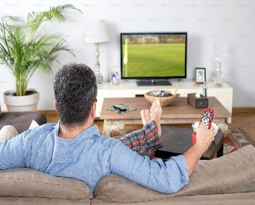
Where do we get our perceptions about knife crime perpetrators from?
We get our perceptions about knife crime from many places, but one place is through the media, for instance TV, film, online articles and social media.
Images and chosen stories that are used for articles and social media posts, send a strong message about who carries a knife, who commits knife crime and in what communities this happens, which in turn creates harmful stereotypes.
Stereotype – A set idea that people have about what someone or something is like, especially an idea that is wrong

Slide 4
Key facts and statistics about people who commit knife crime
In South Yorkshire, from 2020 to 2024, 83% of known suspects were male.
16.3% of KNOWN suspects were aged between 10 to 17 in the years 2020-2024.
Recent analysis of data collected in the UK indicates that there is no statistically significant relationship between ethnicity and weapon carrying
The most common place where knife crime happens is in town centres, and in the evening. However, after school is also a common time.

Slide 5
Why might someone carry a knife?
They believe it provides protection/self defence
To instil fear in others
They feel scared or fear other people are carrying knives
It makes them feel tough
They believe it earns respect
They think people will like them more
Peer pressure
They carry it for someone else
They want to take revenge
Key takeaway
Knife crime can be committed by any person, of any age, any nationality, and for a variety of reasons. Also, people who carry knives can often be injured by their own knife.
Fact – 99.75% of people in South Yorkshire don’t carry a knife

Slide 6
Introduction/background to the lesson
At Key Stage 4, you are becoming more independent and are likely to encounter new experiences and environments. Some environments and experiences increase the risk of knife crime, even though it is rare.
We need to think about practical safety strategies for avoiding risky situations, de-escalating conflicts, and knowing where to seek help.
Lesson objectives
Recognise potentially dangerous situations and develop strategies for keeping safe
Learn conflict resolution and de-escalation techniques to avoid violence
Know where to seek help and support if needed

Slide 7
Ground rules
Everyone has the right to be heard and respected, so listen to what others say and show respect by not talking over people.
Use language that will not offend or upset anyone and avoid stereotypes.
When you give an opinion, try to explain your reasons.
If you disagree, do so with what is said not with the person who said it.
We will not judge people or make assumptions about them.
Do not share personal information or stories about other people. Always make that person anonymous. This may also be wise if the story is about you.
We won’t put people on the spot. Everyone has the right not to comment.
If you’re worried about something that has happened to you or a friend, talk to a member of staff or an adult you trust, after the lesson.
If a member of staff becomes aware of a risk to a young person’s safety, this information may need to be shared.

Slide 8
Paired activity
House parties
Festivals
Clubs/bars
Public transport at night
What new potentially risky experiences and environments might you encounter as you get older?
Domestic violence situations
Working in customer-facing jobs
Going on holiday with friends
Walking home alone late at night
Road rage
Activity 1

Slide 9
Discussion - why might these situations contain risk?
Alcohol and drugs impair judgement (clubs/bars/festivals/house parties)
Crowded venues limit escape routes (clubs/bars/festivals)
Arguments between strangers can quickly turn violent
Gangs may use night settings for confrontation (walking home/clubs/bars)
Late-night travel attracts crime
Attackers may target individuals walking alone (e.g. muggings)
Some drivers carry weapons (road rage)
Anger makes some people unpredictable
Abusive partners may use knives or other weapons to control or threaten (domestic violence)
Activity 1

Slide 10
Real-life examples
Although it is rare, these tragic incidents do happen
Notting Hill Carnival (2024). Several violent incidents occurred, including multiple stabbings. Two individuals died.
Murder of Karen Gilliland (2020). Gilliland was stabbed 26 times by her estranged husband. He had a history of abusive behaviour.
Hurghada Beach Resort Attack (2017). A male swam from a public beach to resort hotels, attacking several female tourists with a knife.
Bodmin Nightclub Stabbing (2023). Jake Hill stabbed five individuals outside a nightclub using a hunting knife. One person died.

Slide 11
Small group work
Choose a scenario and work through the questions below
A
B
C
While on holiday you take a taxi with a friend. The driver demands more money than agreed. Your friend argues with the driver and threatens to call the police. The driver gets angry and reaches into the glove compartment.
You and your partner are arguing at home, and it gets heated. Your partner grabs a knife and points it at you, saying ‘if you ever say that again you will be sorry’.
A mate at college tells you he knows a way to make quick cash, using your bank account. You quickly realise that it involves a gang and many of them carry knives.
What are the risks in this situation?
What could you do that would make the situation worse?
What is the safest course of action?
How can the situation be de-escalated?
Activity 2

Slide 12
Small group work
Choose a scenario and work through the questions below
D
E
F
You are at a house party when someone pulls out a knife and starts showing it off, saying they carry it for protection.
You are walking home late at night when a stranger appears and tells you to give him your money and phone. He has a knife in his hand.
You are in a nightclub when you suddenly hear screaming. You see someone lying on the floor bleeding – they’ve been stabbed.
What are the risks in this situation?
What could you do that would make the situation worse?
What is the safest course of action?
How can the situation be de-escalated?
Activity 2

Slide 13
Stabbing First Aid
Look at the statements on your sheet and match them to the headings below
A
Ensure your own safety first
Call 999 immediately
Stop the bleeding
Keep the victim calm
Things you should not do
B
C
D
E
Activity 3

Slide 14
Signposting
If you are worried about anything you have heard in today’s lesson, please speak to trusted adult.
Knife crime is very rare but very real.
We can work together to make good decisions and keep ourselves and others safe.
If you are concerned about knives or other weapons that your friends or any other family member might have, these are the people who can help you.
Teachers and any other school staff that you trust
Family
Friends
Youth workers, sports/out of school activity coaches or tutors
The Police
Childline 0800 1111
You can also contact Fearless on 0800 555 111 to give information anonymously.

