Slide 1
EPKCE KS4 Session 2
Take Action!

Slide 2
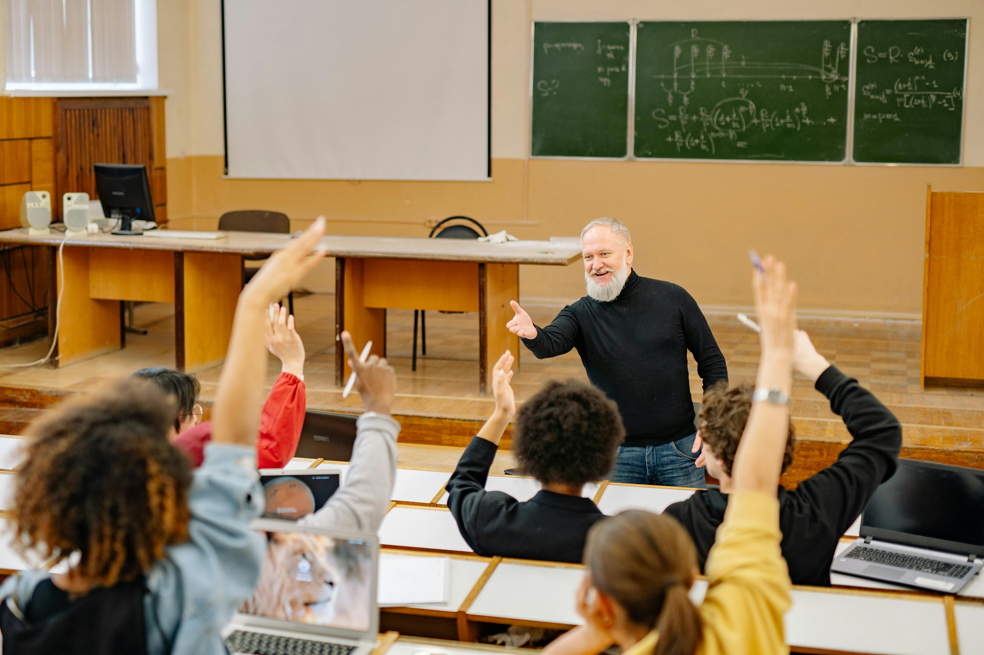
Stand Up If…

Slide 3
Vote with your feet

Slide 4
Vote with your feet
‘If I saw someone carrying a knife I would report it.’

Slide 5
Vote with your feet
‘There should be harsher legal consequences for people who carry knives.’

Slide 6
Vote with your feet
‘The police are doing enough to stop knife crime.’

Slide 7
Vote with your feet
‘Knife crime is a bigger problem in cities than in smaller towns.’

Slide 8
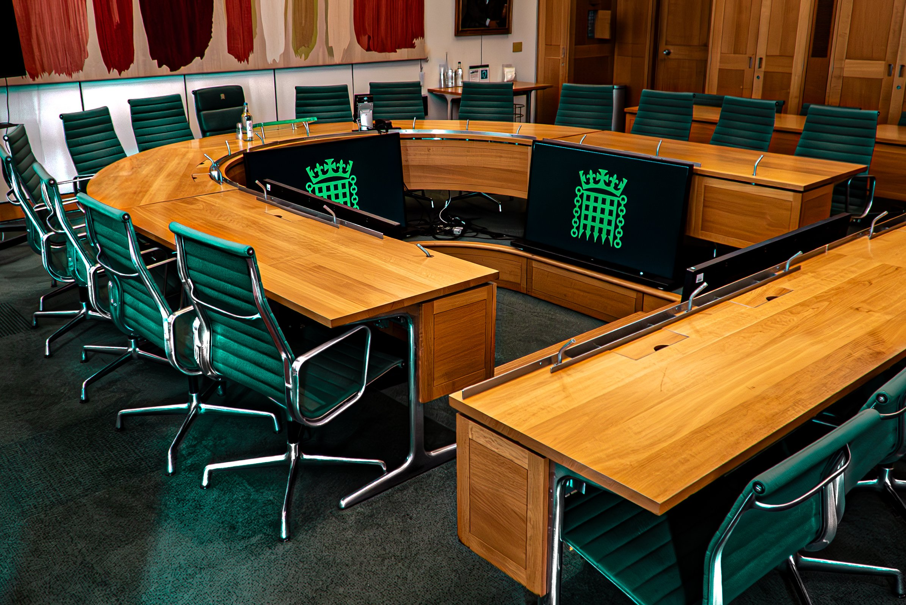
Taking Action

Slide 9

Taking Action

Slide 10
Future Impact Outcomes
Bronze (limited impact):
Your campaign was good but didn’t change many attitudes.
Knife crime rates in the area have decreased by 20%.
Some young people engaged, but the campaign lacked real-world impact.

Slide 11
Future Impact Outcomes
Silver (Moderate Impact):
Your campaign raised national awareness, which led to new local initiatives.
Some young people change their views, and a viral campaign resulted in knife crime dropping by 25%.
Your campaign was shared on social media and got thousands of views.

Slide 12
Future Impact Outcomes
Gold (Highly Successful Impact):
Knife Crime rates in your local area drop by 80% and nationally by 40%
Schools and youth centres adopt your campaign permanently
Your campaign reach is millions across the UK and is used in policy making

Slide 13
Reflection

