Slide 1
EPKCE KS4 Session 1
Knife Crime, Glamour and Exploitation

Slide 2
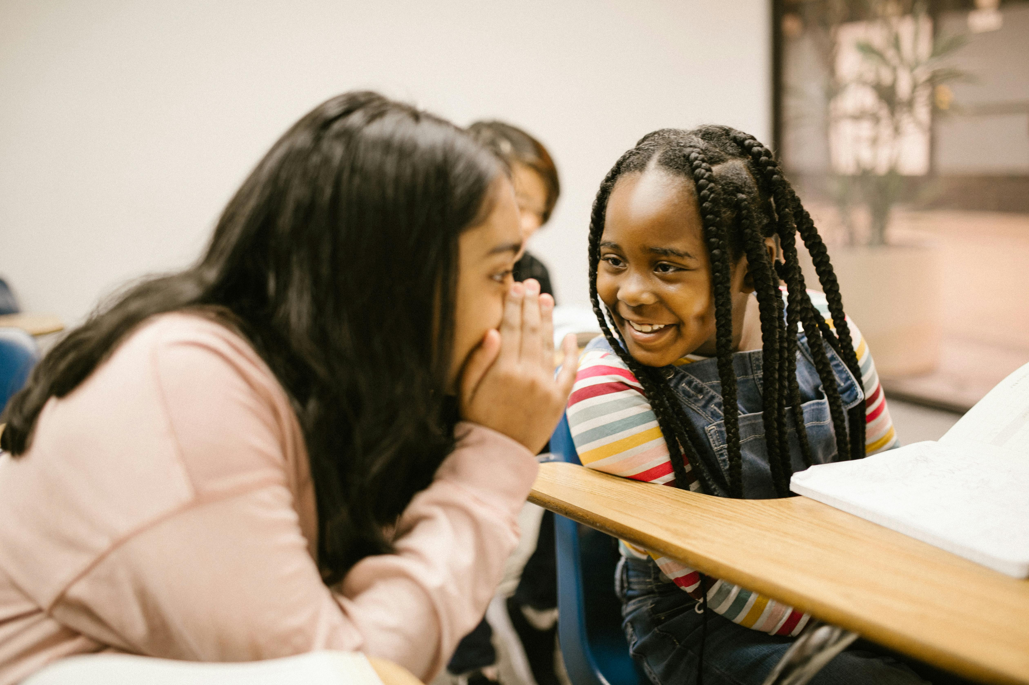
Two Truths and a Lie

Slide 3
Knives and Glamour
Together we’ll be exploring
Songs and Lyrics
Streetwear and Fashion
Film and TV

Slide 4
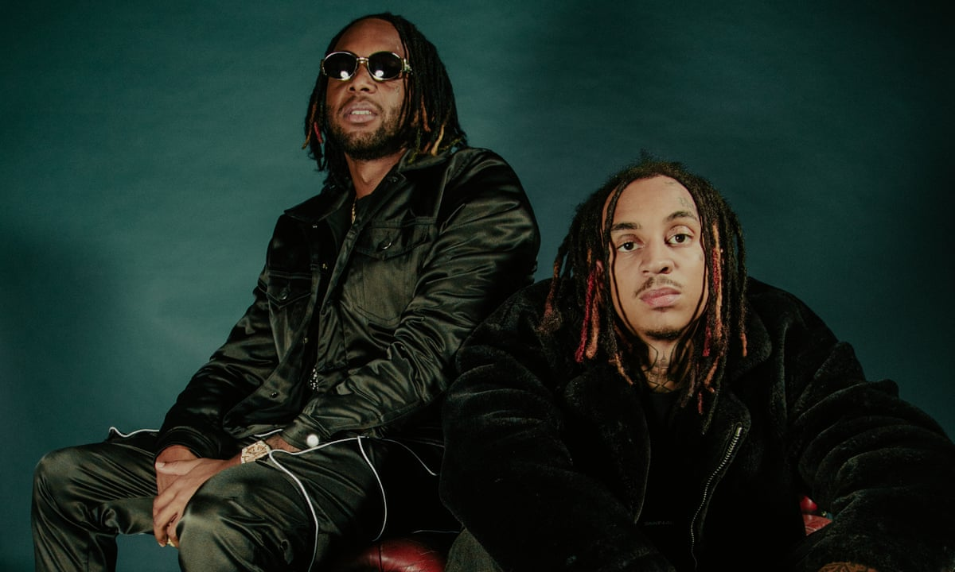
Knives and Glamour
“No Behaviour” - D-Block Europe
“Step with a blade, get ready for war / I don’t know what I’m doing, but I know it’s on”

Slide 5
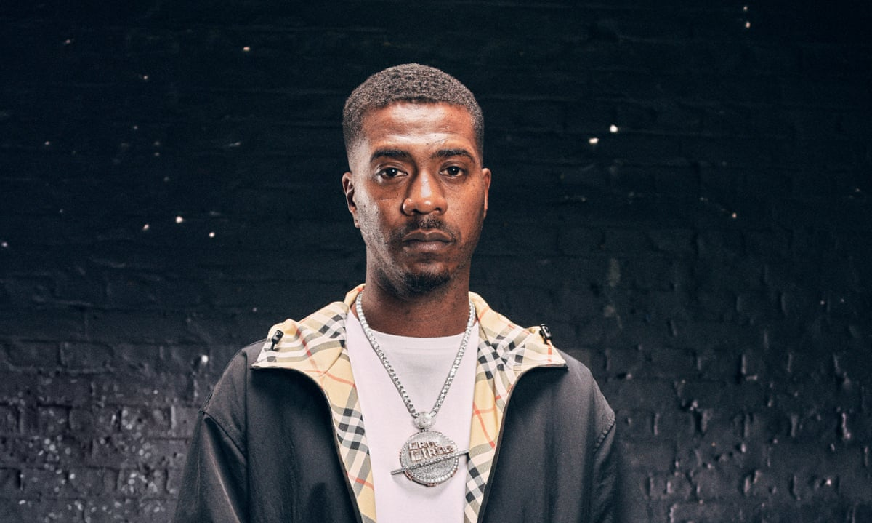
Knives and Glamour
“Mad About Bars” - Nines ft. Fredo
“I got my knife on me, don’t make me come out the flat / Young G’s tryna make it with the shank in the back”

Slide 6
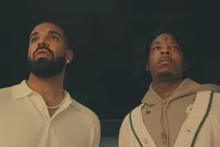
Knives and Glamour
“Knife Talk” - Drake & 21 Savage ft. Project Pat
“Real killers don’t speak, they let the weapons talk / If it’s up we gon slide, we don’t get no talk”

Slide 7
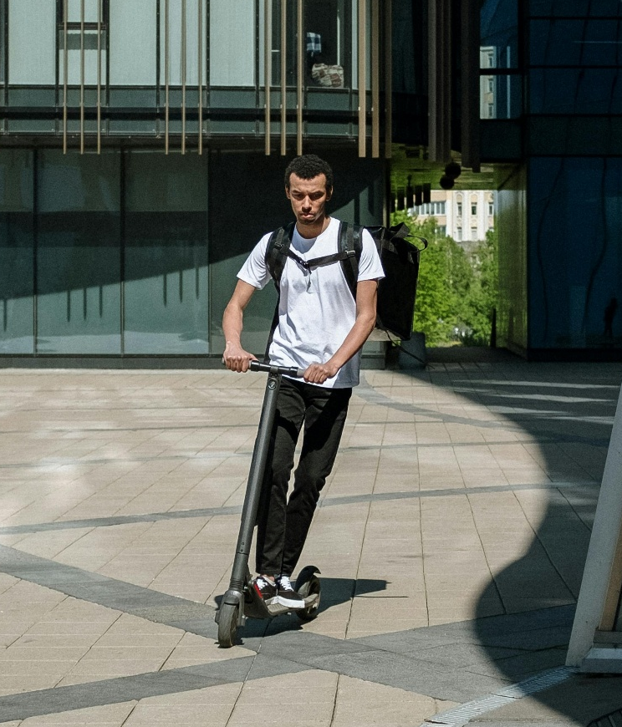

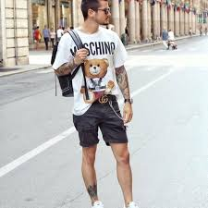
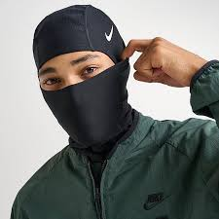
Knives and Glamour
Streetwear & Fashion
Branded tracksuits
Balaclavas, Ski Masks
Designer Belts
Electric Scooters

Slide 8
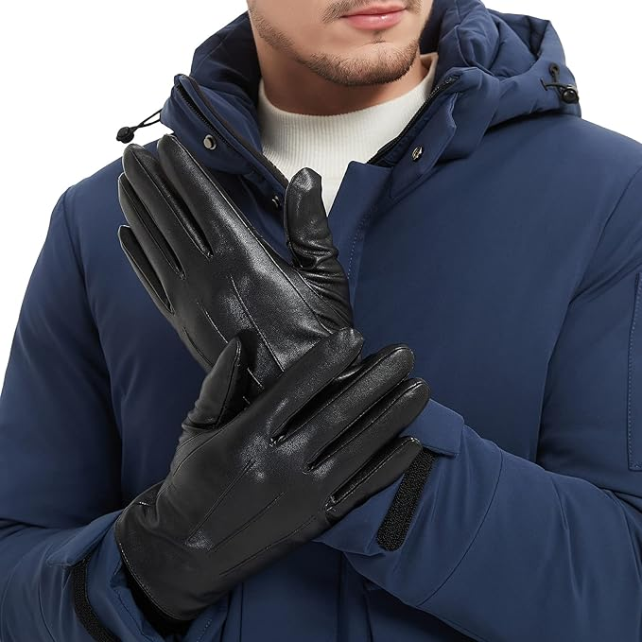
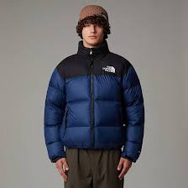
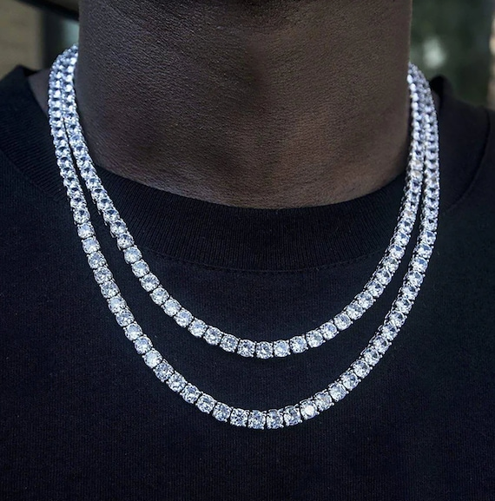
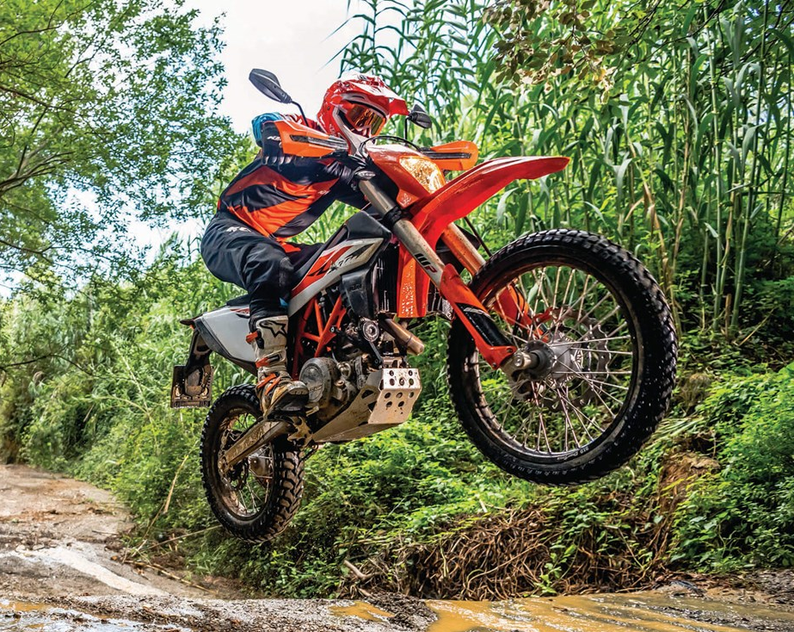
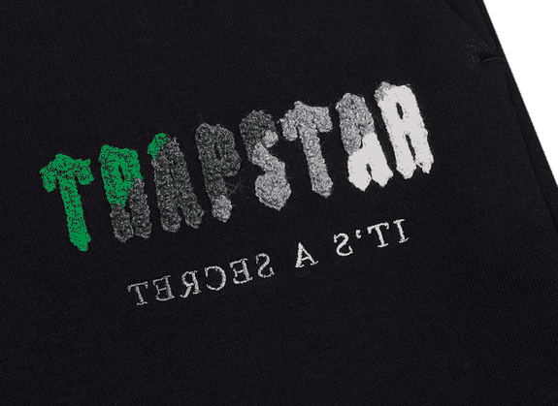
Knives and Glamour
Streetwear & Fashion P2
Black Gloves
Puffer Jackets
Diamond jewellery
Trapstar brand
Off road bikes

Slide 9
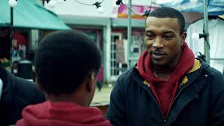
Knives and Glamour
Popular TV scene 1: Top Boy
Dushane pressures a Young Recruit
Season 1, Episode 2

Slide 10
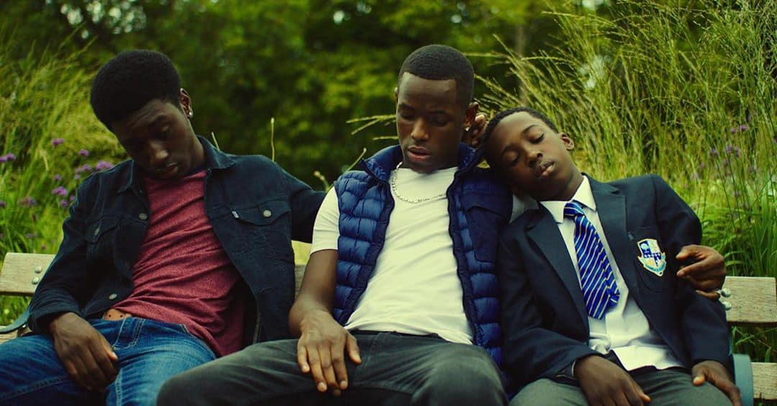
Knives and Glamour
Popular TV scene 2: Top Boy
Jamie gets arrested in front of his brothers.
Season 3, Episode 10

Slide 11
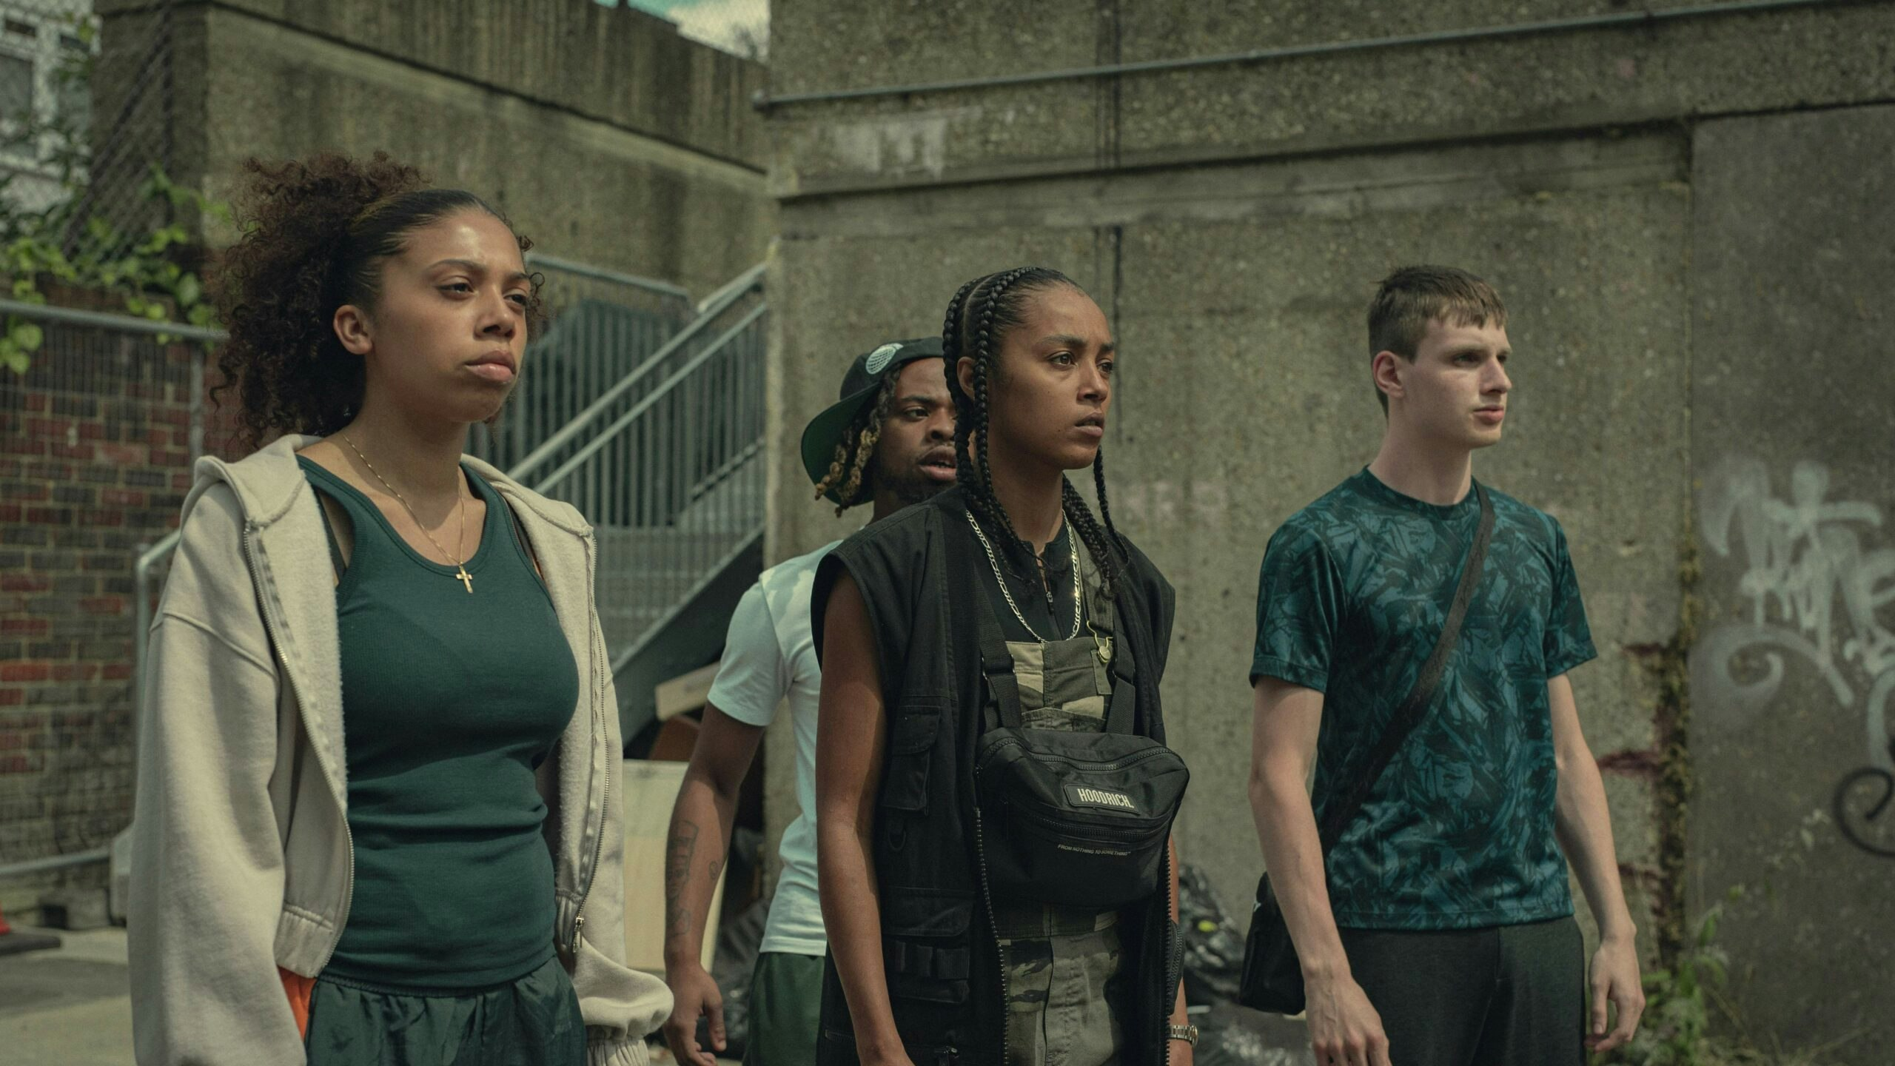
Knives and Glamour
Popular TV scene 3: Top Boy
A stabbing leads to retaliation
Season 3, Episode 6

Slide 12
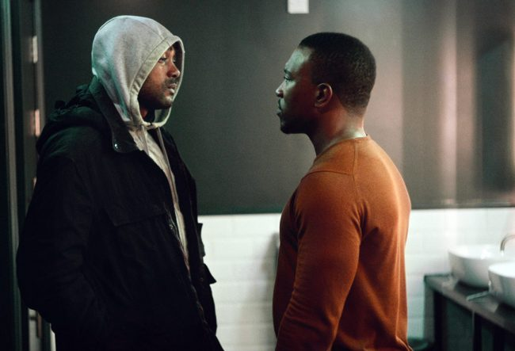
Knives and Glamour
Popular TV scene 4: Top Boy
A character tries to leave
the gang but faces threats
Season 2, Episode 3

Slide 13
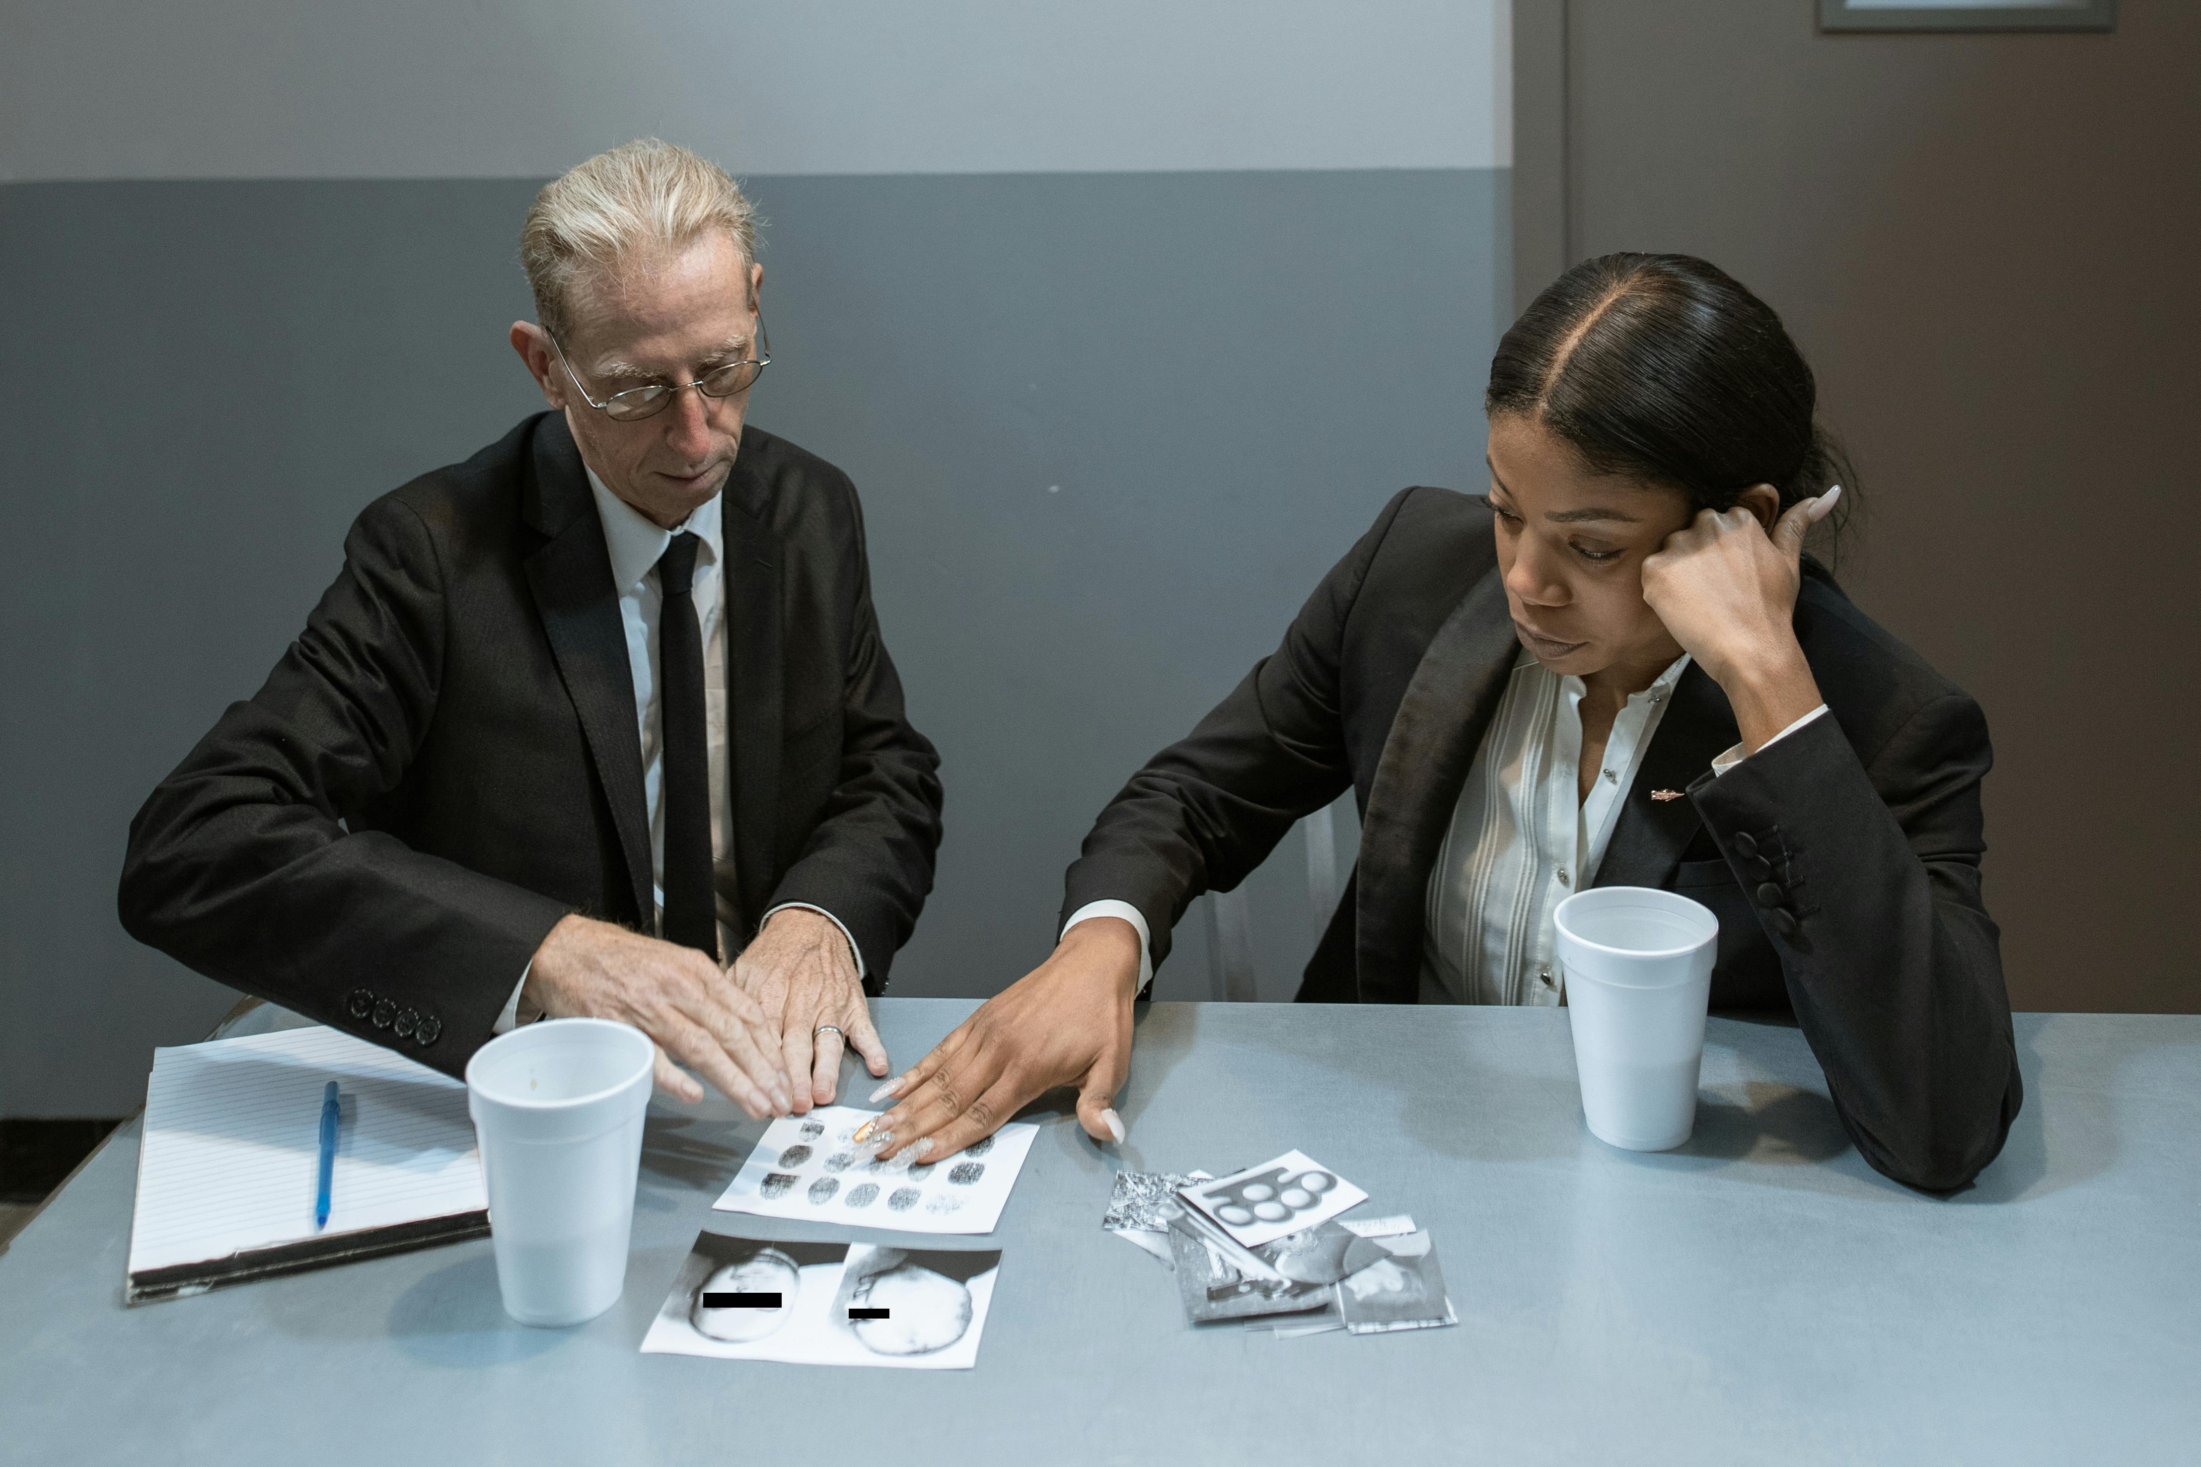
Consequences in Action
Part 1

Slide 14
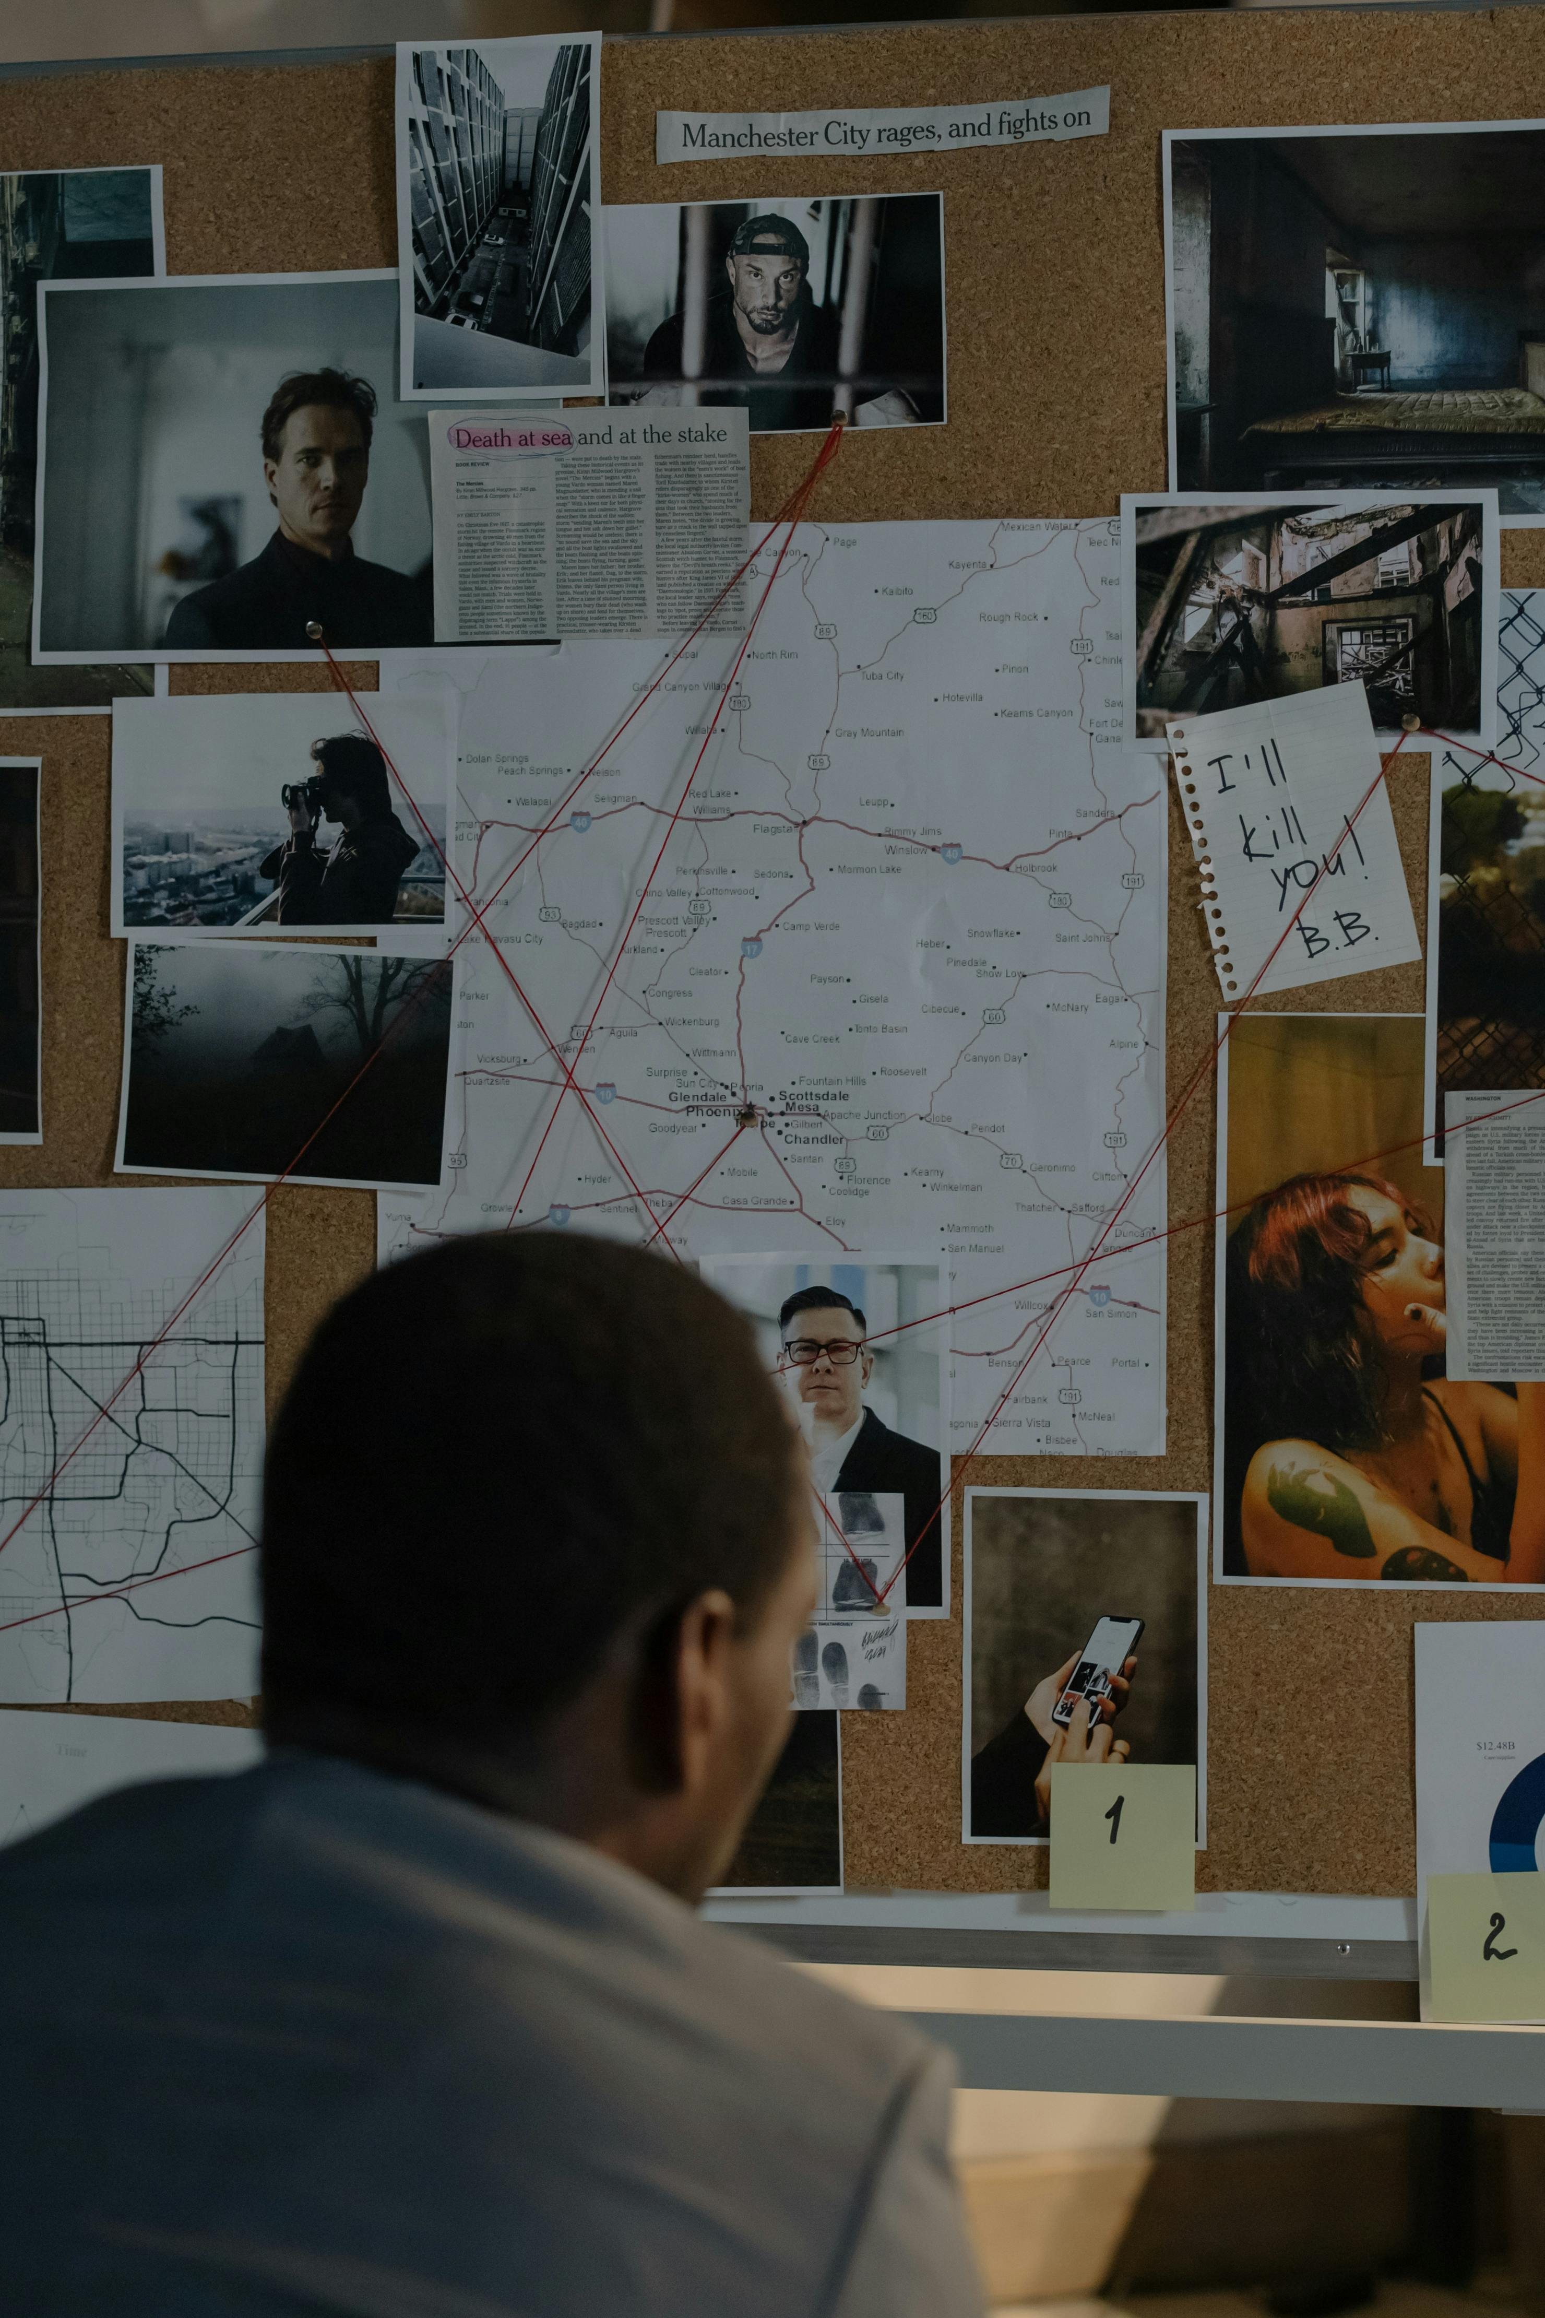
Consequences in Action
Part 2

Slide 15

Consequences in Action
Part 3

Slide 16
Final Thoughts
Watch this video, (00:28 to end)
https://youtu.be/b6kDLN4zfnM?si=uduRedS8VP1kYBvT&t=28

