Slide 1
EPKCE KS3 Lesson 2
Ripple Effect, Gangs, Conflict and Resolution

Slide 2
Lesson Summary
Section | Timing | Content
Starter | 5 mins | Starter: Post-it note challenge. Every student to have 3 post it notes. Students to answer each question on a different post it note and come to the front of the classroom once they are all completed and stick them on the board. Teacher to divide the board into 3 sections titled question 1, question 2 and question 3. Students to place the post it note to the relevant place on the board. If any students cannot think of a response to a question, they can pop their name on another student’s response if they agree with their answer.
Task 1 | 5 mins | White board task. This task is ideal for staff to gather student’s views, thoughts and opinions. Teacher can read each statement out loud, and the students write either 1 (strongly agree), 2 (agree), 3 (not sure/don’t know), 4 (disagree),or 5 (strongly disagree). Allow time for individual thinking time to ensure students have reflected and thought about their response.
Task 2 | 10 – 15 mins | Introduce the 3 Rs. Explain to students that instinctively many of them will do this in any given situation or scenario. Teacher to read each scenario out to the students. Can they recognise the situations? How would they respond? How can the situation be resolved? This activity could be done through small group discussions or use a role play activity.
Task 3 | 10 mins | Students to make a list and describe the types of conflict they have witnessed and/or been part of. Students to select one of their answers and explain how they responded and if that was appropriate. Could they have responded differently? How was the situation resolved? Has it been resolved? If not, why not?
Task 4 | 10 mins | Think, pair and share task – handling arguments or fall outs. Give students thinking time. Allow students to share their thoughts and views with a partner. Students to share their discussions with the class.
Task 5 | 8 mins | How would you respond to these messages on your chat group? Write a text message back. It will be important here to send out a clear message not to incite, promote and/or encourage violence/inappropriate actions or messages. Opportunity to share news stories from Summer 2024 about the riots that caused unrest in communities with people arrested and charged for inciting, commenting and encouraging behaviour which resulted them in being charged by police.
Plenary Task 6 | 7 mins | Review class pledge from lesson 1. Are there any action points/pledges that the students would like to add? Does a new class pledge need to be written? Signposting slide.

Slide 3

Starter
Let us look back at lesson 1
What does the law state about carrying a knife or weapon?
What is joint enterprise?
Who is impacted as a result of knife crime?

Slide 4
Introduction and lesson objectives
Lesson objectives:
For students to explore knife crime in and around their communities.
Students to have open and meaningful discussions around knife crime and explore their thoughts and opinions.
To challenge the idea that telling someone or seeking help for a friend is wrong.
Students to understand the 3R’s of conflict resolution. Recognise, Respond and Resolve.
Students to understand that conflict resolution is crucial to reducing knife and other violent crime.

Slide 5
Task 1 : Whiteboard task
How far do you agree with the following statements
Do you…
1 = strongly agree | 2 = agree | 3 = not sure/don’t know | 4 = disagree | 5 = strongly disagree
Write either 1, 2, 3, 4 or 5 on your white board.
It’s not a big deal to carry a knife.
Carrying a knife is dangerous.
You can’t get into trouble for carrying a knife.
It is important to take steps to protect yourself.
If someone I know is carrying a weapon and they told me not to tell anyone, I would not speak to anyone about it.
I have seen teenagers carry a knife on social media.
Notes:
Teacher to read out each statement and display it on the screen. Students to use whiteboard and write the number that best reflects if they strongly agree, agree, not sure, disagree and strongly disagree.

Slide 6
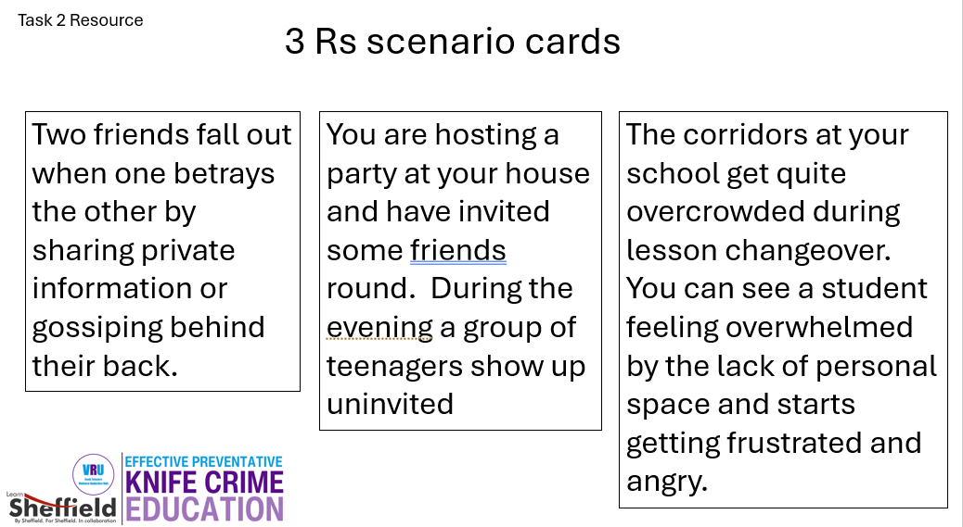
Task 2 : Conflict and Resolution
Scenario card (handout on last slide)
The 3 Rs… Recognise Respond Resolve
Using the 3 Rs:
Can you recognise the situation in these scenarios. What are the possible risks?
How would you respond?
How could the situation be resolved?

Slide 7
Task 3 : Conflict and Resolution
Conflict is an inevitable part of all our lives. It can vary from harmful to devastating if handled badly. If handled well, it can lead to better understanding and increased tolerance.
Make a list of the different types or forms of conflict that you have witnessed, seen in the media or social media or been part of yourself.

Slide 8
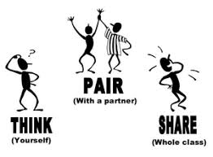
Task 4 : Think, Pair, Share Task
How do you handle arguments or fall outs?
Does it depend on who the argument/fall out is with?
30 seconds to think by yourself
3 minutes each to share your thoughts and views with your partner
Let’s hear from you…

Slide 9
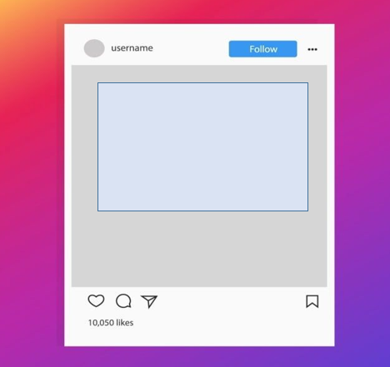
How would you respond to these messages on your chat group? Write a text message back
Task 5 : Responding on Social Media
Hey, you know that group who hang round the rec near where we hang out? I heard one of them carries a knife
Hey, u ok? I saw Bethany absolutely loose it with you earlier. She was so angry, I would have been so scared. What u gonna do?

Slide 10
Task 6
Our Class Pledge
(SYVRU logo)
(EKCPE logo)
Name of School ……………………………………………..
Class name ……………………………………….
By signing this pledge, we make a promise to our school, friends, family and ourself to:
Never carry a knife or any type of weapon that could cause harm to anyone.
Never accept or remain silent about knife crime.
Report anyone carrying a knife to a trusted adult.
Always strive to behave in a non-violent manner.
Sign your name here:
Date: ………………………………………
Example of a class pledge.
Every student to sign their name here to show they a willing to make the pledge.

Slide 11
Signposting
If you are worried about anything you have heard in today’s lesson, please speak to trusted adult. Knife crime is very rare but very real.
We can work together to make good decisions and keep ourselves and others safe.
If you are concerned about knives or other weapons that your friends or any other family member might have, these are the people who can help you.
Teachers and any other school staff that you trust
Family
Friends
Youth workers, sports/out of school activity coaches or tutors
The Police
Childline 0800 1111
Fearless

Slide 12
3 Rs scenario cards
Task 2 Resource
Two friends fall out when one betrays the other by sharing private information or gossiping behind their back.
You are hosting a party at your house and have invited some friends around. During the evening, a group of teenagers show up uninvited.
The corridors at your school get quite overcrowded during lesson changeover. You can see a student feeling overwhelmed by the lack of personal space and starts getting frustrated and angry.

