Slide 1
EPKCE KS3 Lesson 1
The Causes and Effects of Knife Crime,
The Law and Joint Enterprise.

Slide 2
Lesson 1 Summary
Lesson section | Timing | Content
Starter | 8 mins | Think, pair share task – places in your community where you feel safe. Teacher to question – why do you feel safe there and what makes those areas safe? Independent task – who makes you feel safe? Partner work – area in your community where you do not feel safe.
Lesson aims/objectives and background information including ground rules | 5 mins | Share the lesson objectives slide. Share some background information and latest statistics. Share the ‘Ground Rules’ slide.
Task 1 | 8 mins | Post-it note task. Why do some young people carry a knife? Share slide with possible answers for the class to check.
Task 2 | 5 mins | Discussion task about why males are more likely to carry a knife than females.
Task 3 | 5 mins | The law Joint Enterprise
Task 4 | 4 mins | Stop and Search. How would you feel if you were stopped and searched by the police or teachers in your school? How would you feel if that happened to your friend whom you were with at the time?
Task 5 | 5 mins | Nisah and Alex scenario/story. What would you do if you were Nisha?
Task 6 | 8 mins | Consequences. Mini-white board task.
Task 7 - Plenary | 7 mins | Create a class pledge.
Signposting | 5 mins | Slide to show who can help you and where to go for help and advice.

Slide 3
Starter
Retrieval/follow on from KS2 lesson
(Applicable whether students have received/understood the KS2 EKCPE lessons or not).
Think, pair share task
Think about all the places in your community where you feel safe. Make a list of these places. Share your list with a partner. Do you agree with your partner’s list?
Teacher question to students
Why do you feel safe in those areas? What makes those areas safe?
Independent student task:
Next to the list of places you feel safe, make a list of all the people who make you feel safe in these areas.
Share with a partner places/areas in your community where you do not feel safe. Explain your reasons.

Slide 4
Introduction and lesson objectives
Lesson objectives:
For students to explore knife crime in and around their communities.
For students to consider reasons why a young person may carry a knife.
Students to have open and meaningful discussions around knife crime.
Students to understand the law around carrying a weapon, the law around Joint Enterprise and Stop and Search.
Students understand the far-reaching effects of knife crime.

Slide 5
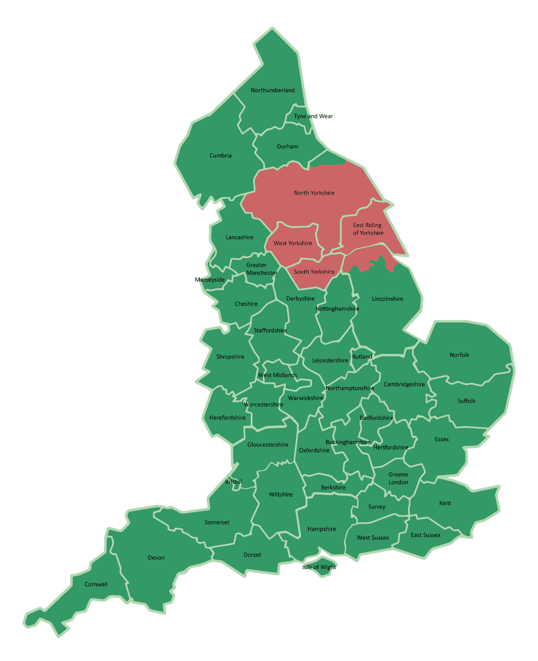
Introduction/background to the lesson
What is the definition of Knife Crime?
“A knife crime is when a knife or other sharp or sharpened object is used to hurt somebody, or threaten them into doing something, such as in an assault, a robbery or (more rarely) a sexual offence”
97 per 100,000
Regional Comparisons
116 per 100,000
104 per 100,000
In the last 12 months in South Yorkshire, there have been 104 per 100,000 population knife crimes recorded. This compares to 185 per 100,000 in Greater London, 165 per 100,000 in the West Midlands, and 116 per 100,000 in Greater Manchester, and 97 per 100,000 in West Yorkshire. This does still place South Yorkshire as one of the highest regions for Knife Crime.
185 per 100,000

Slide 6
Ground rules
Everyone has the right to be heard and respected, so listen to what others say and show respect by not talking over people.
Use language that will not offend or upset anyone and avoid stereotypes.
When you give an opinion, try to explain your reasons.
If you disagree, do so with what is said not with the person who said it.
We will not judge people or make assumptions about them.
Do not share personal information or stories about other people. Always make that person anonymous. This may also be wise if the story is about you.
We won’t put people on the spot. Everyone has the right not to comment.
If you’re worried about something that has happened to you or a friend, talk to a member of staff or an adult you trust, after the lesson.
If a member of staff becomes aware of a risk to a young person’s safety, this information may need to be shared.

Slide 7

Task 1
Why do you think some young people carry knives?
Using one post it note per response, write your answers and come up to the front and stick your notes on the board.
(Responses can be sorted into groups of similar/same responses by the teacher)
Summarise results and findings with the students, discuss the most popular answers

Slide 8
Young people may decide to carry a knife because:
They believe it provides protection/self defence
To instil fear in others
They feel scared or fear other people
It makes them feel tough
They believe it earns respect
They think people will like them more
Peer pressure
Carrying it for someone else such as an older person
(police wouldn’t suspect a young person carrying a knife)
They want to take revenge.

Slide 9

Task 2
Paired discussions:
“Knives make you feel safer” (male aged 13)
Why do you think this is? Discuss.
Males are more likely to carry a knife than females.
From 2020 to 2024, 83% of known suspects were male.
Why do you think this is? Discuss.
Males are therefore the biggest victims of knife crime.

Slide 10
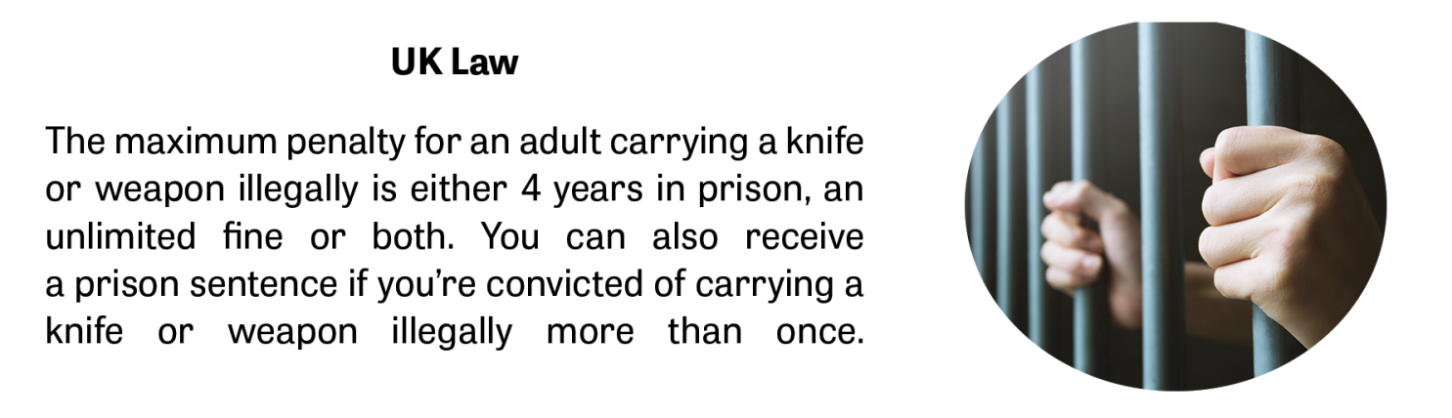
Task 3 - The Law
A criminal record can affect someone getting a job or travelling to a different country.
What is the current law around carrying a knife?
(Source: Ben Kinsella Trust)

Slide 11
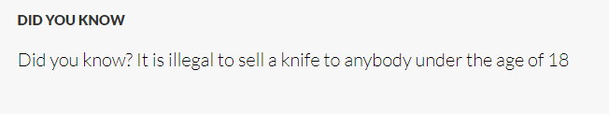
The Law
You can be stopped and searched by the police, if you are 10 years or over, if the police believe or suspect you are carrying a knife
Teachers can search you if they have information that you are carrying a knife.
If you are caught carrying a knife you can face 4 years in prison
If you kill someone using a knife you will get the minimum sentence of 25 years.
If you are with someone that uses a knife you can be convicted under the ‘joint enterprise’ law. This is a law where a group can be charged for being involved in some way even though they were not the ones that actually committed the crime. The sentence for joint enterprise has been raised over the years

Slide 12
There are some genuine reasons that someone may need to carry a knife:
Can you think of any genuine examples when a person may legally carry a knife?
They have just purchased a kitchen knife from a shop, and they are older than 18 years old. It is still cased in packaging/protection.
They are going fishing, and they need a small knife as part of their fishing equipment. Stored safely in their equipment.
They need a specific type of knife for their job like a chef or carpenter.

Slide 13
What is Joint Enterprise?
Joint enterprise is a section of the law that allows two or more people to be convicted of the same crime even though they had differing levels of involvement.
For example:
A group of 5 teenagers were involved in a stabbing of another person. One of the teenagers was convicted of murder and the other 4 were charged under joint enterprise as they knew the teenager had a knife and that he intended to use it. However, all 4 did nothing to prevent this from happening and helped him flee the scene.
Someone convicted of joint enterprise could have played a number of roles, such as;
Providing the weapon.
Arranging the meeting between the victim and perpetrator.
Assisting the perpetrator with fleeing the scene.
Think about who your friends are and what they do. Could they get you into trouble?

Slide 14
Stop and Search
Police have the power to stop and search any person if they have ‘reasonable grounds’ to suspect that person may be carrying something on them that is against the law or could cause harm to others. This could include illegal drugs, a knife or weapon, stolen items or an item that could be used to commit a crime.
Examples of ‘reasonable grounds’ could include:
A member of the public has told a police officer that someone is carrying something they shouldn’t be
Somebody matches the description of someone they are looking for.
When an officer conducts a stop & search there are a number of steps they must take during the process.
Task 4:
How would you feel if you were stopped by the police or in school by somebody and explained that a bag search was going to be carried out?
Notes:
They must: • Let the person they are searching know their name and police station or show them their warrant ID card • Explain to the person the reason why they are being stopped and searched and the law in which this falls under • Give the person a written record of the stop & search, or notify them of where they can collect this record later A stop & search is not voluntary. If a person refuses a stop & search, then police can use reasonable force to conduct a search, or the person may be taken to a police station for the search to be conducted

Slide 15
Task 5: Read the situation below and answer the following questions using your own thoughts and opinions.
Imagine a young person of about your age called Nisah, who is hanging out with their best friend Alex.
Alex says, ‘Do you want to see what I have got?’
‘What is it?’ Nisha replies.
Alex takes something from their pocket. ‘Look – I got a knife from my brother. It’s only small. I am going to carry it with me all the time.’
‘Why would you want to do that?’ Nisah asks.
‘You mustn’t tell anyone it’s a secret. Promise me you won’t tell anyone. I could get into trouble.’ Alex says.
Why do you think Alex is carrying a knife?
2. What should Nisah do?

Slide 16
Task 6
Mini-white board task
Your family and friends
In 4 groups, choose 1 category.
List on mini-white boards as many consequences as they can on knife crime to their given category/person.
Hold up your mini-white boards after 5 mins.
You
Communities
Victims

Slide 17
Plenary
Task 7
Our Class Pledge
(SYVRU logo)
Name of School ……………………………………………..
Class name ……………………………………….
By signing this pledge, we make a promise to our school, friends, family and ourself to:
Never carry a knife or any type of weapon that could cause harm to anyone.
Never accept or remain silent about knife crime.
Report anyone carrying a knife to a trusted adult.
Always strive to behave in a non-violent manner.
Sign your name here:
Date: ………………………………………
Students can sign their name here to show they a willing to make the pledge.

Slide 18
Signposting
If you are worried about anything you have heard in today’s lesson, please speak to trusted adult. Knife crime is very rare but very real.
We can work together to make good decisions and keep ourselves and others safe.
If you are concerned about knives or other weapons that your friends or any other family member might have, these are the people who can help you:
Teachers and any other school staff that you trust
Family
Friends
Youth workers, sports/out of school activity coaches or tutors
The Police
Childline 0800 1111
Fearless

