Slide 1
Healthy eating
Notes:
Hello everyone! Our assembly today is going talk about healthy eating.

Slide 2
How do you feel when you’re hungry?
Notes:
How do you feel when you’re hungry? Think in your head of some sensations that you feel when you’re hungry

Slide 3
Grumbling tummy?
dizzy?
grumpy?
tired?
Hard to concentrate?
Low energy?
Notes:
Do you feel dizzy or tired? Does your tummy grumble and feel empty? Maybe you feel gumpy, low on energy and find if hard to concentrate?

Slide 4
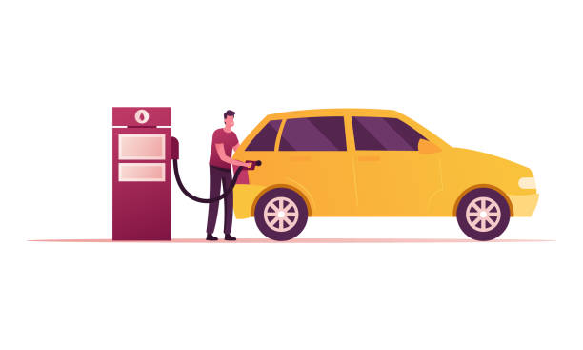
This is because our body needs energy to survive, a little bit like a car
Notes:
When cars are low on energy (fuel), they slow down and grumble and sometimes stop completely

Slide 5
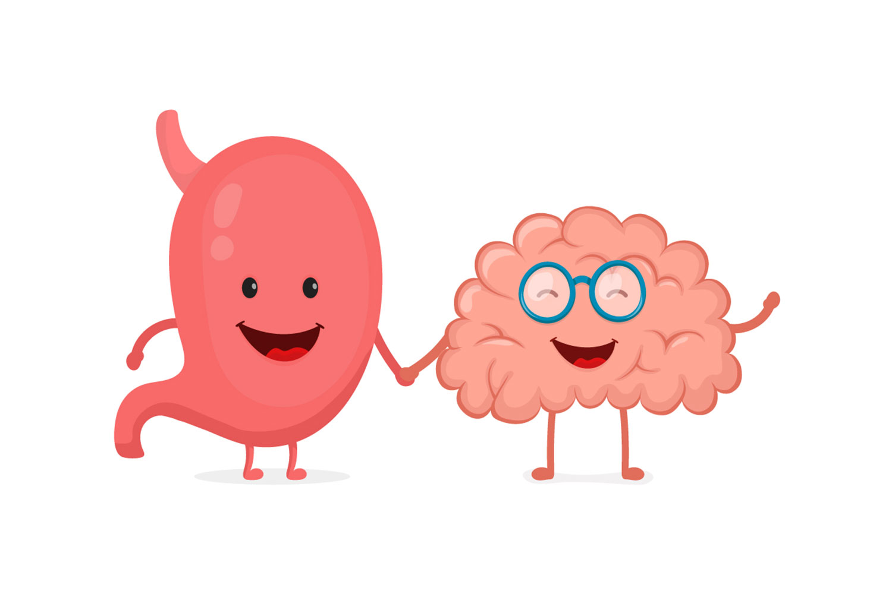
Our bodies are very clever
Notes:
Our bodies are very clever and they like to look after themselves, so they will make you feel these “hunger” sensations to tell you that you need to eat, so it is always important to respond to these feelings, and fuel your body with healthy food.

Slide 6
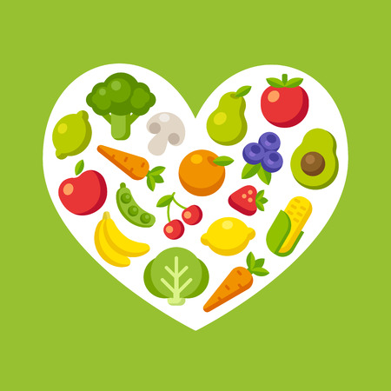
It’s not just about energy...
Notes:
But it’s not just about eating when you’re hungry… it’s just as important to eat healthy foods, that make your body feel good and help it to work properly.
Just like how a car needs a certain type of fuel to work properly, our bodies need healthy, nutritious foods in order to function.

Slide 7
So, we need to eat a balanced diet to keep our bodies happy

Slide 8
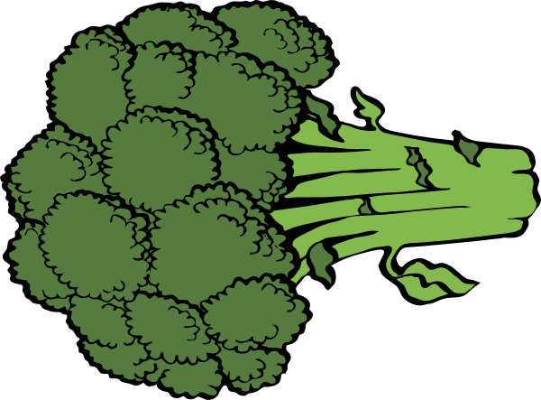
What is a balanced diet?
A balanced diet means that you don’t have too much of one thing, but you have a good mixture of everything
You couldn’t survive on just cake
You couldn’t survive on just broccoli
Notes:
A balanced diet means that you don’t have too much of one thing, but a mixture of everything.
You couldn’t survive only eating cake, and you couldn’t survive only eating broccoli.
Its bad to have too much of one thing, because you don’t get all the nutrients, vitamins and minerals that your body needs to survive

Slide 9
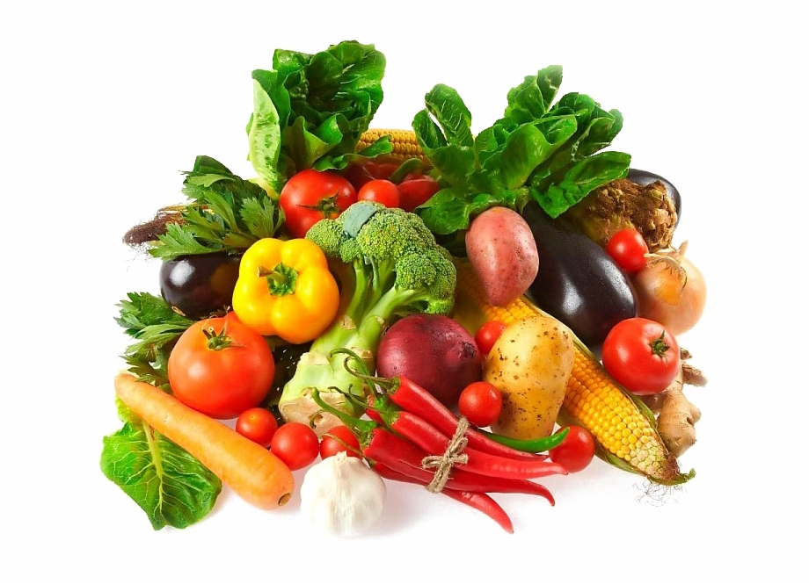
What are nutrients? Why do we need them?
Nutrients are part of foods. Some are really small, and these are micronutrients.
Notes:
Nutrients are part of foods, some are really small, so small that we cannot see them, these are micronutrients.

Slide 10
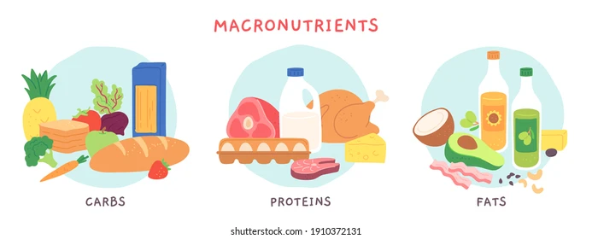
And some are bigger, these are...
Notes:
And some bigger nutrients, these are called macronutrients
There are three macronutrients within our diets: carbs, proteins, and fats.
A good balance of these macronutrients in our diets will provide us with energy, build strong and healthy muscles, and help our brain to work properly!

Slide 11
WHAT ARE SOME TIPS FOR EATING balanced diet and getTING all our nutrients?
Notes:
So, what are some tips for eating a balanced diet, and getting all of our macro and micro nutrients?

Slide 12
BY EATING THE RAINBOW!
Notes:
We should always try and eat our 5 a day, which means 5 portions of fruits and vegetables every day. Our five a day should be all different colours of the rainbow to make sure we are getting all the different nutrients

Slide 13
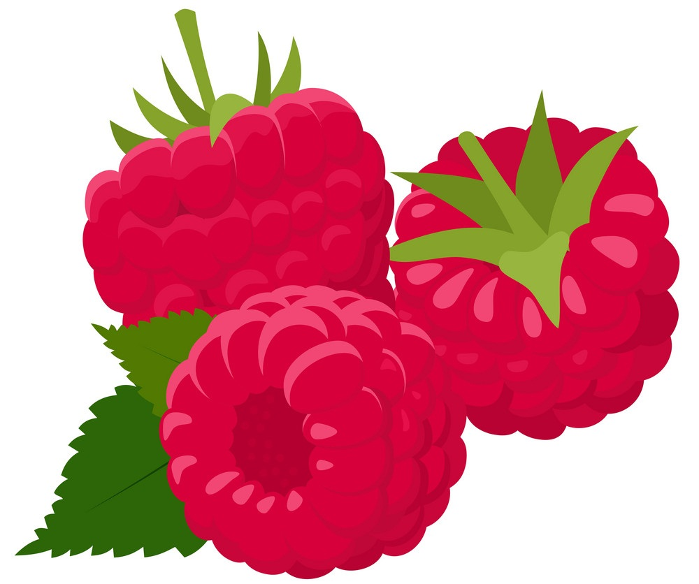
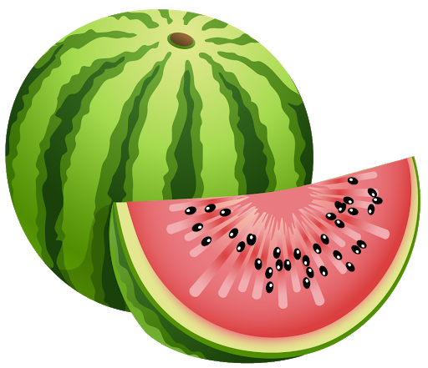
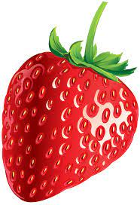
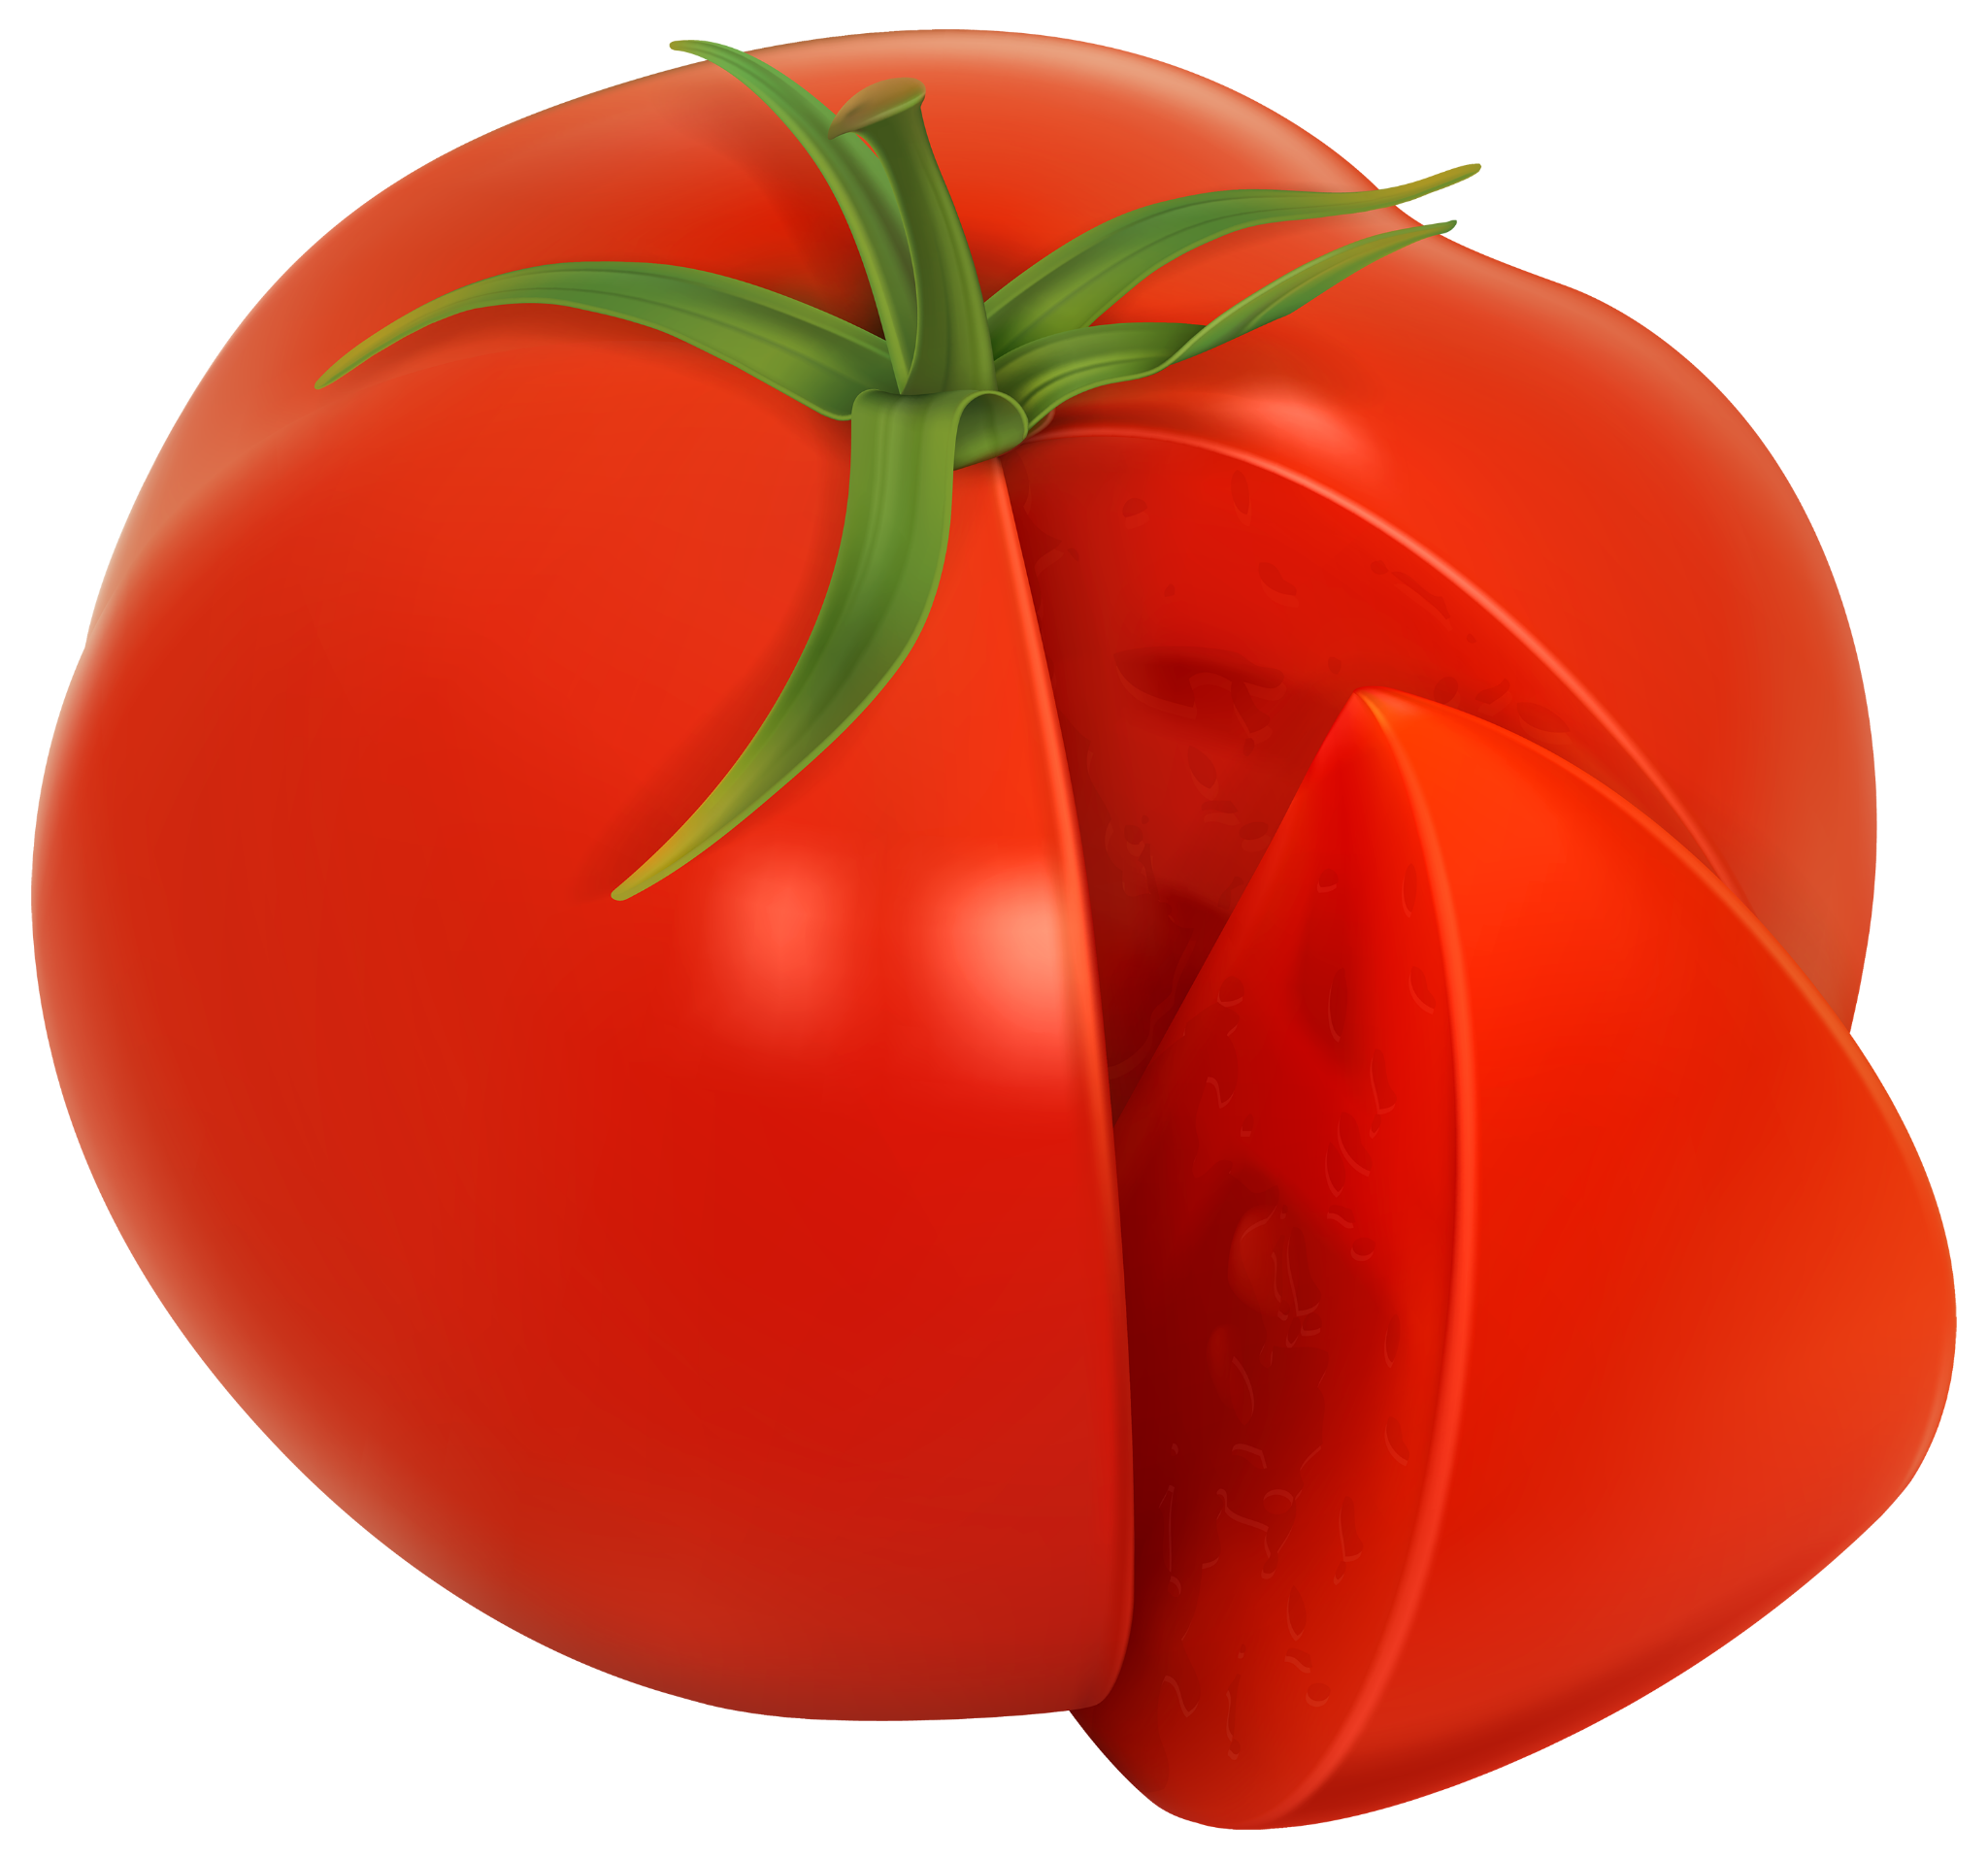
RED!
Notes:
Can you name all these fruits and vegetables? We have raspberries, watermelon, red pepper, cherries, tomatoes and strawberries
*click* to make heart come up
These foods are good for our heart and stop your heart from getting poorly

Slide 14
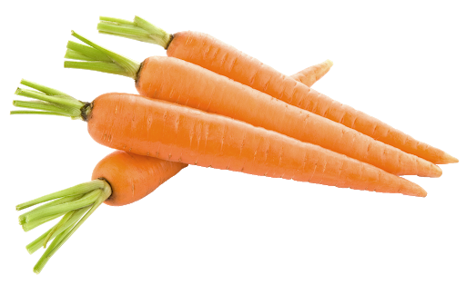
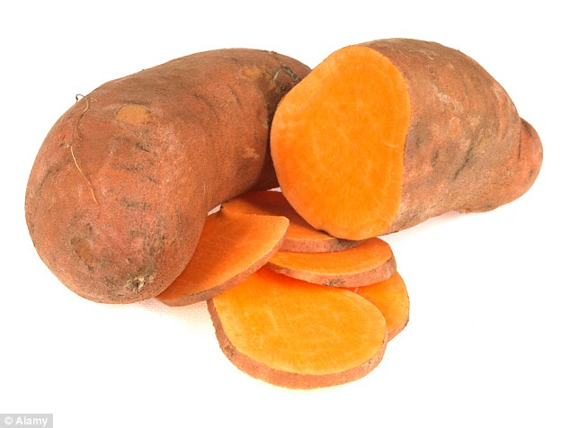
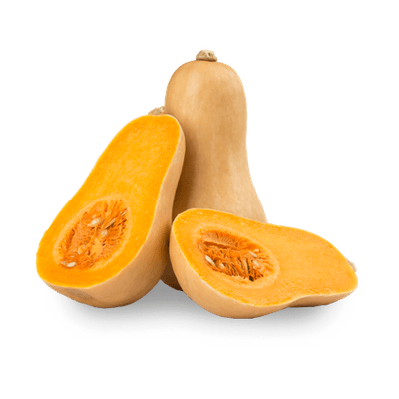
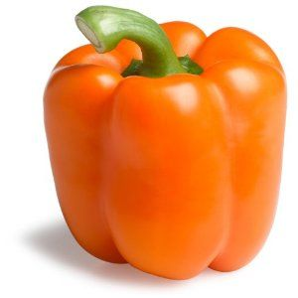
ORANGE!
Notes:
You can eat orange foods like carrots, sweet potato, butternut squash, orange peppers, and even pumpkin!
Have you heard of anyone say “carrots make you see in the dark”?
Well its kind of right
*click for image*
Orange foods can really help with keeping your eyes happy and healthy, and can help you see better in the dark!

Slide 15
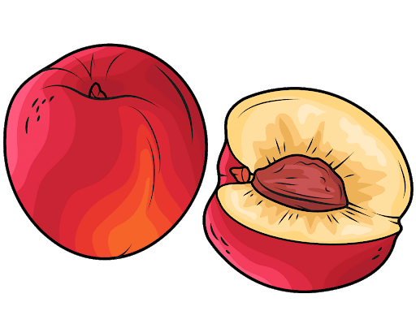
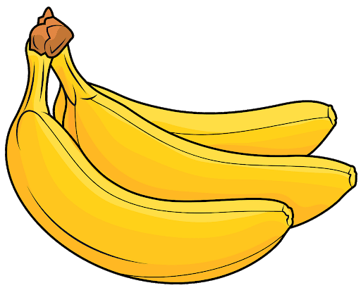
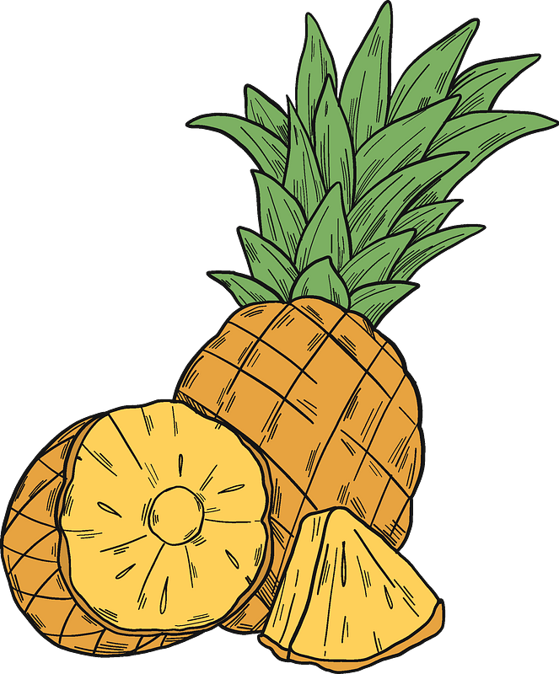
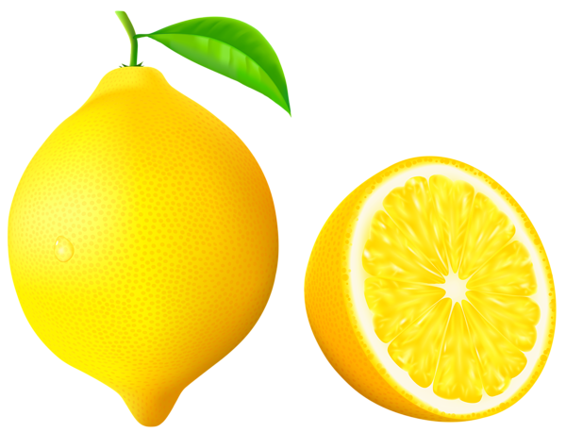
YELLOW!
Notes:
Yellow foods help our immune system and our skin.
Having a happy immune system means that we get less coughs and colds

Slide 16
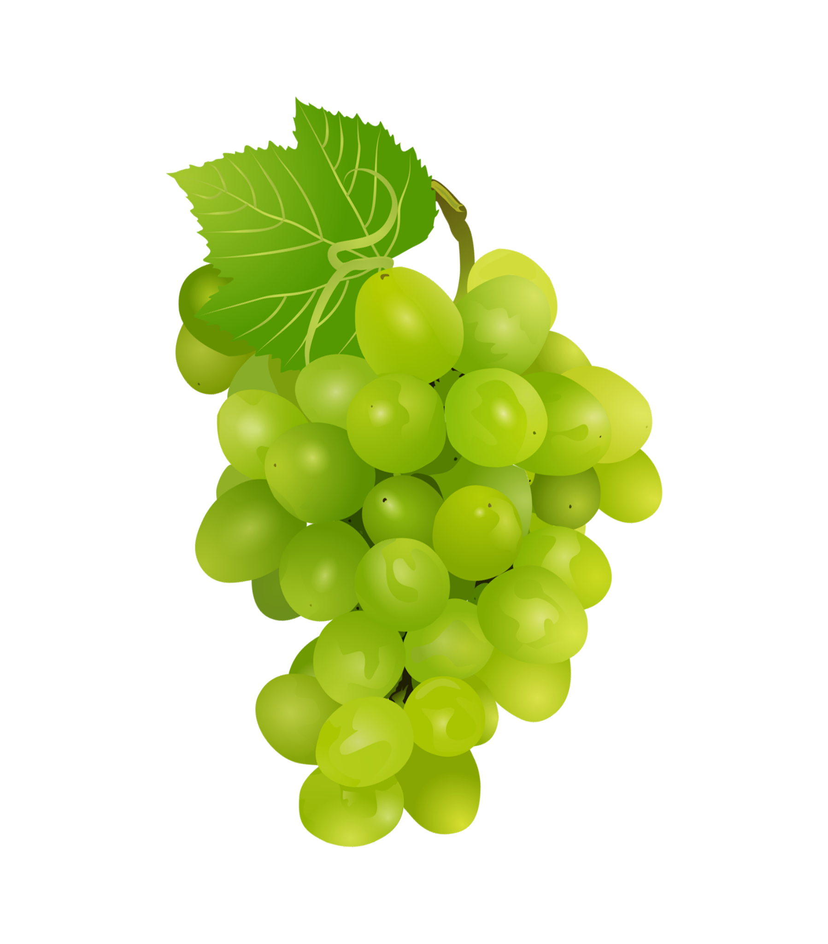
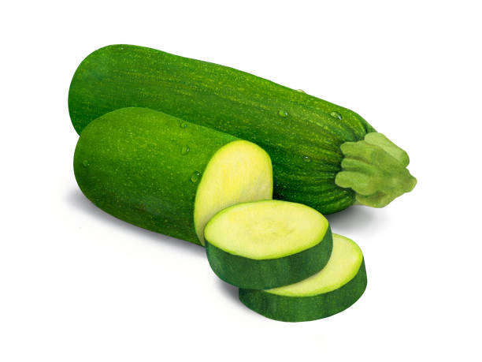
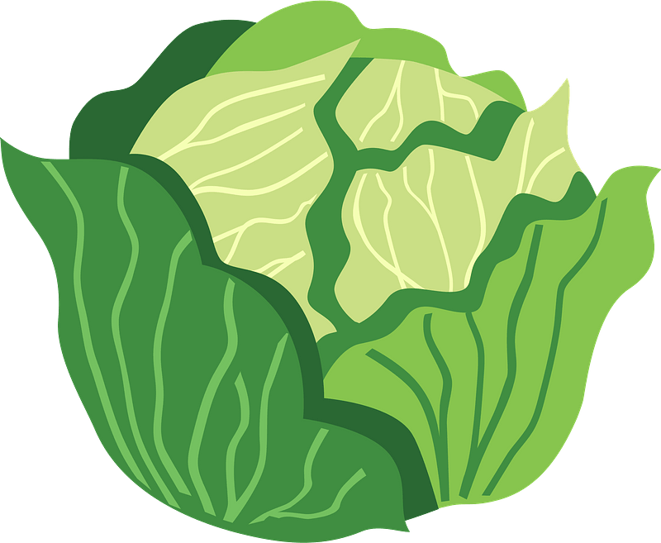
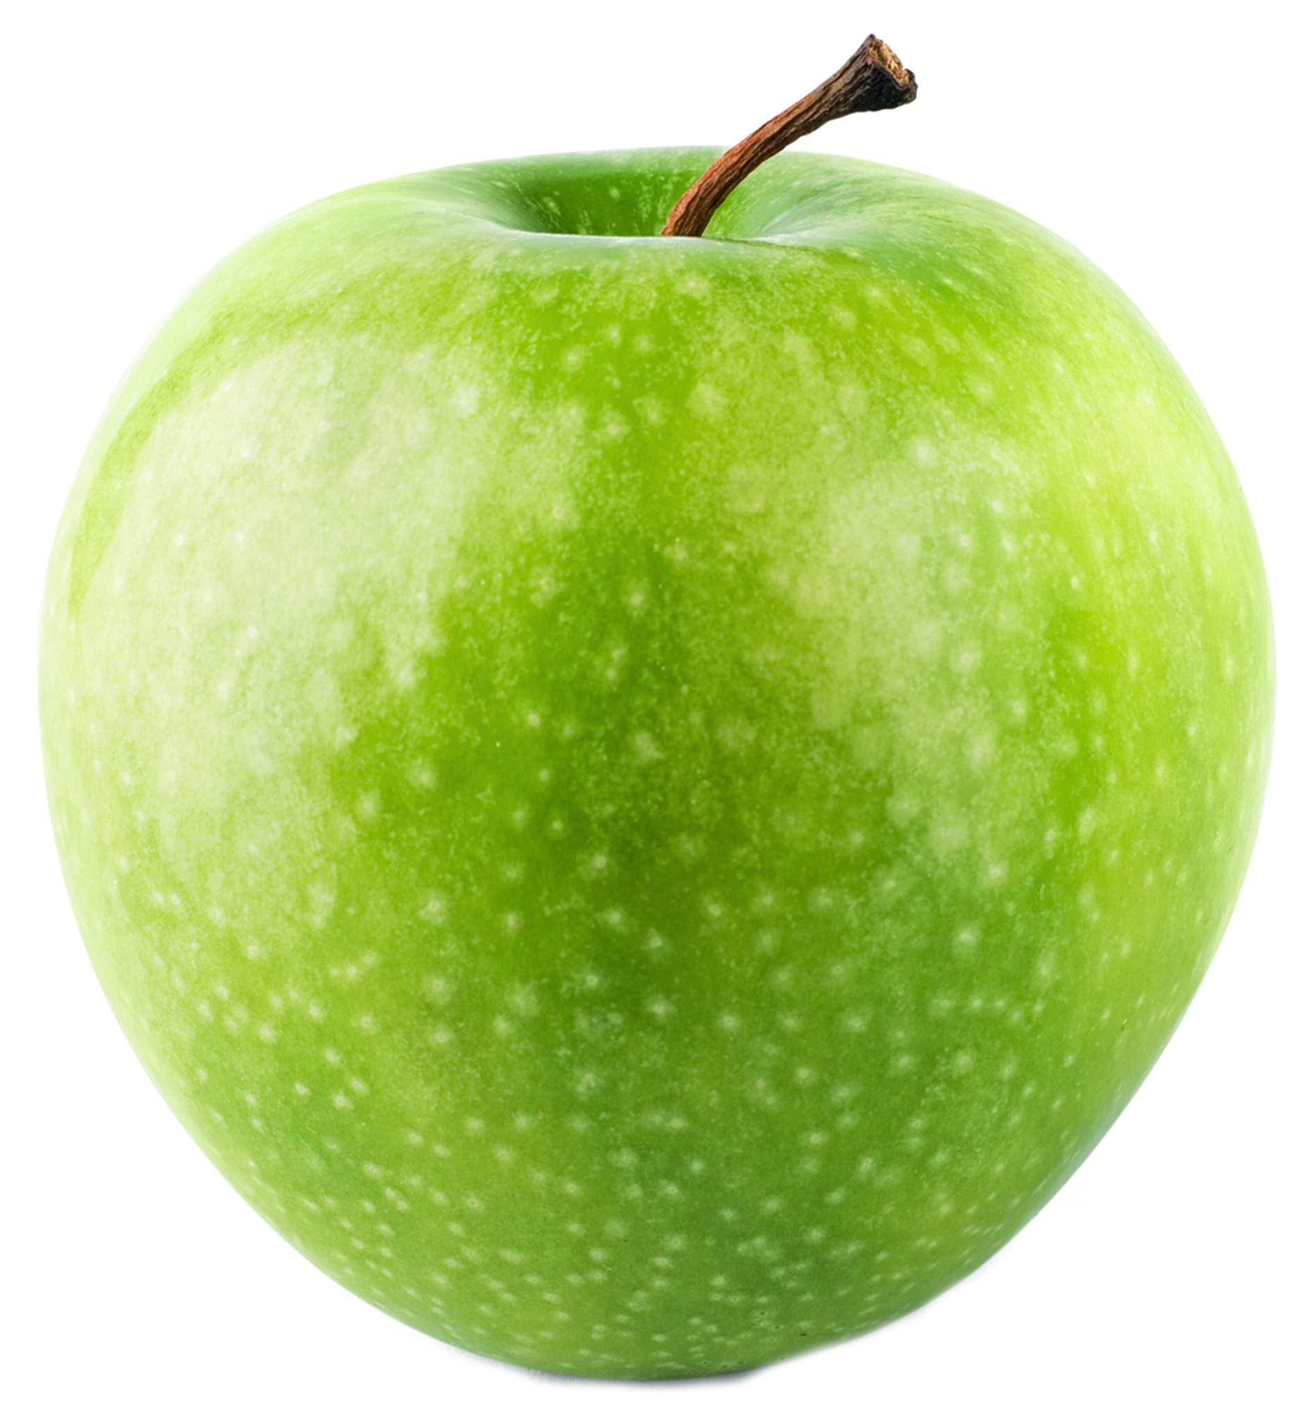
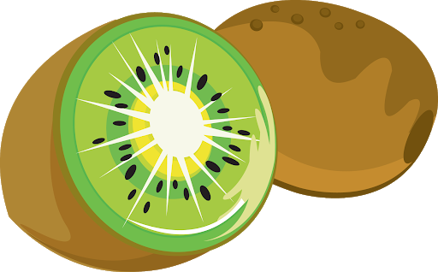
GREEN!
Notes:
Green foods contain something called “anti-oxidants” which protect us from getting very poorly, especially when we get older. Lots of green vegetables also contain calcium, which helps our bones to grow, and to stay strong and healthy.

Slide 17
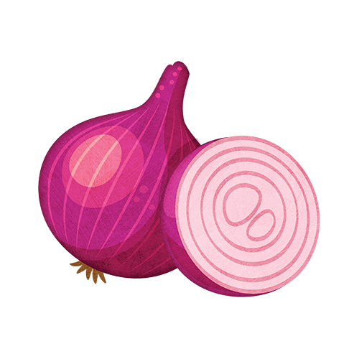
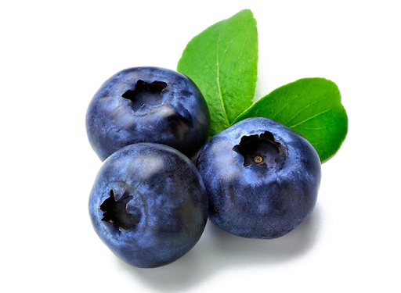
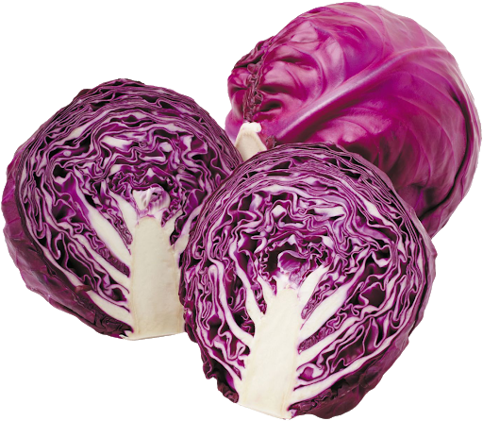
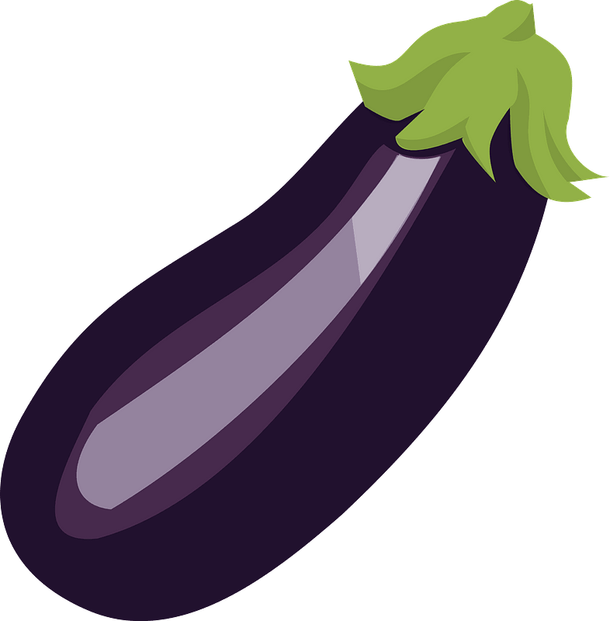
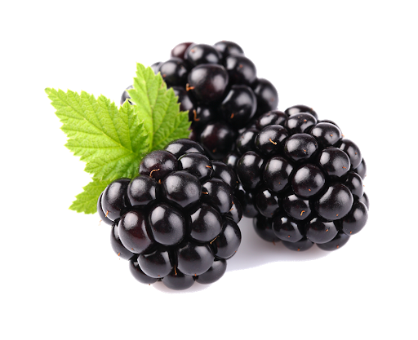
BLUE + PURPLE!
Notes:
Blue and purple foods are good for our memory and our brain, they also contain anti oxidants like green foods.

Slide 18
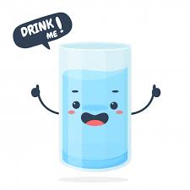
And finally… lots of water!
Notes:
Finally… A healthy diet isn’t just about what food you eat. It is very important to drink lots of water and stay hydrated, because when our bodies are dehydrated, they become very unhappy and stop working properly. Try to drink at least 8 big glasses of water every day, especially when it is hot and sunny!

Slide 19
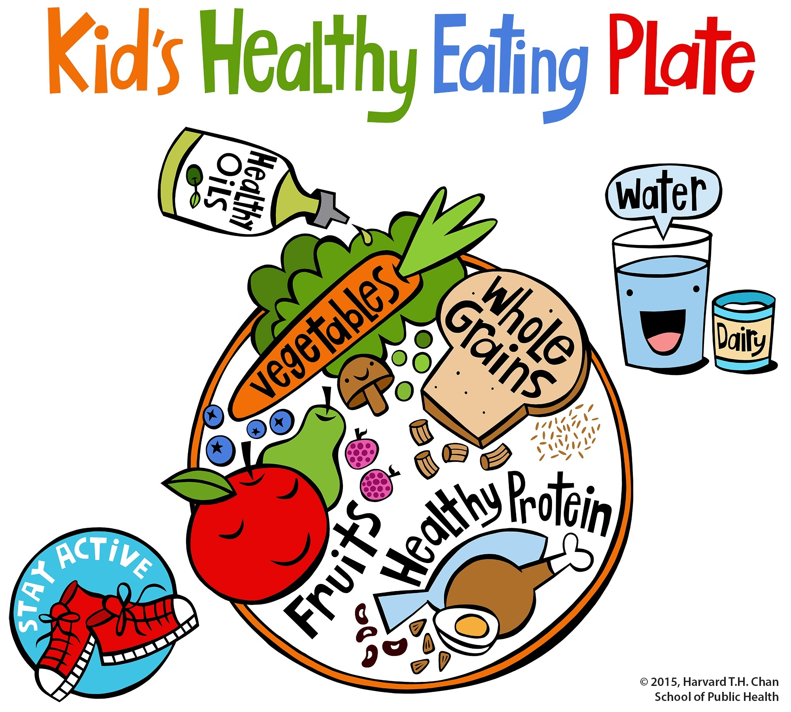
So in summary...
Notes:
So, in summary, we need to eat a good balance of healthy foods so that our bodies can work properly.
Eating a healthy diet means listening to our bodies when they tell us they are hungry, and eating enough food each day, to give us energy to read, run, and play. We need to eat a colourful balance of foods, fruits, and vegetables, and drink lots of water, to make sure that we are giving our bodies plenty of nutrients, vitamins and minerals, which make it happy and healthy. A happy body means a happy life!
Thank you for listening!

