Slide 1
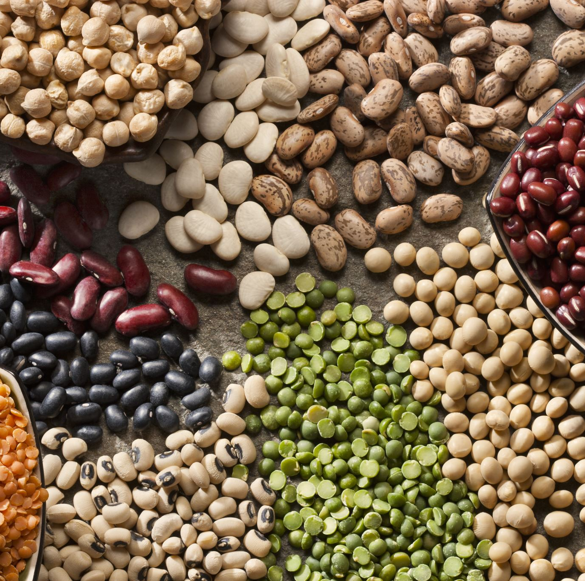
Food For Thought
Food and Sustainability

Slide 2
Why do we need food?
It gives us the energy we need and the carbohydrates, fats, protein, vitamins and minerals to keep us healthy!
Food is a part of culture, and we can share it with our family and friends.
BUT….
Our planet provides us with all our food and the way we grow, process and produce food can have an impact and put pressure on the environment!

Slide 3
Food and our Planet
60% of the world’s land surface is used in agriculture and food production.
Food production is also responsible for 30% of global greenhouse gas emissions.
Worldwide around a third of the food that’s grown is wasted. Households in the UK throw away 6.7m tonnes of food every year!

Slide 4
Food and the people
The world’s population has doubled since 1960 and is predicted to keep increasing to 9 billion by 2050!
We already produce enough food for this amount of people..
But the problem is what is grown, where it is grown and who it is for.
Close to 1 billion people in the world are undernourished.
Yet 65% of the world population live in countries where being overweight or obese kills.

Slide 5
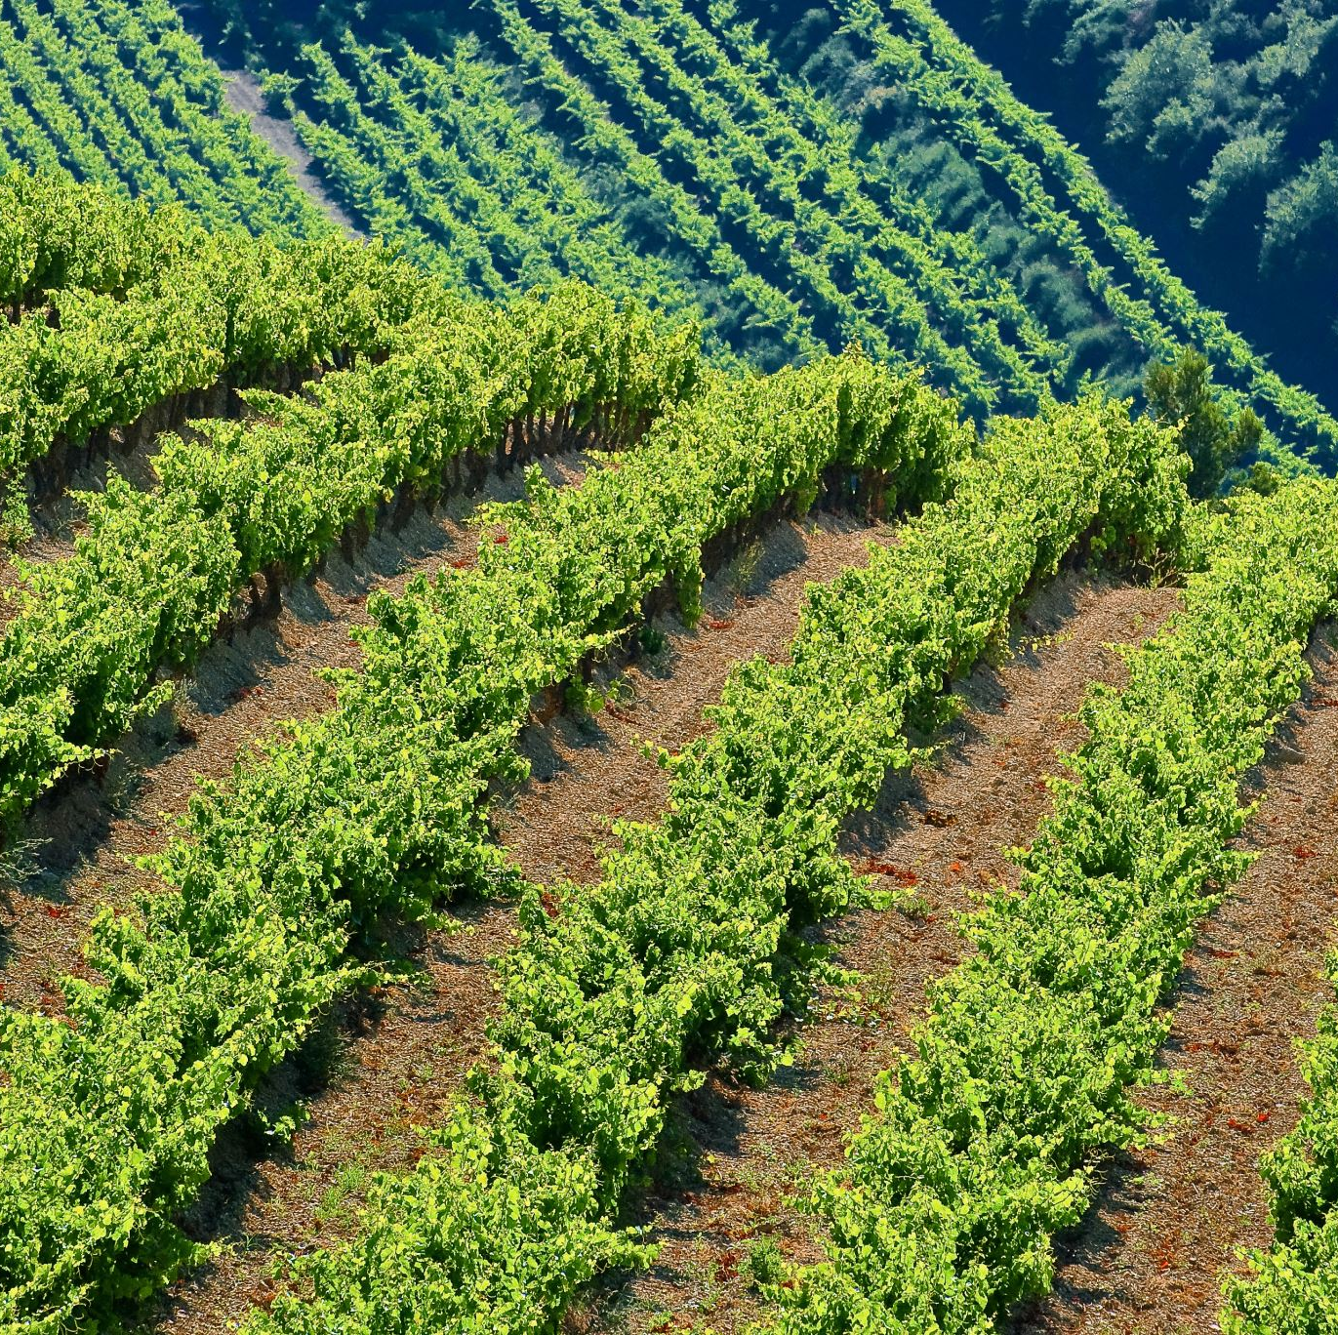
What is sustainability?
Being sustainable means:
• caring for yourself
• caring for each other – your family, friends, your school community and people in other countries
• caring for nature and the environment now and for the future.
Sustainability is something we should all be aiming for in order to help protect the planet.
Notes:
Sustainability is a way of life that allows people to meet their needs and enjoy a good quality of life while allowing nature to thrive and protecting the planet for future generations
More info https://www.wwf.org.uk/get-involved/schools/resources/food-resources#resources

Slide 6
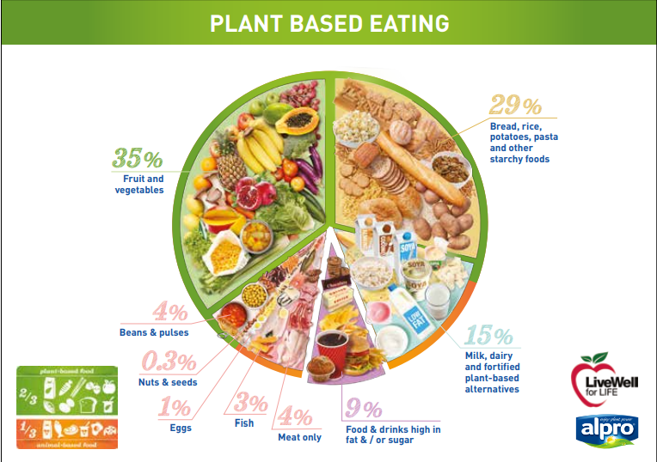
Plant based eating
Remember the Eatwell Guide? This version shows a more specific guide to sustainable eating!
Products from farmed animals (meat and dairy) are among the most energy and greenhouse gas intensive food products.
A Livewell diet involves replacing more meat with plant-based foods and drinks.
It’s a healthy and affordable diet which would lead to a 25% cut in greenhouse gas emissions from food production.
Notes:
Information from https://www.wwf.org.uk/sites/default/files/2016-10/Plant2Plate_Food_for_Thought.pdf

Slide 7
Food Miles
All food makes a journey from where it is grown/produced to your plate!
Choosing foods with fewer miles can help to reduce pollution and protect our planet.
For example: Strawberries picked from a local farm have travelled few miles before they reach your plate, but oranges from Spain have been transported by plane and lorry to the supermarket.
Remember to add how you travelled to the shop, was it by car or bus? These create carbon emissions too!
https://www.bbc.co.uk/bitesize/topics/zjr8mp3/articles/zjnxwnb
Notes:
2 min 31 sec video and short quiz about food miles https://www.bbc.co.uk/bitesize/topics/zjr8mp3/articles/zjnxwnb

Slide 8
Seasonal Foods- Spring 2021
Vegetables
Cabbage, cucumber, pak choi , pepper, broccoli, broad beans, beetroot, parsnips, asparagus, lettuce, strawberries
Fruit
Bananas, grapefruit, nectarines, apricot, cherries, blueberries, rhubarb, figs, pineapple
Meat
Beef, chicken, lamb, pork
Fish
Halibut, kipper, salmon, tuna
Activity:
Try to design a meal using a range of these foods!

