Slide 1
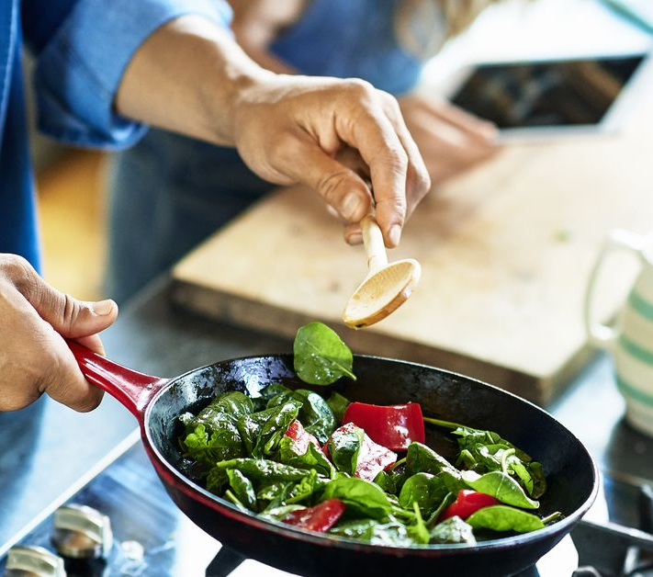
cooking& growing activities

Slide 2
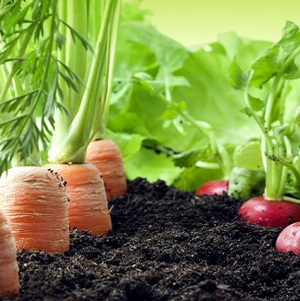
Why grow your own food?
Ensures you consume fresh and healthy food
Potentially includes more nutrients than shop bought food
Can develop a new hobby
Can be cheaper than buying from a shop
Keeps you active
Better for the environment
Can even increase your vitamin D levels on a sunny day

Slide 3
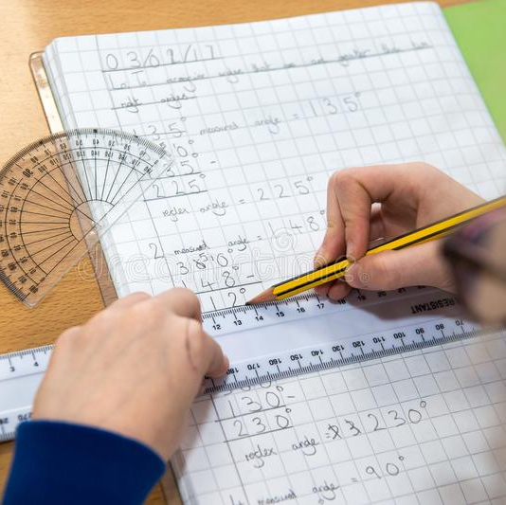
How does growing food help your schoolwork?
Growing food as a pupil can improve health and wellbeing.
Improved levels of health and wellbeing are associated with better levels of attention in class.
Better attention levels = Better learning

Slide 4
"Growing activity increased self-esteem and confidence, especially in pupils who didn’t flourish in other aspects of school life."
Cree Report (2011, p.35)

Slide 5
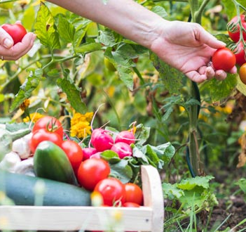
How to grow food?
1. Find the perfect spot
Perhaps section off a corner of your garden
Gather small containers from a garden centre or supermarket
2. Plan in advance
Fruit and vegetables tend to have their own season where they will be most ripe and tasty
Make a plan/diary when you will grow foods throughout the year
3. Mix it up
Varying the food you grow will keep you excited and you will learn much more.

Slide 6
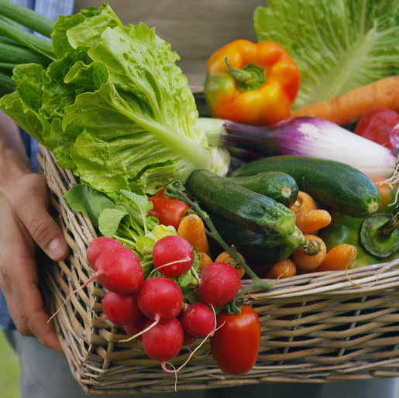
Easy vegetables to grow at home
Beetroots
Potatoes
Carrots
Eggplant
Radishes
Swiss chard
Green onion
Spinach
Lettuce
Herbs

Slide 8
Why cook your own food?
Gain valuable life skills
Can develop a passion and could be a future career option
Great way to explore new cultures
Gain a sense of control
Relieves stress
Boosts energy
Saves money
Brings enjoyment

Slide 9
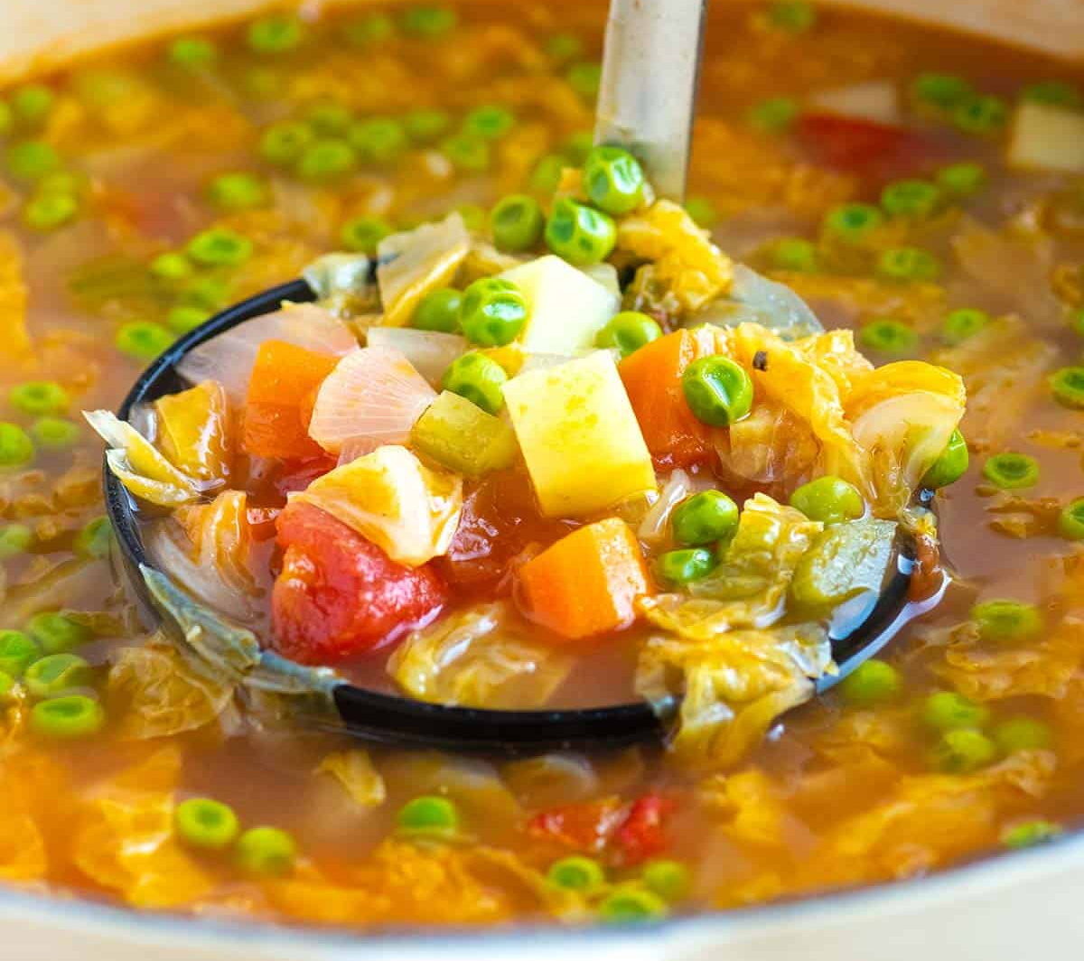
Easy meal to cook at home
Vegetable soup:
1. Sweat onions, carrots, and celery in olive oil and tomato paste. The tomato paste adds lots of flavor to the soup. You can also use some of the vegetables mentioned that are easy to grow.
2. Add more flavour with garlic, ground fennel seeds (or use other spices), pepper, and salt.
3. Pour in vegetable or chicken stock, a can of diced tomatoes, potatoes, cabbage, and bay leaves.
4. Simmer until the veggies are tender (about 20 minutes).
5. Add frozen peas and cook five more minutes.
6. Season to taste with more salt, pepper, and a little acid like apple cider vinegar or lemon juice.

Slide 10
Further resources
https://www.bbcgoodfood.com/recipes
https://www.foodforlife.org.uk/schools/what-can-you-do/get-growing
https://www.foodforlife.org.uk/schools/what-can-you-do/get-cooking
https://www.foodforlife.org.uk/commissioners/cooking-training-and-consultancy

