Slide 1
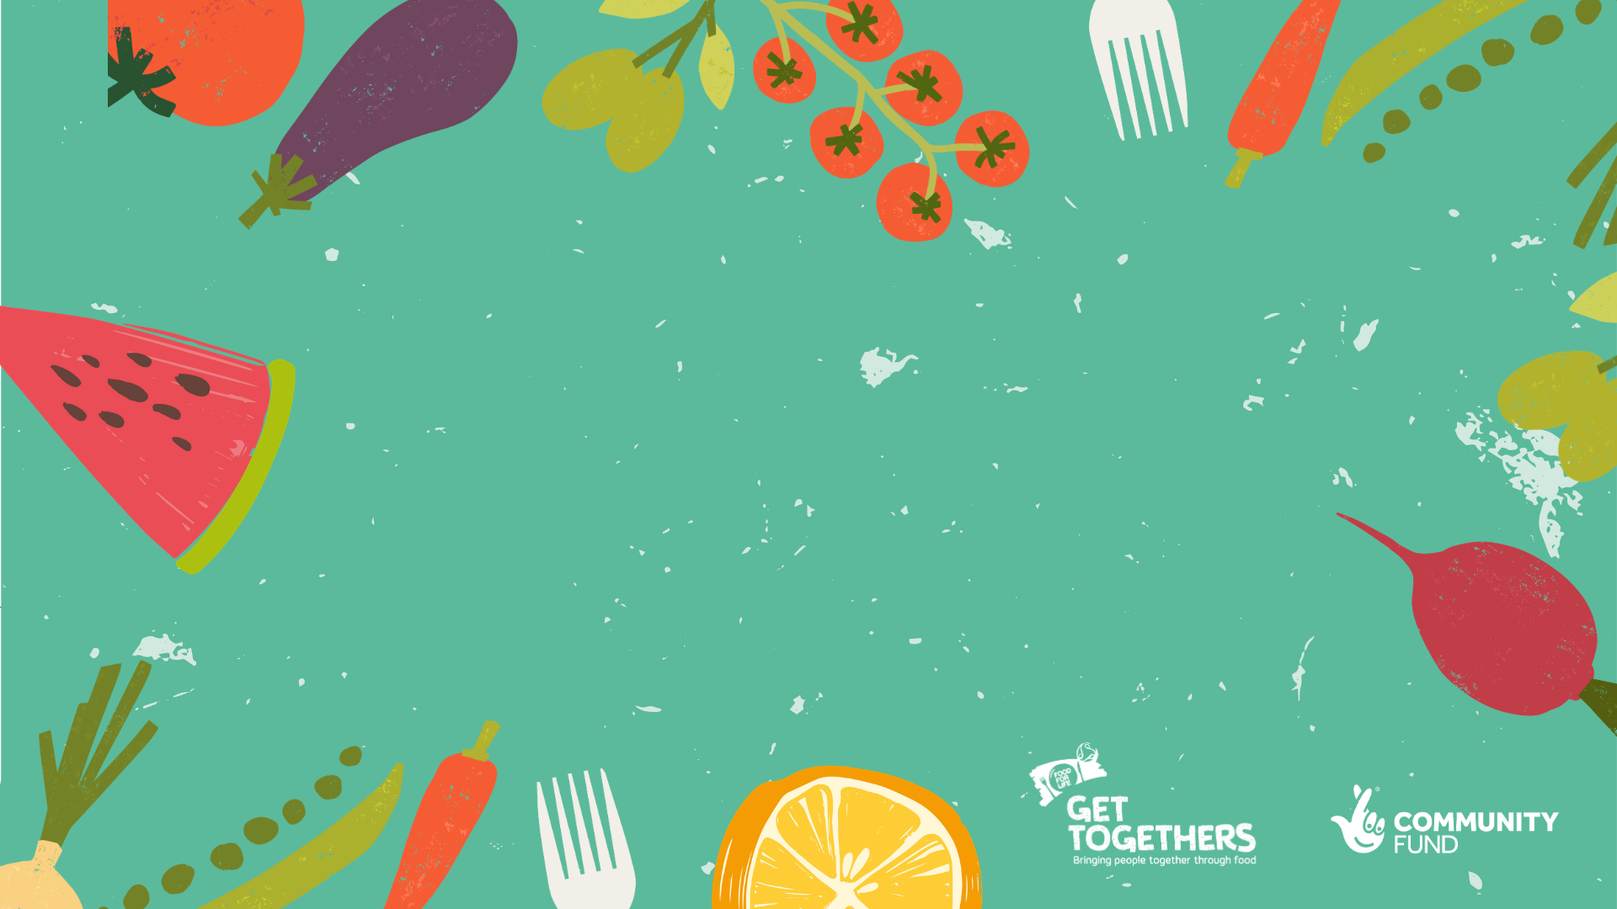
Action on Food Waste
Bringing people together through food

Slide 2
How did we get to the situation we’re in?
1954
When did rationing on meat and bacon end?
How many allotments were used in 1950?
By 1968, how many allotments were still being used?
The average person ate 1kg of chicken a year in 1950. How many do they eat now?
1,200,000
500,000
25kg each!
In 1950, how many supermarkets were there in the UK?
And by 2013?
And now?
When was the first fast food outlet opened in England?
How many are there now?
50
10,308
87,141
Wimpy in 1954!
26,005

Slide 3
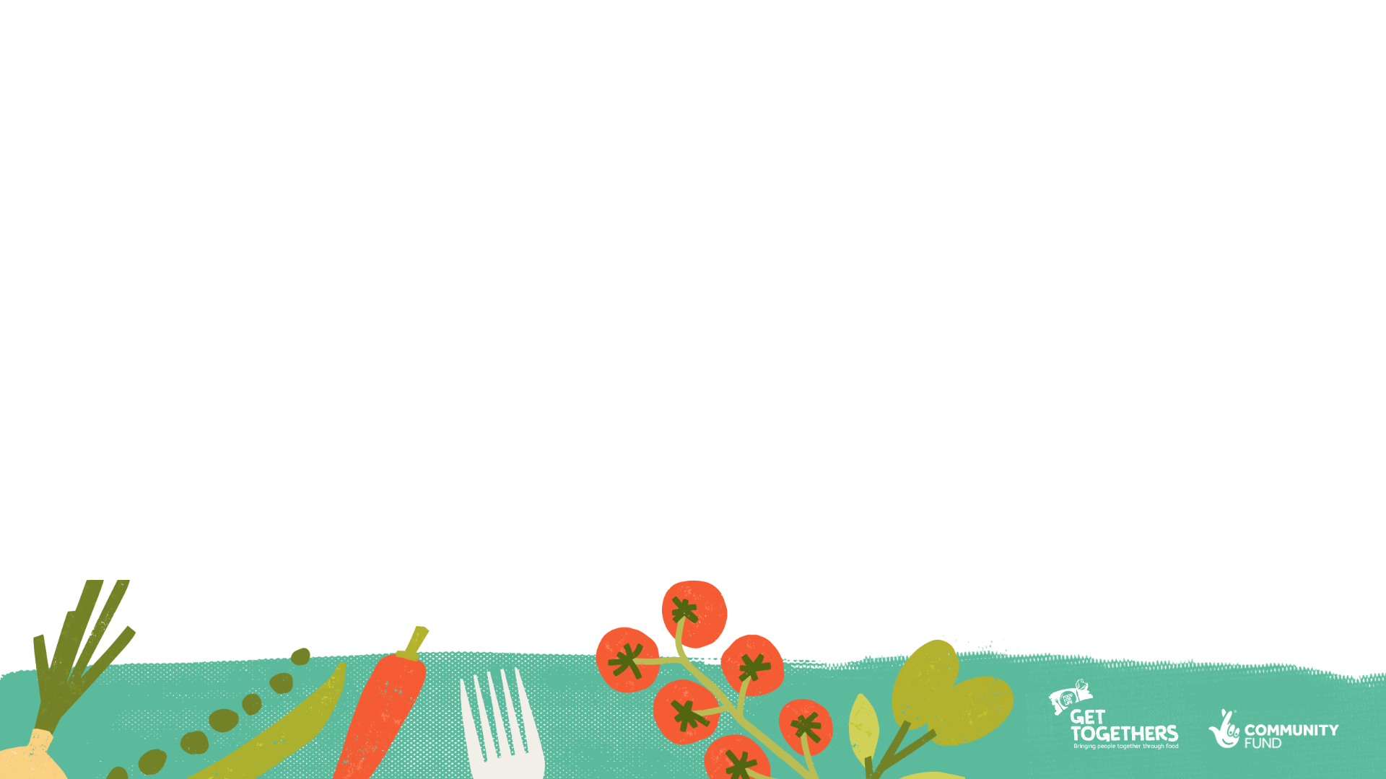
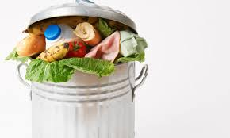
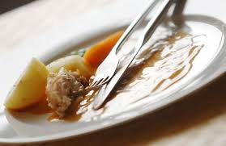
Test your knowledge on waste facts
How much of our carbon footprint is generated by the food we eat?
Approximately how much food waste is generated annually in the UK?
What % food waste in the UK comes from households?
How much money per household, on average is wasted monthly by throwing away food?
What are the top 5 most wasted foods?
What is the reason most people give for throwing away food?
What’s the difference between a use by date and a best before date?
What temperature should a fridge be set at to get the best performance?
How should food be defrosted once out of the freezer

Slide 4
Did you know?
The food we eat makes up 30% of our carbon footprint
9.5 million tonnes of wate generated in the UK annually costing £19 billion:
70% from households
12% from Hospitality and Service industry
16% from food manufacture
3% from retail
70% of this waste is seen as edible – eg plated food, fresh food, bread
30% is inedible – eg egg shells, veg and fruit peelings,

Slide 5
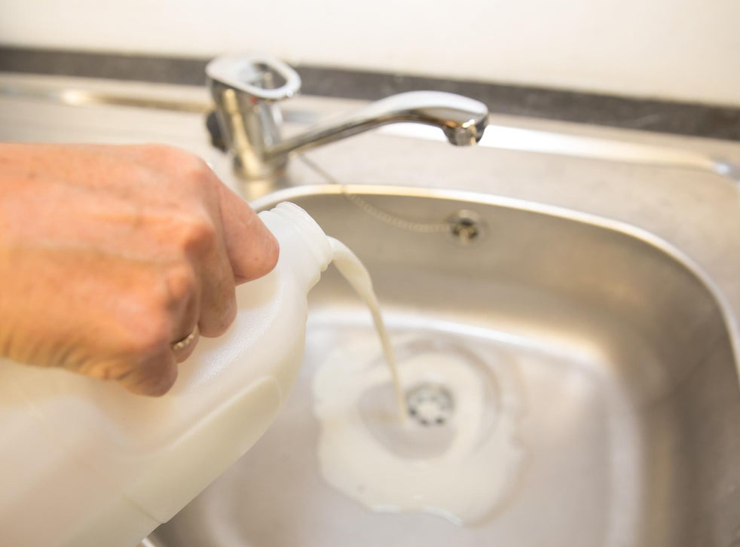
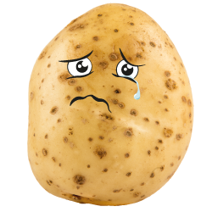
On average a household wastes £60 a month when throwing away food – the equivalent of 8 meals a week
The top wasted foods are:
Fresh potatoes
Milk
Meals – homemade or ready meals
Pork, ham and bacon
Chicken
Carrots and other veg
Each day in the uk we throw away:
20 million slices of bread
4.4 million whole potatoes
3.1 million glasses of milk
2.7 million whole carrots
2.2 million slices of ham
1.2 million whole tomatoes
0.9 million whole bananas

Slide 6
Why is food wasted
Food not used in time
Personal preference – didn’t want it
Cooked or prepared too much
Served too much
Don’t understand labelling and worried about food going off
Buying too much because of offers in the shops
Unsure how to store the food
Not labelled in freezer
Lack of time to plan

Slide 7
Best before and use by?

Slide 8
Top tips to minimise food waste?
Over to you – what would you say if asked for 3 top tips to minimise food waste
*Food waste can never be stopped entirely – some times it’s unavoidable but there are great ways to make it as low as possible

Slide 9
Our top tips – do they match?
PPE – another meaning maybe…………..
Plan
May seem tedious but it really does work to cut waste – know what you’re going to eat and make a list of what you need
Portion
Think about how much you actually eat – buying more food is false economy if you don’t eat it – even if it’s on offer
Eat
Put less on the plate – get more if you want more. Food is easier to save if it’s in the pan not on the plate

Slide 10
Got to show your fridge some love……….
Shut that door – even if you’re just getting milk for a brew. When the door opens it gets warm and uses more electric to cool again
Get the temperature right – under 5°C is the best. A thermometer is a cheap way of checking this
Don’t put hot food into the fridge – warms everything up – see point 1
Store food in the right area – some areas are warmer eg the door
Use a cool bag when shopping to keep everything chilled

Slide 11
Make use of all of the ingredients:
Not all veg need peeling but if you do save the peel and use to make vegetable stock – they can be collected and frozen
Bread crusts make great pizza bases – freeze and get out to cover with tomato ketchup, oregano and cheese for a quick toasted snack
There are lots to do with banana skins both cooking and cleaning
Leftover bones from a chicken make great stock to use as a base for soup – if you don’t have time freeze them for later
Greens from veg can be used – cauliflower leaves are great roastedin the oven with spices
Freeze lemons, limes and oranges in slices – use frozen in drinks

Slide 12
Shop and store smarter:
Buy loose fruit and veg then you can buy what you need and not end up throwing it away
If you but meat or fish but you’re not 100% sure you’ll use it freeze it straightaway after shopping rather than leaving in the fridge
Store items like bread in a cloth bag and if they feel a little stale refresh them in the over before eating
Don’t be tempted by special offers if you don’t need the food – plan to but only what you need
Try shop more regularly – sometimes shopping once weekly can lead to food being bought that may not be needed

Slide 13
Batch cooking
A great way to take advantage of special offers on, or use up spare ingredients is to cook and prepare meals in advance:
Use leftover veg (cooked or raw) to make soup – just mix with stock and spices and boil up. Freeze in portions for a quick lunch option or share with family and neighbours
Make large pans of curries and stews then portion up into servings and freeze.
Use leftover milk to make milk puddings which also freeze well – or just pop the milk in the freezer as it is until you need it
Use left over potato to make fishcakes or potato cakes
Freeze leftovers until you have time to use them

Slide 14
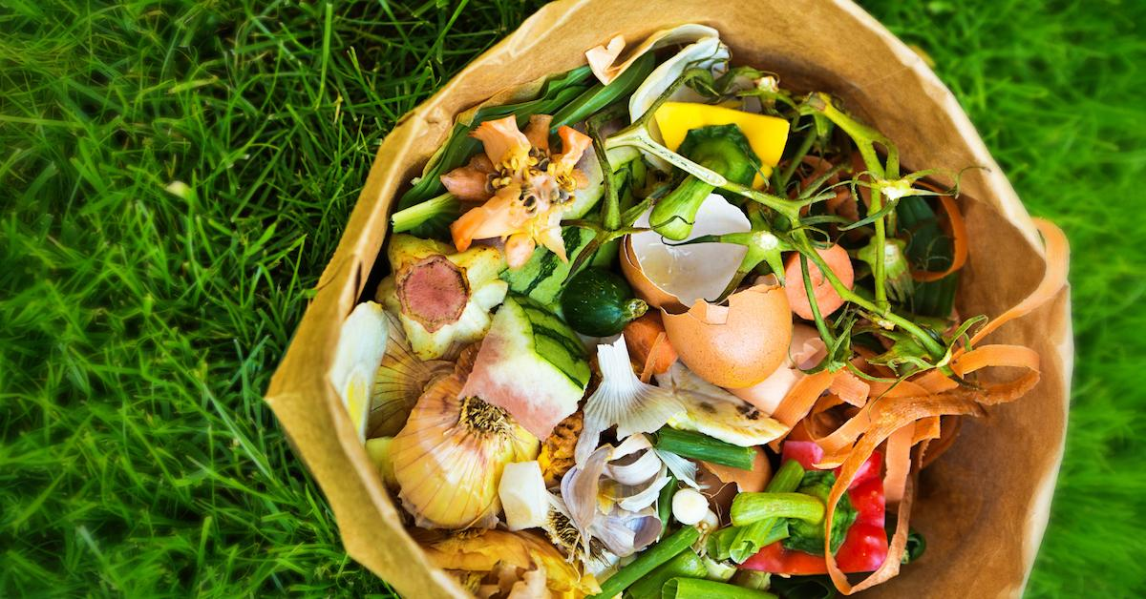
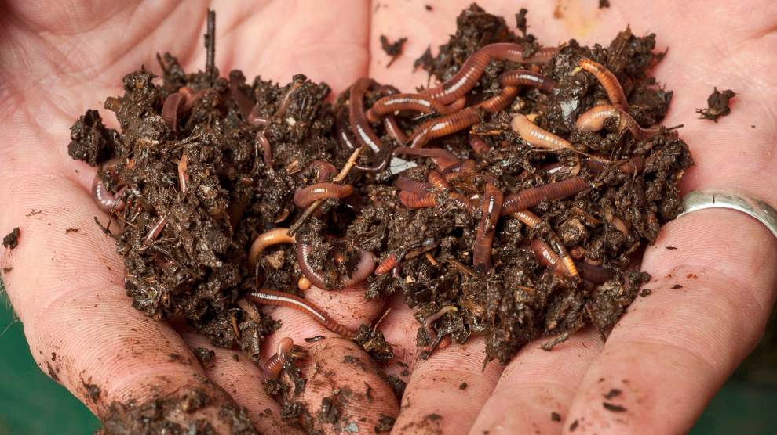
Composting
Home composting is the most environmentally friendly way of dealing with kitchen and garden waste – the end result produces fantastic soil improver
There are schemes for those without composting facilities to connect with local contacts who can take food waste to compost
Some Local Authority waste schemes include a food waste collection and the plan is for all to do so by – there is a DEFRA commitment for all LA’s to have food waste collections by 2023

Slide 15
To compost
Browns:
Cardboard (eg cereal packets, toilet rolls and eggboxes)
Waste paper and junk mail
Paper towels and bags
Bedding from vegetarian pets (eg hamsters, rabbits, guineapigs)
Tough hedge clippings
Woody prunings
Old bedding plants
Straw and sawdust (eg from poultry)
Others:
Wood Ash in moderation
Hair and nail clippings
Egg shells (crushed up ideally)
Natural fibres (wool and cotton)
Greens:
Grass cuttings
Young weeds
Nettles (not roots)
Uncooked fruit and veg peelings
Tea leaves and coffee grounds (teabags sometimes have small plastic particles so best to check the brand or empty them)
Soft green prunings
Animal manure from herbivores
Poultry manure
Urine (ideally diluted 20:1)

Slide 16
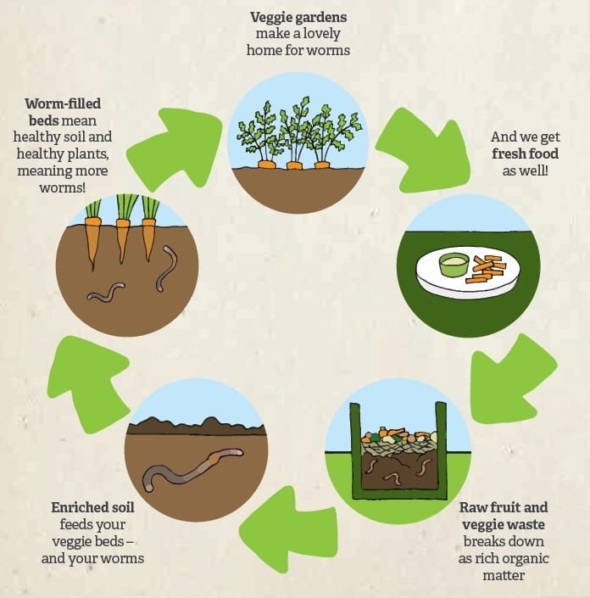
Not to compost
Meat
Fish
Dairy Products
Cooked food
Cat litter
Dog poo
Disposable nappies

Slide 17
Compost Problems:
Wet slimy or strong smelling:
Not enough air and too much water. Cover and add more brown material
Dry and Fibrous / Not rotting:
Too dry – add more green compost or try and activator
NB – all compost needs turning to add air – monthly is suggested.

Slide 18
Community Buying Groups – easier than it sounds?
A buying group can be as small as needed or extended to meet community needs.
Forming a buying group can save money, time and wasted food. It’s also a great way to connect with others and share ideas and recipes. Here are some suggestions:
Join together with family or neighbours to buy bulk items and split – this can save money. Items like rice, flour, pulses, herbs and spices are ideal for this
Use a local veg box supplier to deliver into a community hub so items can be split – lots of schools and community groups already do this
Speak to local producers / shops to see if items can be bought more cheaply for a large order
Put up a notice in the workplace to see if anyone is interested in sharing and splitting deliveries
Work out a system where people only pay for what they need at that time so no-one is under pressure to take more
Once a connection is made this can be really useful for distributing food you don’t need and may waste to other people – someone else may be able to use something on that day

Slide 19
Saving on energy and water – small steps to save the planet:
Always use a lid on a pan – much more efficient
Use the right size pan and only enough water to just cover the food
Boil the water first in a kettle
Invest in a steamer (or a double steamer) – cook vegetables above potatoes in tiers
Keep the oven door closed as much as possible when cooking and warming the oven up
Ensure your fridge and freezer are at the right temperature
Always cool food down before putting into the fridge or freezer
When washing up always run water into a bowl rather than use running water. If possible save the washing up and only do once a day.
If using a dishwasher wait until it’s full to run it

Slide 20
