Slide 1
Assessment of Emotional Vocabulary
©Sheffield Speech and Language Therapy

Slide 2
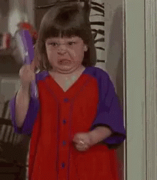

Slide 3

Notes:
Anxious/ nervous/ worried

Slide 4
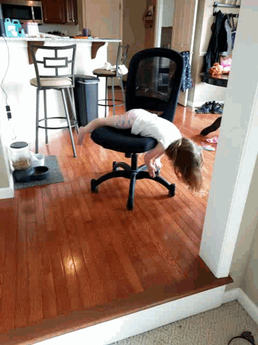
Notes:
bored

Slide 5
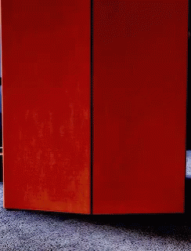
Notes:
Confident/ cool/ proud

Slide 6
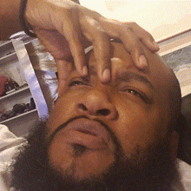
Notes:
confused

Slide 7

Notes:
excited

Slide 8

Notes:
Embarrased/ ashamed

Slide 9

Notes:
interested

Slide 10

Notes:
shocked

Slide 11
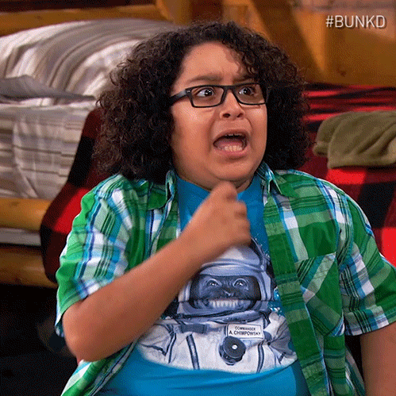
Notes:
Frightened / scared

Slide 12
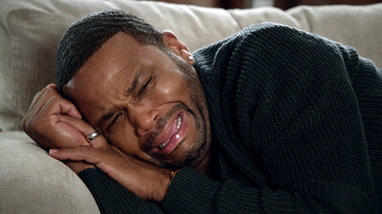
Notes:
upset

Slide 13

Notes:
Overjoyed

