Slide 1
Primary Computing Careers

Slide 2
Computing Careers
About this document
This document was created to help teachers discuss the breadth of careers that link to the Computing curriculum in primary schools and provide a diverse set of role models for learners. It maps to the units contained within the Teach Computing Curriculum, but can be used flexibly with any scheme of work.
The questions on slide 2 can be used with each of the careers to stimulate discussion.
The full document, with careers for all KS2 units, and 3 for each year in KS1 can be accessed as part of a Computing & Digital Innovation Centre subscription, or for a standalone fee. Contact cdicentre@learnsheffield.co.uk for information.
Who created the document
This document was created by the Computing & Digital Innovation Centre, which is part of Learn Sheffield. You can find more resources and discover our work to support schools with computing and educational technology here: https://learnsheffield.co.uk/Projects/Computing-Digital-Innovation-Centre/.

Slide 3
Computing Careers Questions
Add photo here!
1. What job does this person do?
2. How do they use computers?
3. What other skills do you think they need?

Slide 4
Computing Careers – List of Careers
Year 1 – Robotics Engineer
Year 2 – School IT Technician
Year 3 – Social Media Manager
Year 3 – Museum Exhibit Designer
Year 4 – Cybersecurity Analyst
Year 4 – Generative Digital Artist
Year 5 – SEO Analyst
Year 5 – YouTuber
Year 6 – Data Scientist
Year 6 – Software Tester

Slide 5
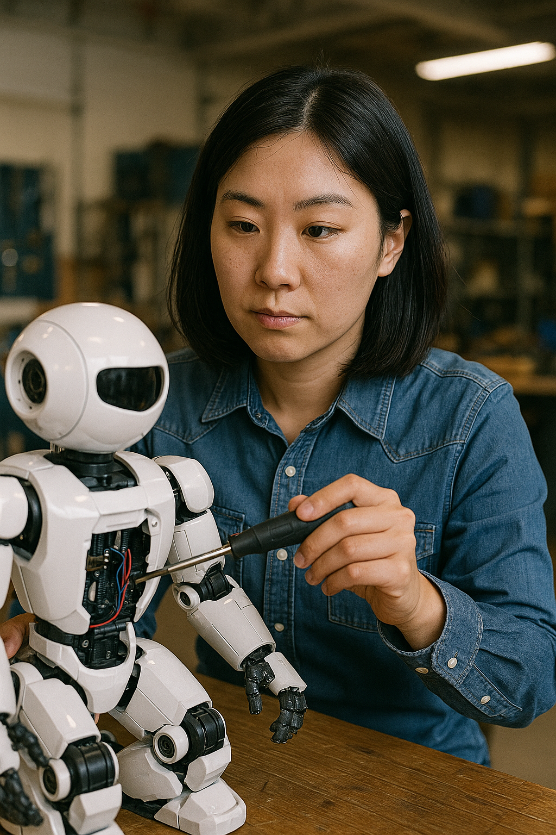
Robotics Engineer
Year 1 – Moving a Robot
Description
A robotics engineer is someone who builds and programs robots. These robots can help people do all kinds of things—like cleaning, exploring space, helping in hospitals, or even playing games. Robotics engineers use computers to design and program robots to move and talk.
Skills required
Teamwork – They work with other people to design robots for a purpose.
Coding – They write programs to tell the robot what to do.
Solving Problems – If the robot doesn’t work, they figure out how to fix it.
Using Technology – They use computers and machines to design and test their robots.
Being Creative – They imagine new kinds of robots that can help people in amazing ways!

Slide 6
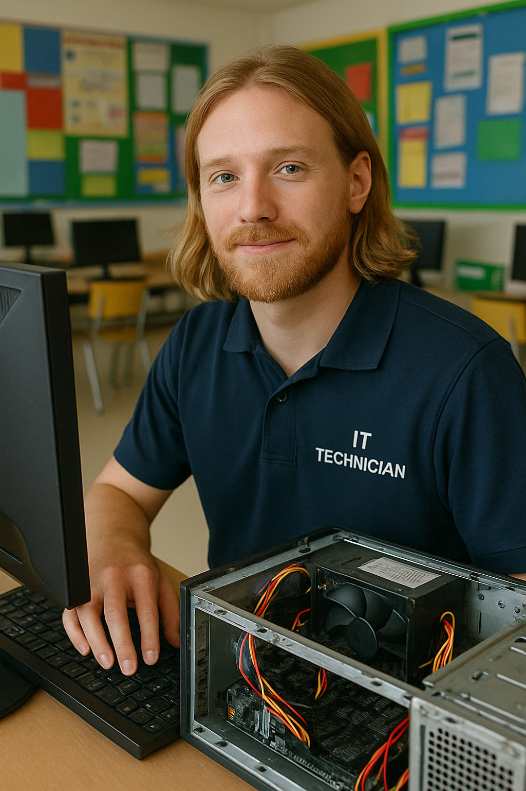
School IT Technician
Year 2 – IT Around Us
Description
A school IT technician helps to fix computers, tablets, printers, and internet problems at school. If something isn’t working—like the smartboard won’t turn on or the printer stops working —they come to the rescue. They can also help teachers and children use technology safely.
Skills required
Fixing Computers – They know how to make broken computers and devices work.
Solving Problems – They’re great at figuring out what’s wrong and debugging.
Using Tech Tools – They use special tools and software to check and repair devices.
Helping People – They’re kind and patient when helping teachers and pupils.
Keeping Things Safe – They make sure the school’s computers are protected from viruses and hackers.

Slide 7
Social Media Manager
Year 3 – Desktop Publishing
Description
A Social Media Manager helps a business, organisation or person look cool and interesting online so more people follow them, like their posts and talk about them, e.g. on Instagram, TikTok or Facebook. They write posts, publish images and communicate with followers on social media.
Skills required
Creativity – They come up with fun ideas, pictures and videos to share.
Writing – They write catchy and interesting messages that people enjoy reading.
Using Computers – They use software on computers to design posts and edit photos.
People Skills – They talk to followers and make them feel welcome and included.
Understanding Social Media – They understand how social media works and what makes content popular.

Slide 8
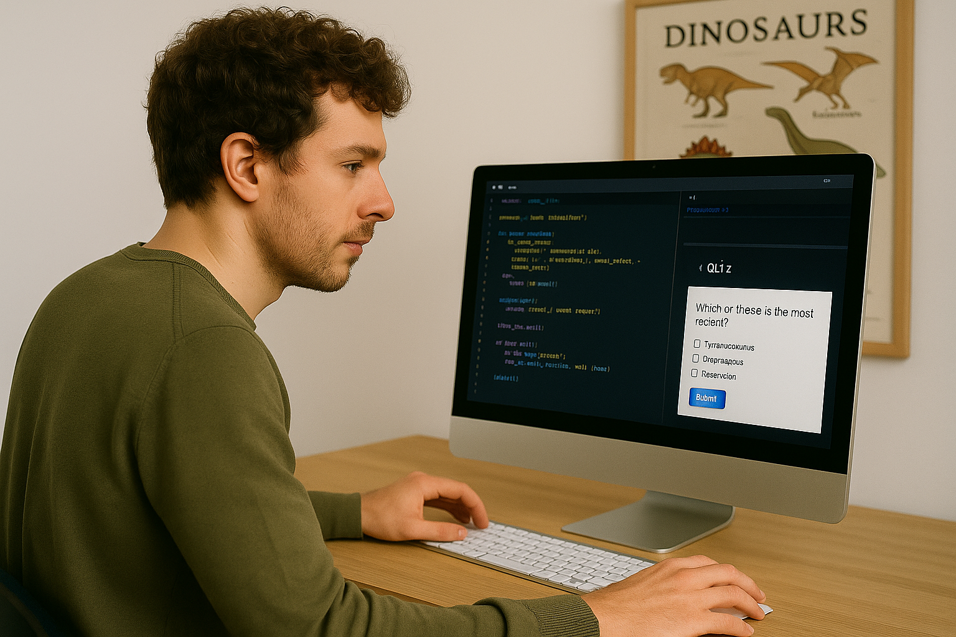
Museum Exhibit Designer
Year 3 – Programming Events & Actions
Description
A museum exhibit designer might use their programming skills to design a game or activity to teach visitors about an exhibit in a museum. For example, an interactive quiz about dinosaurs or an activity to help users create a picture in the style of a famous artist.
Quiz
Skills required
1. Coding – They design and write programs to create interesting activities.
2. Creativity – They come up with fun and exciting ideas for an activity
3. Problem Solving – If something doesn’t work, they debug their code and improve it.
4. Understanding How People Learn – They know how to design an activity to help visitors learn about the exhibit.
5. Using Technology – They use computers and special software to write their programs.

Slide 9
Cybersecurity Analyst
Year 4 – The Internet
Description
A cybersecurity analyst protects computers, websites, and online information from hackers and viruses. They make sure that people’s private data—like passwords, photos, and messages—stays safe. They use special software, coding and detective skills to stop cyber-attacks and fix problems before they get worse.
Skills required
Understanding Networks – They know how the internet and computer systems work.
Coding – They write and read code to find and fix security problems.
Problem Solving – They figure out how hackers break in and how to stop them.
Thinking Differently – They keep up with new threats and learn how to defend against them by looking at problems in different ways.
Attention to Detail – They need to spot the tiniest of details in large amounts of information.

Slide 10
Generative Digital Artist
Year 4 – Repetition in Shapes
Description
A generative digital artist is someone who makes art using computers and code. Instead of drawing every part by hand, they write special instructions (algorithms) that tell the computer how to create shapes, colours, and patterns. The algorithm might contain an element of randomness, so the art is different every time.
Skills required
1. Coding – They write code that tells the computer how to make the art.
2. Creativity – They come up with cool ideas for patterns, colours, and designs.
3. Maths and Logic – They use numbers and rules to shape how the art is made.
4. Using Art Software – They work with specific software that helps them build and display their creations.
5. Problem-Solving – If the program doesn’t work properly, they debug the code and fix it.

Slide 11
SEO Analyst
Year 5 – Systems & Searching
Description
The job of an SEO (Search Engine Optimisation) Analyst is to make changes to websites of companies so that they show up at the top of the results when people search for something using a search engine, like Google. This helps make the website more visible, so that people can find them and use their products and services.
Skills required
Curiosity – They love to figure out how things work on the internet.
Writing – They know how to use the right words so people can find things online.
Data Analysis – They analyse data around website visitors to see what’s working and what’s not.
Understanding Technology – They understand how websites are built and how search engines work.
Problem Solving – They fix things when a website isn’t getting enough visitors.

Slide 12
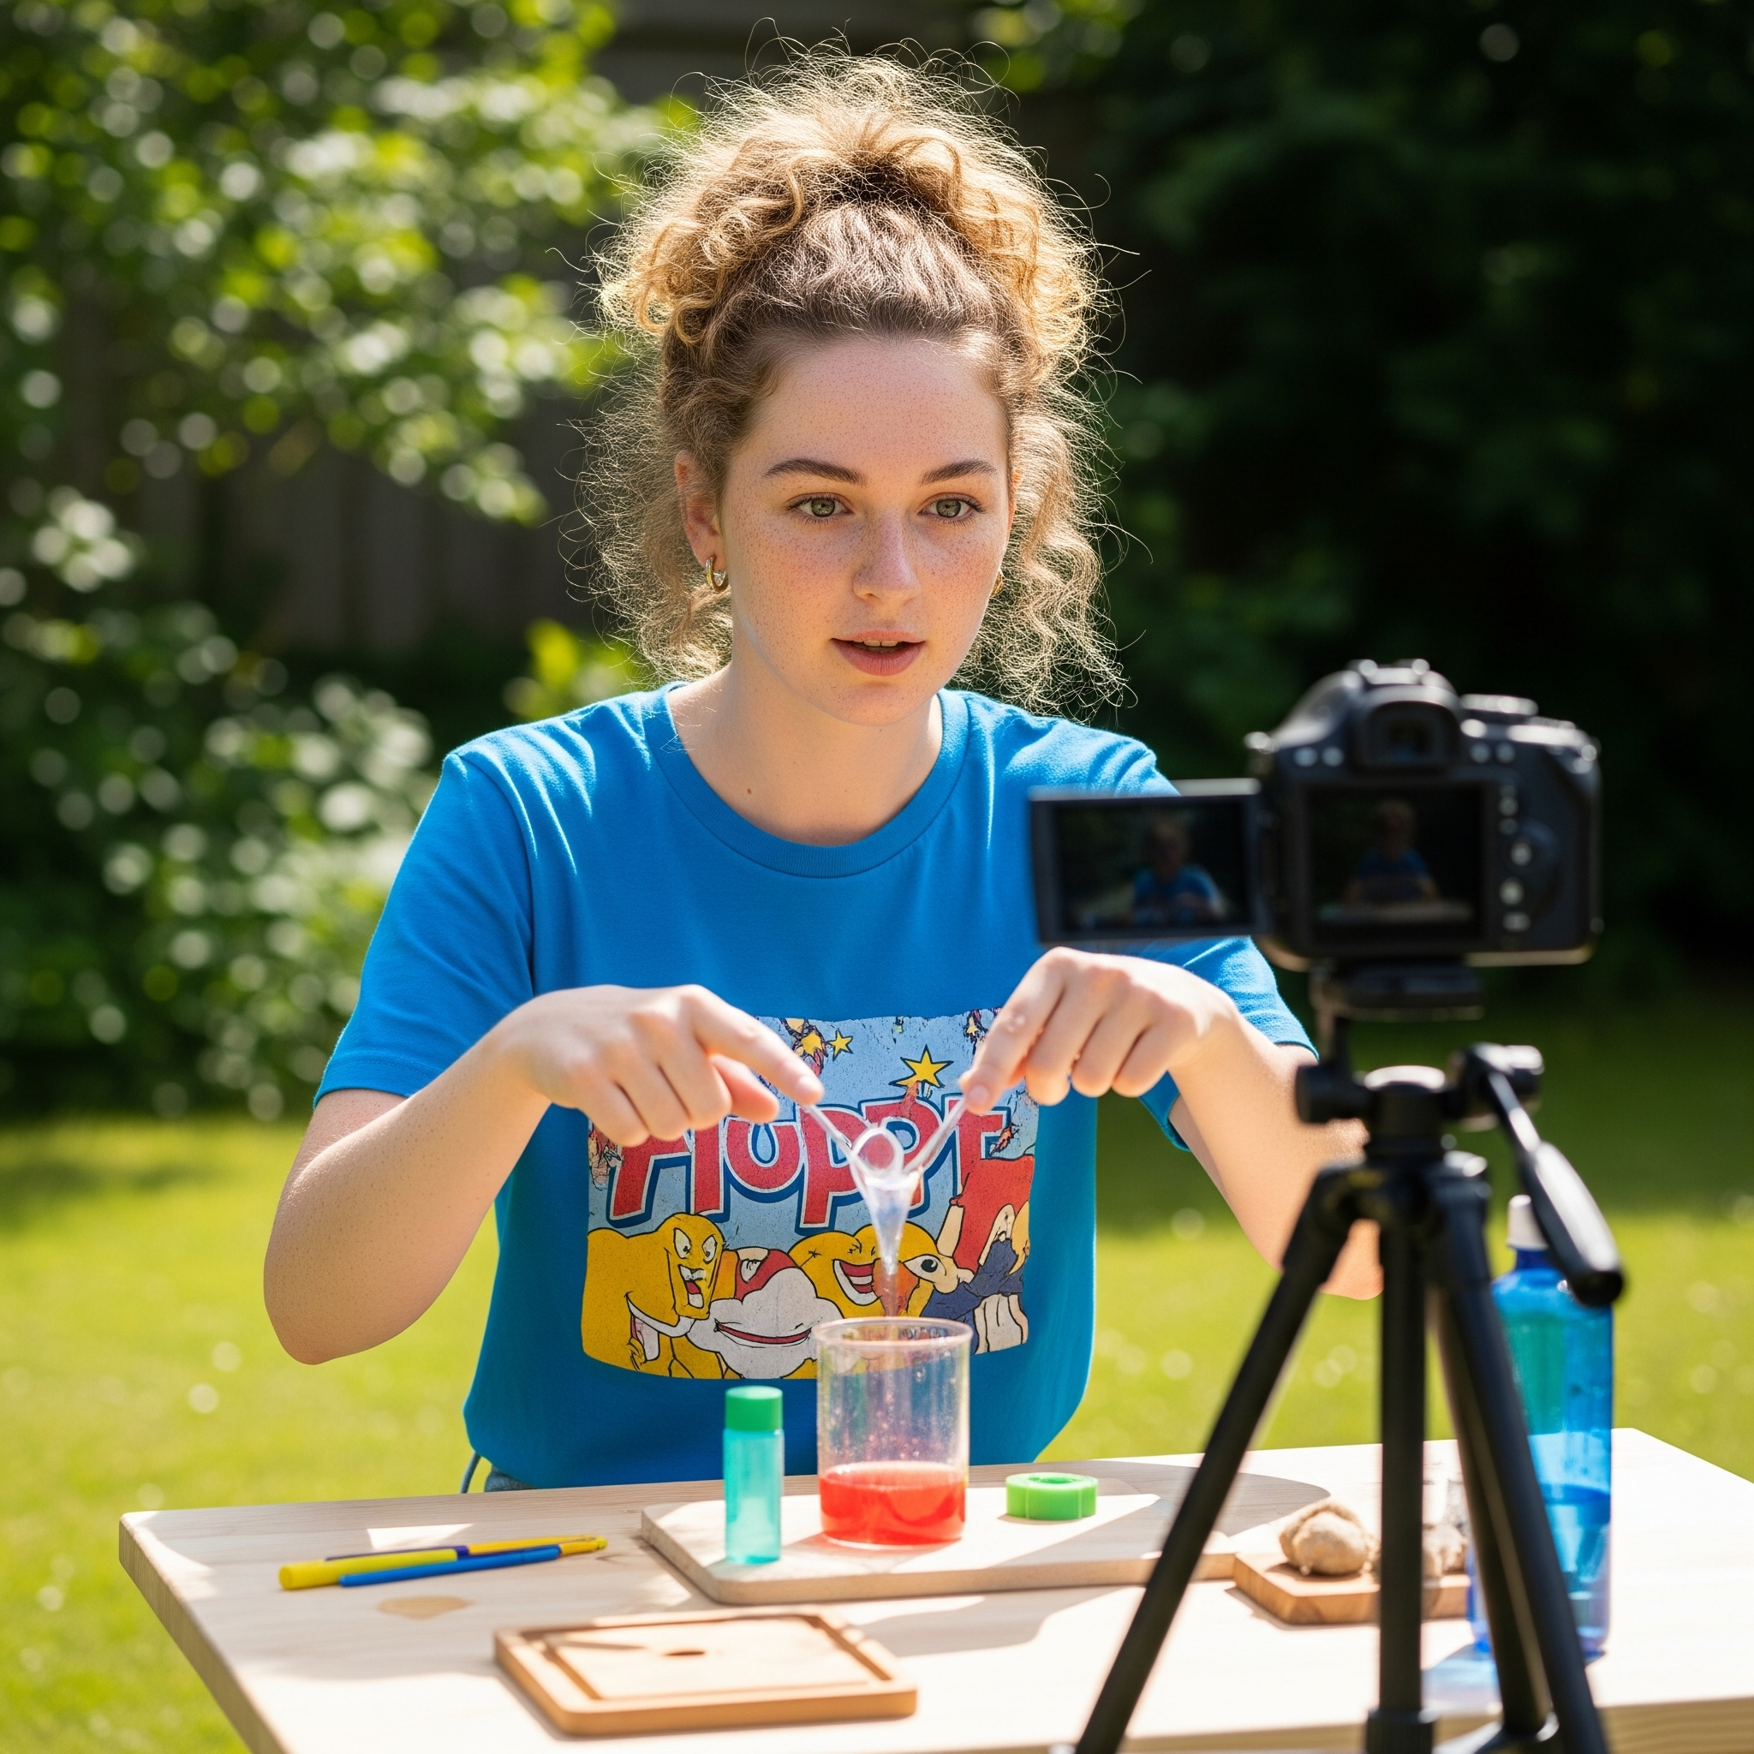
YouTuber
Year 5 – Video Editing
Description
A YouTuber is someone who makes videos and shares them on online for people all over the world to watch! They can make videos about anything—like games, crafts, science experiments, funny stories, or even how-to guides. YouTubers use cameras, microphones and editing software to create their videos, and they often talk to their viewers in the comments.
Skills required
1. Creativity – They come up with fun and interesting ideas for videos.
2. Speaking Clearly – They talk in a way that’s interesting and easy to understand.
3. Video Editing – They use software to edit clips, add music and text to improve their videos.
4. Planning – They think ahead about what to film, what to say, and how to keep viewers interested.
5. Connecting with Viewers – They read comments, answer questions, and build a community of fans

Slide 13
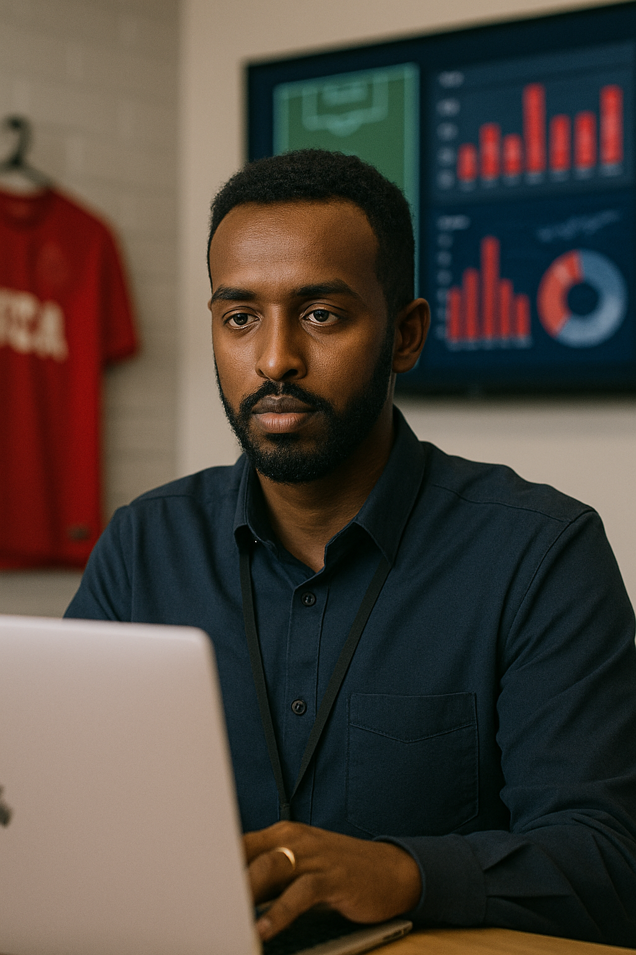
Data Scientist
Year 6 - Spreadsheets
Description
A data scientist look at lots and lots of data to find patterns, answer questions, and help people make good decisions depending on the information available. They might work with medical data to help make people healthier, or with sports teams to anticipate injuries and improve training.
Skills required
1. Understanding Data – They know how to read and organise large amounts of
information.
2. Coding – They write computer programs to help them sort and study the data.
3. Using Maths and Statistics – They use their maths skills to analyse the data.
4. Solving Problems – They ask the right questions and use data to find the answers to solve everyday problems.
5. Explaining Ideas Clearly – They turn complicated data into easy-to-understand charts and stories.

Slide 14
Software Tester
Year 6 – Variables in Games
Description
A software tester makes sure that products, such as games are ready for release. They play games using different devices and in different ways to check they are working. But it’s not just about playing for fun—they look for bugs, like characters getting stuck, levels not loading, or buttons not working, and suggest solutions.
Skills required
1. Paying Attention to Details – They notice even the smallest problems in the game.
2. Problem Solving – They figure out what causes bugs and how to explain them clearly.
3. Writing Reports – They write down what went wrong so the developers can fix it.
4. Understanding How Games Work – They know how games are built, how to play them and how they should work.
5. Being Patient and Focused – They might have to play the same part of a game over and over to test it properly.

